Slide 1
Managing Public Wealth
Jason Harris
Fiscal Affairs Department
GIFT Fiscal Openness Accelerator
The Ether, October 2020

Slide 2
Managing Public Wealth Before we begin
Some questions for you:
How much debt does your government have?
Do they have offsetting assets? How much?
What are the largest SOEs?
Do they contribute to the budget, or drain it?
Notes:
Examples:
How a BS approach changes the view
How the BS can be used for policies:
Risk identification and management
Policy evaluation

Slide 3
Managing Public Wealth Overview
The Public Sector Balance Sheet
Why Does it Matter?
Examples
Conclusion
Notes:
Examples:
How a BS approach changes the view
How the BS can be used for policies:
Risk identification and management
Policy evaluation

Slide 4
I. The Public Sector Balance Sheet Conceptual Framework
Notes:
Now to the framework that we will use to analyse this information.
First big step, which I’ve just taken you through is expanding the coverage, to bring in all the of the public sector, and all of the assets and liabilities.
This is an accounting exercise, but gives us a sense of what the state owns, what it owes and the difference between them – the solvency position.
The interesting analysis is when we can integrate the stocks with the flows; and introduce the time dimension.
We can use the BS to tell a story of how the public finances evolve over time – both historically, and looking forward.
Flow side – deficits, valuation and public investment.
Still, these static balance sheets represent the accumulation of past flows. Interesting, but only to a point. Miss the states biggest asset, the ability to raise revenues, and why states can maintain negative solvency – a big difference to corporations.
Address that by combining current wealth, embodied in the static balance sheet, with the future flows: the government’s discounted future income and obligations; to show a complete intertemporal balance sheet.
This provides a more complete measure of the fiscal sustainability of current policies, and guidance on future adjustment needs

Slide 5
I. The Public Sector Balance Sheet
Move beyond debt and deficits, to provide the most comprehensive view of public finances
Shed light on public assets and liabilities by bringing together existing and newly estimated PSBS data into a single source
Identify the macro-economic relevance of balance sheets and their impact on sovereign yields, economic resilience and potential revenues
Develop and apply a conceptual framework for assessing balance sheets to improve fiscal policy and better manage fiscal risks

Slide 6
I. The Public Sector Balance Sheet Aggregate PSBS for 38 countries
Aggregate Public Sector Balance Sheet (in percent of GDP)
Assets
Liabilities
Financial Assets
97 %
GG Debt
94 %
US$103 Trillion or
216 percent of GDP
Pension Liabilities
46 %
195 percent of GDP
Infrastructure
71 %
Others
56 %
Natural Resources
37 %
Net Worth
21 %
Others 11 %
Source: IMF Public Sector Balance Sheet Database.
Notes:
It’s not just what you owe, but what you own!
Public wealth matters a lot.
Assets are very large. Have a sample of 31 countries, covering 61 percent of global GDP.
What they cumulatively own is worth more US$101 trillion dollars, or more than double the size of their economies.
If this public wealth is managed properly, it can be put to the service of society’s economic and social goal.
What is it made up of?
99 percent of GDP of financial assets
72 percent of GDP of infrastructure assets
Natural resources – relatively small in aggregate, but very important to natural resource rich countries.
On the other side of the ledger, debt makes up less than half of what government’s owe, yet it takes up most of the attention.
There are other important liabilities that often go unnoticed. I’ll draw attention to one: accrued pension liabilities, which are worth 46 percent of GDP.
So you can see, public sector balance sheets provide a comprehensive view of public finances.

Slide 7
II. Key Components New elements
Public Corporation Assets
(Percent of GDP)
Natural Resource Assets
(Percent of GDP)
Accrued Pension Liabilities
(Percent of GDP)
Source: IMF Public Sector Balance Sheet Database

Slide 8
I. The Public Sector Balance Sheet South Africa

Slide 9
I. The Public Sector Balance Sheet Individual country PSBS for 39 countries
Notes:
Looking at the 38 countries, we can see a wide variety of balance sheet positions, both in terms of size and in net worth.
These are the countries where we have a full public sector balance sheet: going beyond general government to include the public corporation sector. With this, we include all of the assets and liabilities that the government controls.
Around two thirds of countries have positive net worth – that is, their assets are larger than their liabilities.
Most of the G7 are in the reverse position – with liabilities exceeding their assets.
On the right hand side, you can see the benefit of natural endowments: the countries with the strongest balance sheets are those with large natural resources: Norway, Russia, Kazakhstan and Australia.
One final point on this: You will see that weren’t limited in our coverage to countries like the UK, New Zealand and Australia who already have high quality data.
We also have complex, large emerging countries, such as Brazil and Indonesia, as well as some Sub-Saharan African countries, like Uganda, Kenya and The Gambia. And herein lies an important message: balance sheet can be produced for countries from all income levels.

Slide 10
I. The Public Sector Balance Sheet Public Corporations
Process:
Identify the majors/full universe of PCs
Statistical agency/govt oversight report
Country team
Financial database: e.g. Orbis
Google
Rank by size/importance
Size of assets/liabilities
Revenue/Expenditure
Top 7 or 8 tell the story – focus on them
Collect the financial statements
Company websites – annual reports
Authorities – provide templates
Italy: Individual Public Corporation Liabilities
(Percent of GDP)
Don’t Sweat the Small Stuff!!!!

Slide 11
II. Why does it Matter? Large Assets → Large Revenue Potential
Distribution of Annual Returns from Public Corporations
(Percent Return on Assets)
Potential Revenue Gains from Improved Asset Management
(in percent of GDP)
Source: IMF October 2018 Fiscal Monitor.
New Zealand case study
Notes:
Managing the assets better can yield significant benefits – potentially increasing revenues by as much as three percent of GDP a year.
This is equivalent to the amount of corporate income tax collected by advanced economies.
By having both stock and flow information, we can compare the assets to the reurns owned on them, and the answer is not pretty. It turns out that the median return on market public corporations – those that should be earning a market rate of return is only 0.6 percent! Imagine if your own personal investments were yielding less than a percent a year.
Taking a conservative approach, and considering only those market public corporations and financial assets owned by the government – not social assets, like schools and fire stations – we benchmark countries against the better performers.
1 percent of GDP from public corps, 2 percent of GDP from financial assets, yielding 3 percent in total!

Slide 12
II. Why does it Matter? Large Assets → Large Revenue Potential
Distribution of Annual Returns from Public Corporations
(Percent Return on Assets)

Slide 13
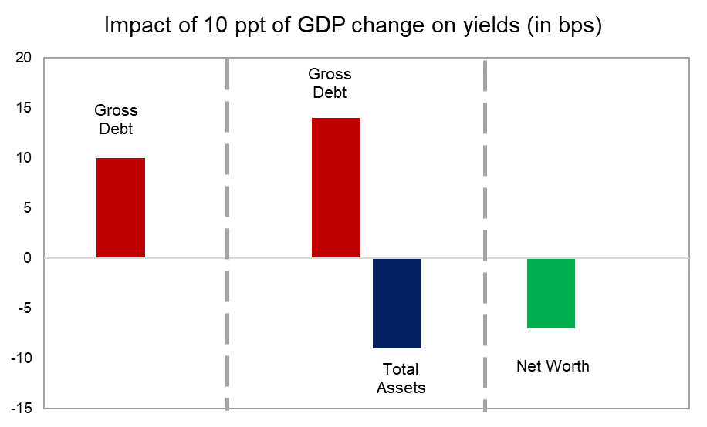
II. Why does it Matter? Stronger balance sheet → lower interest
Source: IMF October 2018 Fiscal Monitor.
Notes:
Even though most fiscal analysis focuses on debt and deficits, it seems that markets recognize assets in pricing sovereign yields.
Our empirical analysis suggests that, in line with standard results, higher debt leads to higher interest costs.
But, assets tend to reduce yields: a 10 percent of GDP increase in assets reduces interest rates by 10 basis points.
Taking all this together, countries with higher net worth pay lower interest.

Slide 14
II. Why does it Matter? Stronger balance sheet → Greater resilience
Real Government Expenditure per Capita Following Recessions (in percent)
Real GDP per Capita Following Recessions
(in percent)
Strong Balance Sheets
Weak Balance Sheets
Source: IMF October 2018 Fiscal Monitor.
Note: Shaded area represents 90 percent confidence interval.
Kazakhstan case study
Notes:
The final big macro relevant finding is that countries with stronger balance sheets experience shorter and shallower recessions.
Our analysis indicates that countries with stronger balance sheets – that is higher net financial worth – have more room to respond to shocks with fiscal stimulus, that is, more counter cyclical fiscal policy. This is true, even after adjusting for debt.
Take the Kazakhstan case. You will recall they have large oil resources:
In 2014, they faced a nasty situation: with a halving of oil prices, combined with a sharp drop in key trading partners (Russia and China) growth.
Were able to draw on their substantial financial assets to respond, with a large stimulus package to absorb some of the shock and prevent a sharper domestic downturn.

Slide 15
V. Conclusion
Our report shows the benefits of PSBS analysis
Comprehensive view of public finances
Identify & manage risks
Evaluate policies
Macroeconomic relevance
Promotes transparency and accountability
Public assets at the service of economic and social goals
Accountability to citizens and creditors
Next steps
Start compiling balance sheets – the database is public at data.imf.org/psbs
Perform basic balance sheet analysis
Over time, improve statistical and accounting practices
Notes:
Possible intermediate steps working toward PSBs compilation:
EM GG graph – these countries already have decent GG (or in some cases CG) data
CB data is generally also of good quality in most EMs
Start compiling and consolidating SOE data. Consolidation is likely particularly an issue for financial PCs—start with these, as they also most often are borrowing and have audited financial statements, perhaps even IFRS.
For nonfinancial PCs, clarify the cross-holdings, if they are substantial
For all PCs – do a risk analysis. How much implicit contingent liabilities could be expected from these PCs to the budget?
Publish an overview of PPPs and guarantees/contingent liabilities and their risk profiles (exposure and probabilities of materializing)
Report and analyze natural resources.
Perform a fiscal risk analysis with the budget – start high level, adding more granularity over time
Look at long-term sustainability – pensions, health expenditure.
Role for investors in encouraging/advancing the adoption of the PSBS approach:
Asking questions on the asset side. What do governments own in financial and nonfinancial assets? What do their SOEs own and owe? What revenue are governments getting from these assets?
On the liability side: how are pension obligations accounted for? Why are accounts payable going up/down?
Similarly, asking questions on the risk side. How do governments match their assets and liabilities? How about including SOEs in there? Example: Uruguay. Liquidity? FX risk?
Analyze the answers/peer comparison – what gets measured gets managed

Slide 16
Thank You
Public Sector Balance sheet Database
data.imf.org/psbs
Managing Public Wealth
IMF October 2018 Fiscal Monitor
www.imf.org/fiscalmonitor

Slide 17
Backpocket

Slide 18
III. Examples – Risk The Gambia – Fiscal Stress Test
The Gambia: Public Sector Balance Sheet
(percent of GDP)
Gross Financing Needs under Stress
(percent of GDP)
Back
Notes:
The Gambia's public sector balance sheet features a large nonfinancial public corporations and is risky
Large refinancing risk (275 of debt is short term)
Large (concessional) FX loans
Stress test: combined drought and pandemic in a tourism-reliant economy
Deficit increases by 8 ppt of GDP
Contingent liabilities add another 10 ppt of GDP
Gross financing needs balloon to 49% of GDP.
Public sector cross-holdings are exposed as a major shock transmission channel
Loans from one PC to another (e.g., the pension fund to the electricity and phone companies)
Could lead to cascading defaults in the PC sector
The stress test illustrates where best to intervene to avoid cascading losses.

Slide 19
Examples – Asset Management New Zealand
New Zealand: Public Sector Balance Sheet
(percent of GDP)
New Zealand: Financial Highlights – Commercial Priority Companies
Back
Notes:
New Zealand’s Investment Statement provides an assessment of the use of all public assets
Subdivides by use: social, financial, commercial – with different return benchmarks
As an example, we can see how they assess the financial returns of key public corporations, and some of the benefits of improved management, though the Kiwis still assess that returns remain low compared to the degree of risk.
Note that:
Total Shareholder Return is the performance from a shareholder perspective: (returns from dividends + change in the value of the company – equity injected)/initial value of company
Return on capital employed is profits/(debt+equity)
We think that the change in sign between the two measures in 2013 is probably due to a negative valuation effect, while profits were positive.

Slide 20
The Public Sector Balance Sheet Evolution since the crisis
Public Sector Balance Sheet
(Weighted average of 17 countries, percent of GDP)
Assets and Liabilities
Net (Financial) Worth
$11 Trillion
Source: IMF Fiscal Monitor, October 2018.
Note: The data excludes natural resource assets and pension liabilities.
Back
Notes:
Another key contribution of this chapter is to track the evolution of balance sheets over the past 15 years for some of these countries: here we show how the aggregate movements across 17 countries where we have time series PSBS.
We can see the lasting scars of the crisis – this presents a masterclass in the importance of understanding and managing fiscal risks.
The destruction of public wealth is considerable: we estimate that net financial worth remains around 11 trillion dollars lower than pre-crisis.
But we can also see that the crisis led to a sharp expansion in balance sheets: not just the liability side – much of this being debt to finance deficits, but also on the asset side.
A large share of this was intervention in the financial sector by governments, to prevent much worse declines. This is an important message: while we do want to pay attention to public wealth, this should not be at the expense of more important objectives: borrowing to prevent a financial meltdown may reduce net worth, but be well worth it to prevent a depression!

Slide 21
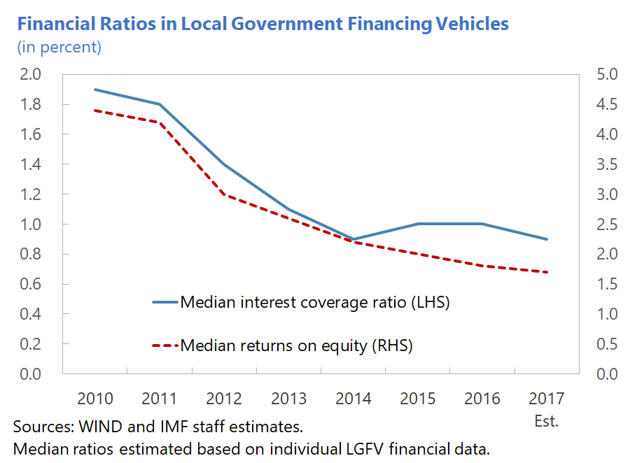
China
What are we missing?
Assets
Liabilities
Cross lending/ borrowing
Valuation of non-financial assets (liquidity)
Exposure to new financing vehicles and policy lending
PPPs
Consolidation: clarify cross lending/borrowing across institutions
Back

Slide 22
EU Aggregate Austria, Finland, France, Germany, Portugal, UK
Aggregate Public Sector Balance Sheet (in percent of GDP)
Assets
Liabilities
Financial Assets
115.7 %
Others
140.5 %
203.3 %
Infrastructure
82.9 %
258.7 %
Pension Liabilities
79.9 %
Negative Net Worth
-55.4%
Debt
38.3 %

