Slide 1
Reporting of SOEs in fiscal reports:
Reporting, consolidation and benchmarking
In collaboration with

Slide 2
Overview of the SOEs sessions

Slide 3
Sessions
In collaboration with
Session 1: Framing of SOEs reporting in the context of Fiscal Transparency and progress in FOA countries
Date: October 20
Time: 3-5 pm CAT
Session 2: Information flows for reporting SOEs transactions with government, including integration through FMIS
Date: October 22
Time: 3-5 pm CAT
Session 3: Reporting and management of guarantees to SOEs and the link with fiscal risks
Date: October 27
Time: 3-5 pm CAT

Slide 4
Session 1
Session 1: Framing of SOEs reporting in the context of Fiscal Transparency and progress in FOA countries
Date: October 20
Time: 3-5 pm CAT
Agenda:
FOA Project introduction. SOEs reporting in the context of fiscal transparency what does it mean
Why SOE’s (and public entities) reporting matters. CABRI
Liberia- Benedict G. Fully, Director of the SOE Unit. Development of the SOEs consolidated report.
Nigeria- Ginikanwa Etisong-Osung, Budget Office. Progress in including allocations to and earnings from its SOEs in its budget documents.
Update of work with Liberia and Nigeria- Naresh Jha and Kubai Khasiani from AFRITAC West 2
Q&A
Benin- Progress in expansion of the coverage of public finance statistics to all general government subsectors.
Senegal- Amadou Birahim,Director of the Public Sector of the General Directorate of Public Accounting and Treasury. Production of consolidated general government statistics and beginning of the production of statistics for government-held corporations.
Update of work with AFRITAC Ouest in Benin- Nicoletta Feruglio
Q&A
The public sector balance sheets (PSBSs)-Jason Harris, Fiscal Affairs Department
Q&A

Slide 5
Session 2
Session 2: Information flows for reporting SOEs transactions with government, including integration through FMIS
Date: October 22
Time: 3-5 pm CAT
Agenda:
Welcome remarks and polling- GIFT (10 minutes)
SOEs Health Check- Gaps in recording, monitoring, and reporting of reliable and comprehensive transactions with SOEs- Sybi Hida, Fiscal Affairs Department IMF
Q&A
Ongoing work on information flows and integration issues- CABRI- FMIS and findings related to its use for consolidating SOEs
Country example - South Africa- Sheila Thipe, National Treasury. How are SOEs consolidated as part of government financial statistics and budget reports
Country example - Nigeria- why it was decided to incorporate SOEs into the GIFMIS, progress and challenges with those with internally generated revenue.
Q&A (15 minutes)

Slide 6
Session 3
Session 3: Reporting and management of guarantees to SOEs and the link with fiscal risks
Date: October 27
Time: 3-5 pm CAT
Agenda:
Welcome remarks- GIFT/IBP
Gaps in recording, monitoring, and reporting of reliable and comprehensive SOEs guarantees (and other public entities categorized similar to SOEs)
Q&A
Fiscal risks statements- Robert Clifton, AFRITAC South- methodology for development and process and examples
Country Example- South Africa
Q&A
Fiscal Stress Test--applied to COVID-19- Camilo Gómez Osorio AFRITAC South- new methodology
Q&A

Slide 7
SOEs reporting in the context of fiscal transparency what does it mean
Framing of SOEs reporting in the context of Fiscal Transparency and progress in FOA countries
Virtual session
October 2020
Lorena Rivero del Paso
Manager for Technical Knowledge and Collaboration
lorena@fiscaltransparency.net
@LorenaRDP

Slide 8
Transparency Objectives and Indicators for the FOA Project

Slide 9
Fiscal Transparency FOA Objectives:
Overall
Timely publication
Open Budget Survey (OBS) 8 key documents timely publication
Comprehensiveness of budget reports
US Fiscal Transparency Report, PEFA, OBS
Country specific indicators.
Based on findings of the US Fiscal Transparency Report
User-orientation
Mapping of required information for PP mechanisms. Accessibility (Principle 1)

Slide 10
Fiscal Transparency FOA Objectives:
Based on the Fiscal Transparency Report, US State Department 2019
Benin: The government of Benin enhances budget comprehensiveness and reliability by taking steps towards expanding information on both revenues and expenditures, including transfers to and from state-owned enterprises, publishing supplemental budgets, and ensuring key audit reports are publicly available within 12 months of dissemination of the government's end-of year report.
Nigeria: The government of Nigeria enhances budget comprehensiveness and reliability by taking steps towards publishing more information on revenues, detailing allocations to and earnings from state-owned enterprises, and publishing key budget and audit reports in a timely manner.
Liberia: The government of Liberia enhances budget comprehensiveness and reliability by taking steps towards publishing key budget and audit reports in a timely manner, ensuring key audit reports are publicly available within 12 months of dissemination of the government's end-of-year report, and ensuring the criteria and procedures used to award natural resource extraction contracts and licenses are consistent with the requirements set by law or regulation.

Slide 11
Reporting and Transparency of
allocations to, earnings from and guarantees for
SOEs

Slide 12
Defining State Owned Enterprises
SOEs are known by many names
government corporations,
government business enterprises,
government-linked companies,
parastatals,
public enterprises,
public sector units or enterprises
(…)

Slide 13
Defining State Owned Enterprises
Definition also varies depending on:
Full, majority or minority ownership by the government.
Government shareholdings through pension funds, asset management funds, restructuring corporations and development lenders.
The level of government that owns the enterprise (central/federal, state/regional or local).
The way in which the enterprise was founded.
The position in the public administration hierarchy.
The purpose of the SOE.
The status of the SOE if it is in the process of being privatized.
Listing (or not) on a stock exchange.
State-enabled (for example enterprises which have been granted exclusive rights by the state) as opposed to state-owned.

Slide 14
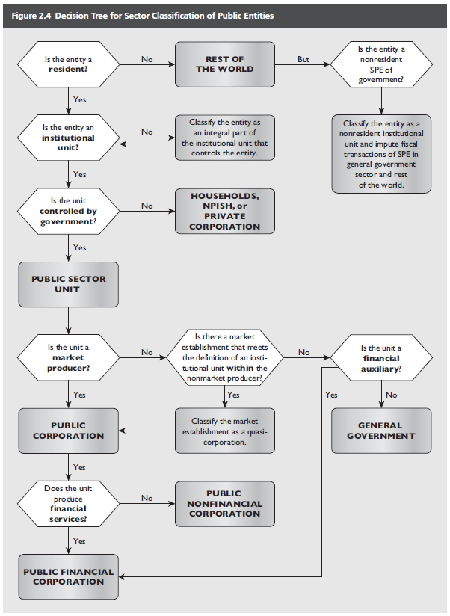
Defining State Owned Enterprises
Government Finance Statistics Manual 2014, Public Corporations

Slide 15
Poll:
Is there a national definition of SOE's in your country? / Existe-t-il une définition nationale des entreprises publiques dans votre pays?
2 minutes

Slide 16
Evaluation of
Reporting and Transparency of
allocations to, earnings from and guarantees for
SOEs

Slide 17
State Owned Enterprises
Open Budget Survey
Question 37:
Does the Executive’s Budget Proposal or any supporting budget documentation present estimates of transfers to public corporations for at least the budget year?
A: Yes, estimates of all transfers to public corporations are presented, along with a narrative discussion. (2019- Liberia, South Africa)
B: Yes, estimates of all transfers to public corporations are presented, but a narrative discussion is not included. (2019- Senegal)
C: Yes, estimates of some but not all transfers to public corporations are presented. (2019- Nigeria)
D: No, estimates of transfers to public corporations are not presented. (2019- Benin, Cameroon)
E: Not applicable/other.

Slide 18
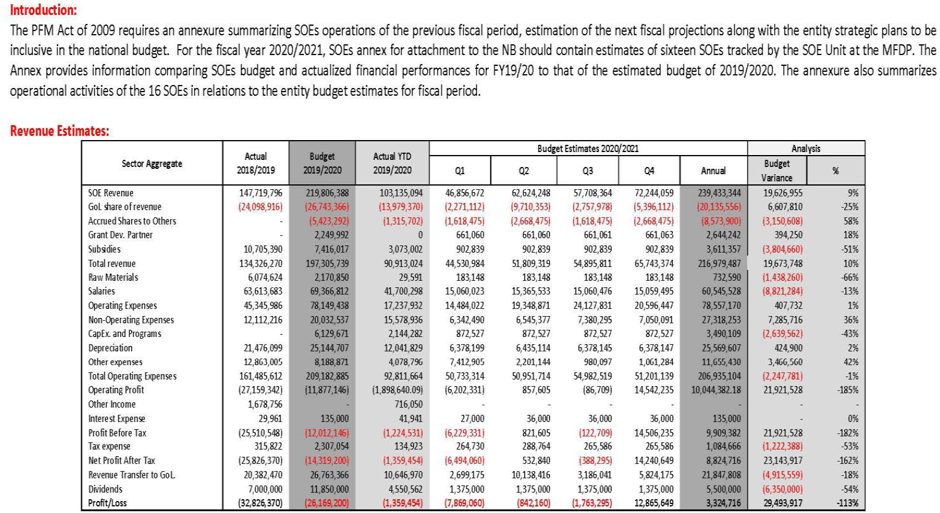
State Owned Enterprises
Open Budget Survey
Liberia’s Draft Budget 2020/2021
View annex 2: https://mfdp.gov.lr/index.php/main-menu-reports/mm-bdp/mm-bd-nb/draft-national-budget-fy2020-2021/download

Slide 19
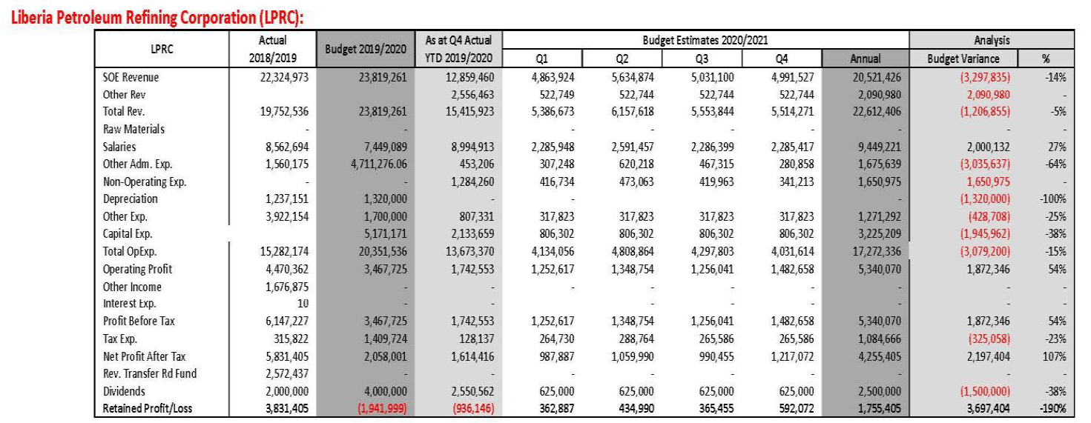
State Owned Enterprises
Open Budget Survey
Liberia’s Draft Budget 2020/2021
View annex 2: https://mfdp.gov.lr/index.php/main-menu-reports/mm-bdp/mm-bd-nb/draft-national-budget-fy2020-2021/download

Slide 20
State Owned Enterprises
Fiscal Transparency Code, IMF
# | Dimension | Principle | Practice
 |  |  | Basic | Good | Advanced
3.3.2 | Public Corporations | The government regularly publishes comprehensive information on the financial performance of public corporations, including any quasi-fiscal activity undertaken by them. | All transfers between the government and public corporations are disclosed on at least an annual basis. | All transfers between the government and public corporations are disclosed, and based on a published ownership policy, a report on the overall financial performance of the public corporations sector is published on at least an annual basis. | All direct and indirect support between the government and public corporations are disclosed, and based on a published ownership policy. A report on the overall financial performance of the public corporations sector, including estimates of any quasifiscal activities undertaken, is published on at least an annual basis.

Slide 21
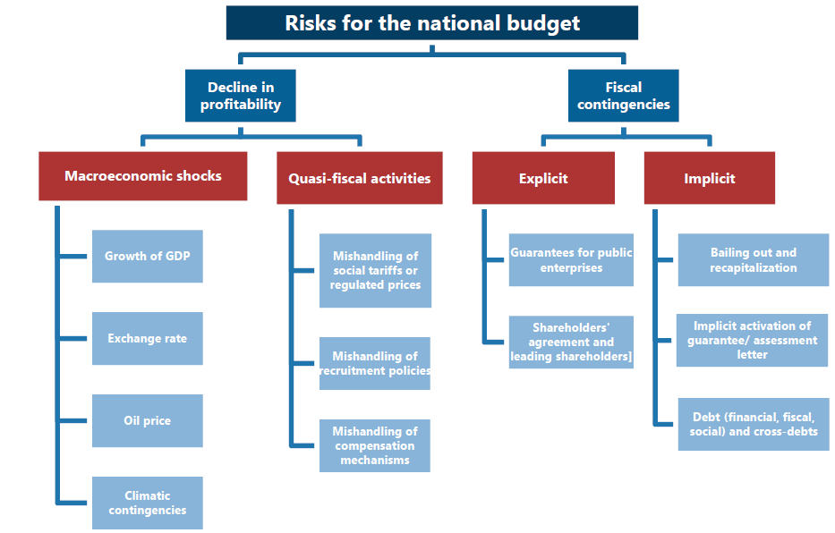
State Owned Enterprises
Fiscal Transparency Code, IMF
Senegal, Fiscal Transparency Evaluation, 2019
https://www.imf.org/en/Publications/CR/Issues/2019/01/30/Senegal-Fiscal-Transparency-Evaluation-46569

Slide 22
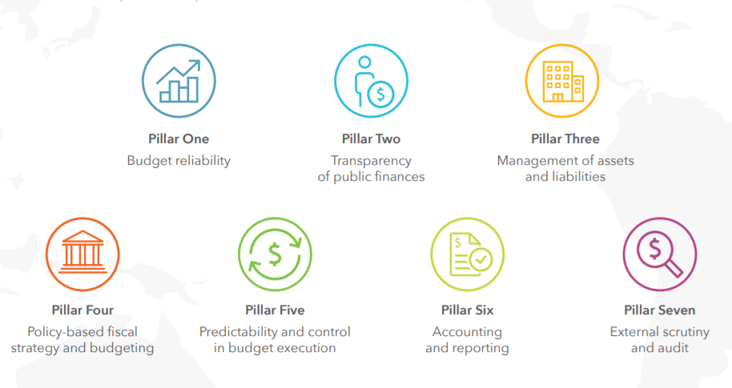
Public Expenditure and Financial Accountability (PEFA): Pillars

Slide 23
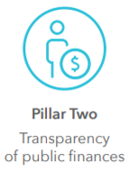

Slide 24
PEFA Assessment in FOA Project countries
Country | PEFA (only national)
Benin | 2007, 2012, 2014
Cameroon* | 2008, 2017
Liberia | 2009, 2012, 2016, 2020(planned)
Nigeria | 2013, 2019(draft)
Senegal | 2011
South Africa | 2008, 2014

Slide 25
Next up

Slide 26
Session 1
Session 1: Framing of SOEs reporting in the context of Fiscal Transparency and progress in FOA countries
Date: October 20
Time: 3-5 pm CAT
Agenda:
FOA Project introduction. SOEs reporting in the context of fiscal transparency what does it mean
Why SOE’s (and public entities) reporting matters. CABRI
Liberia- Benedict G. Fully, Director of the SOE Unit. Development of the SOEs consolidated report.
Nigeria- Ginikanwa Etisong-Osung, Budget Office. Progress in including allocations to and earnings from its SOEs in its budget documents.
Update of work with Liberia and Nigeria- Naresh Jha and Kubai Khasiani from AFRITAC West 2
Q&A
Benin- Progress in expansion of the coverage of public finance statistics to all general government subsectors.
Senegal- Amadou Birahim,Director of the Public Sector of the General Directorate of Public Accounting and Treasury. Production of consolidated general government statistics and beginning of the production of statistics for government-held corporations.
Update of work with AFRITAC Ouest in Benin- Nicoletta Feruglio
Q&A
The public sector balance sheets (PSBSs)-Jason Harris, Fiscal Affairs Department
Q&A

Slide 27
Stay tuned!
@fiscaltrans
@fiscaltransparency
@fiscaltransparency
www.fiscaltransparency.net

