Slide 1
Budget Transaperency in Brazil

Slide 2
Inesc and GIFT
Open Data (Learning and exchanges activities, Ex. Fiscal Transparency Portals Workshop, Jakarta, 2016)
Fiscal Justice (Research and advocacy through the Fiscal Justice Network)
Building contents togheter (Ex. Article - The Good News in Brazil's Two-Headed Crisis, with Vivek Ramkumar, 2016).
OBI (Ex. Meeting in Mozambique, 2018 - Lusophony Countries, with Government – successful (!) advocacy in budget cycle)
Webinars (Ex. Fiscal Transparency Portals, Brazil and South Africa, September, 2018)

Slide 3
Reaching out the public with tecnhology
Transparency Portal
Launch of Portal in Brasilia, with GIFT meeting (2018);
Exchanges with South Africa CSOs and Government (2018);
New materials for trainnigs with civil society (2018).
Open Data
Tool Budget at your fingertips (Open Spending)

Slide 4
Motivating Citizens on Budget
Strategy - focus on different publics with specific messages
Analysis – academics, journalists, CSOs
Campaigns (ex. The end of fiscal secrecy for fossil fuel) – society in general, educated but low informed
Workshops, trainings – social movements (black, women, indigenous, youth) and national councils (Food Security, Racial Equality)
Difference kinds of communication products – cards, videos, texts….

Slide 5
A gift to GIFT
New studies (Ex. Budget Credibility; Budget and Discrimination)
Participation (Ex. Improving the perception of participation in Finance Ministry; improve participation in discussion about tax and revenues)
Importance of GIFT Network (Ex. Setbacks in transparency policy with changes in Government, that already happening – the weakening of Inter Council Forum).

Slide 6
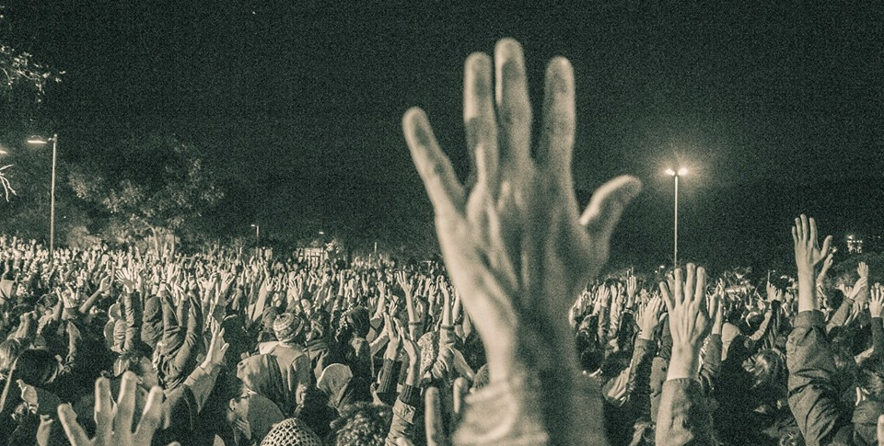
Obrigada!
www.inesc.org.br
Credit: Jornalistas Livres

