Slide 1
Budget Monitor ICT based citizen Participation in Supervision of Public Finances
STATE AUDIT OFFICE
OF GEORGIA
Global Initiative for Fiscal Transparency workshop
Tbilisi, Georgia 17/07/2018

Slide 2
Challenges
STATE AUDIT OFFICE
OF GEORGIA
Lack of public awareness:
Complexity
Accessibility
Lack of citizen engagement:
Insufficient complaint mechanisms

Slide 3
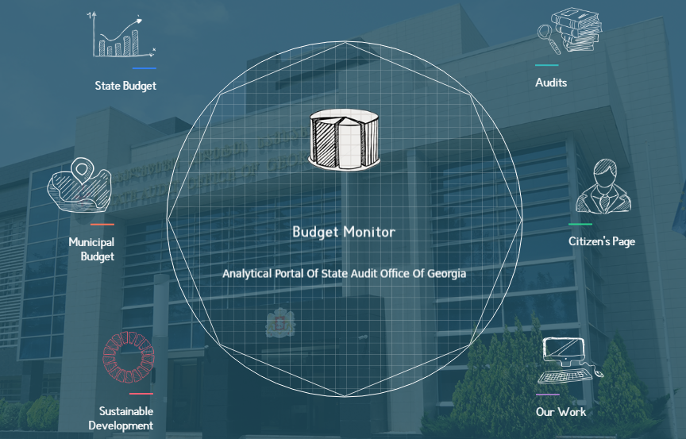
www.BudgetMonitor.ge
STATE AUDIT OFFICE
OF GEORGIA

Slide 4
Information Presented on Budget Monitor
STATE AUDIT OFFICE
OF GEORGIA
100
Audit reports
per year
76
Municipal budgets
1.State Budget Overview
2.Municipal Budgets
3.Audit Findings
400
State Programs
62
Public agencies’ Expenditures

Slide 5
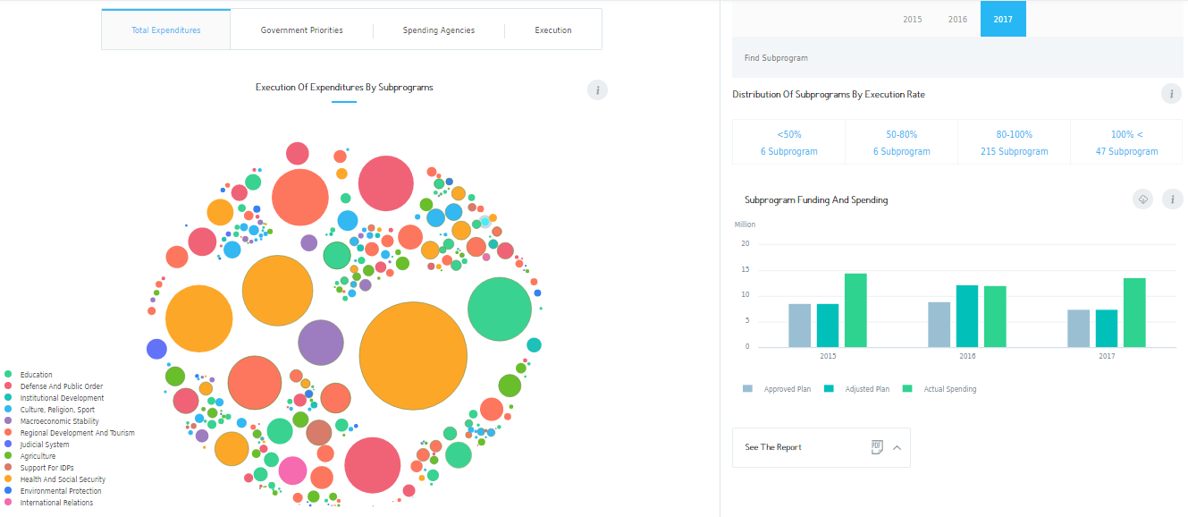
State Budget
Municipal Budget
Audit
Citizen’s Page
Budget Spending

Slide 6
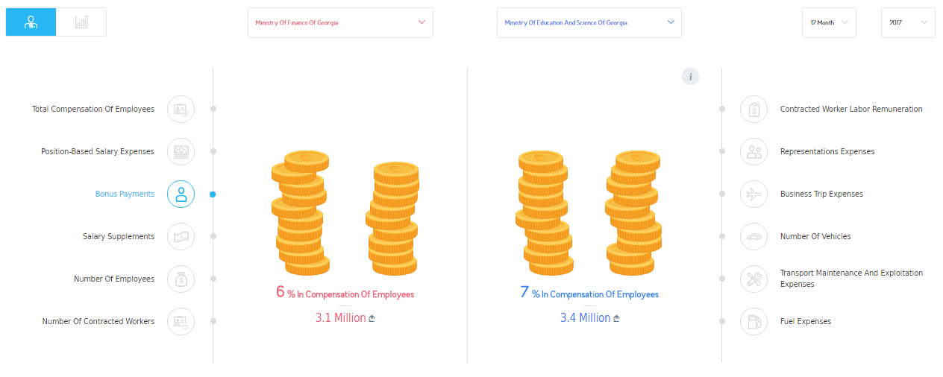
State Budget
Municipal Budget
Audit
Citizen’s Page
Administrative Expenses

Slide 7
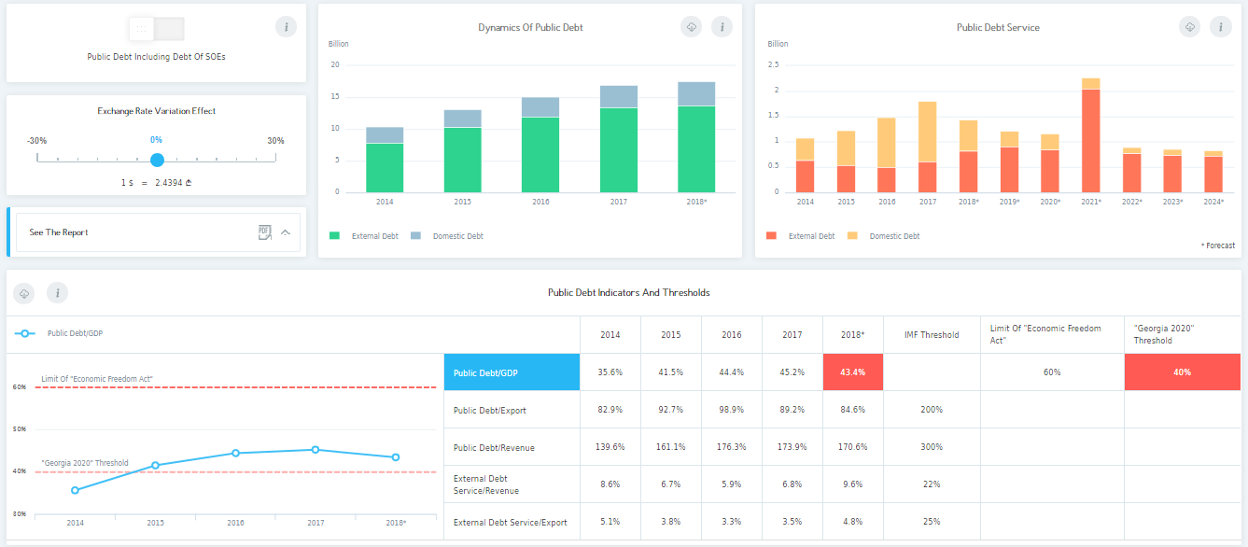
State Budget
Municipal Budget
Audit
Citizen’s Page
Public Debt
Foreign
Domestic
Foreign
Domestic

Slide 8
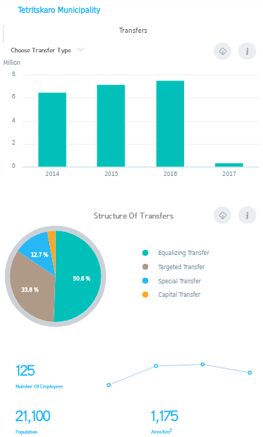
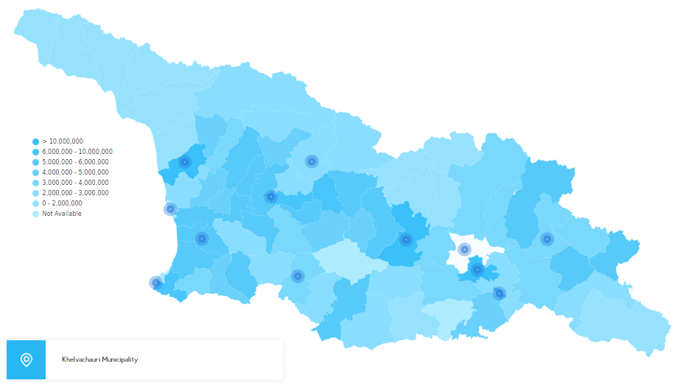
მოქალაქის გვერდი
State Budget
Municipal Budget
Audit
Citizen’s Page
Municipality Budget

Slide 9
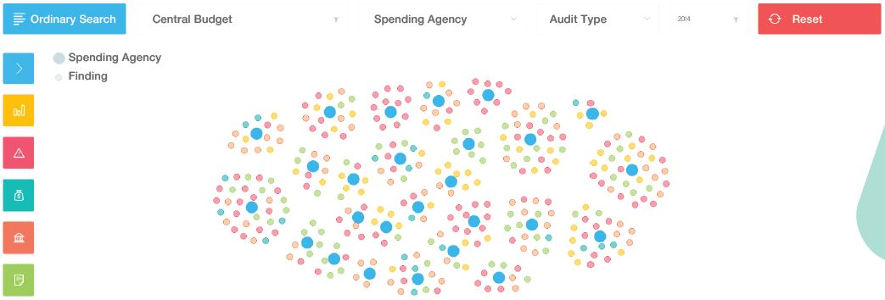
მოქალაქის გვერდი
State Budget
Municipal Budget
Audit
Citizen’s Page
Audit Findings

Slide 10
Sustainable Development Goals
State Budget
Municipal Budget
Audit
Citizen’s Page
Sustainable Development Goals

Slide 11
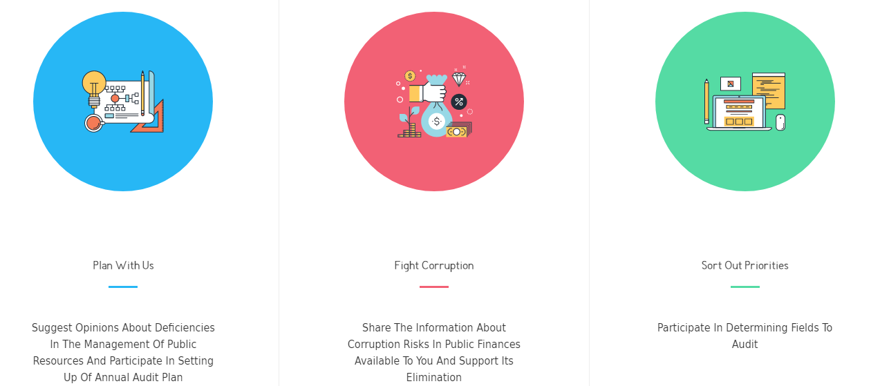
მოქალაქის გვერდი
State Budget
Municipal Budget
Audit
Citizen’s Page
Citizen’s Page

Slide 12
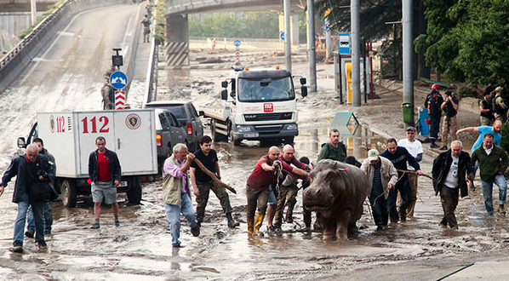
STATE AUDIT OFFICE
OF GEORGIA
Received and Audited Citizens’ Requests
Audit of funds for victims of disaster
Social rehabilitation and child care program
Risks in public procurement

Slide 13
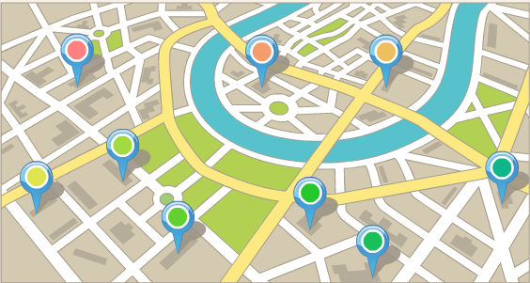
STATE AUDIT OFFICE
OF GEORGIA
Requests included in the 2018 Audit Plan
Risks in remuneration expenses and possible nepotism
Inappropriate budget spending in fields of sports and culture
Audit expenditures of specific Municipalities

Slide 14
STATE AUDIT OFFICE
OF GEORGIA
Budgetmonitor.ge
Your space for budget control!
State Audit Office for better governance

