Slide 1
Republic of Slovenia
The Court of Audit
Cooperation with GIFT
Jorg K. Petrovič, MBA, Vice President
The Court of Audit of the Republic of Slovenia

Slide 2
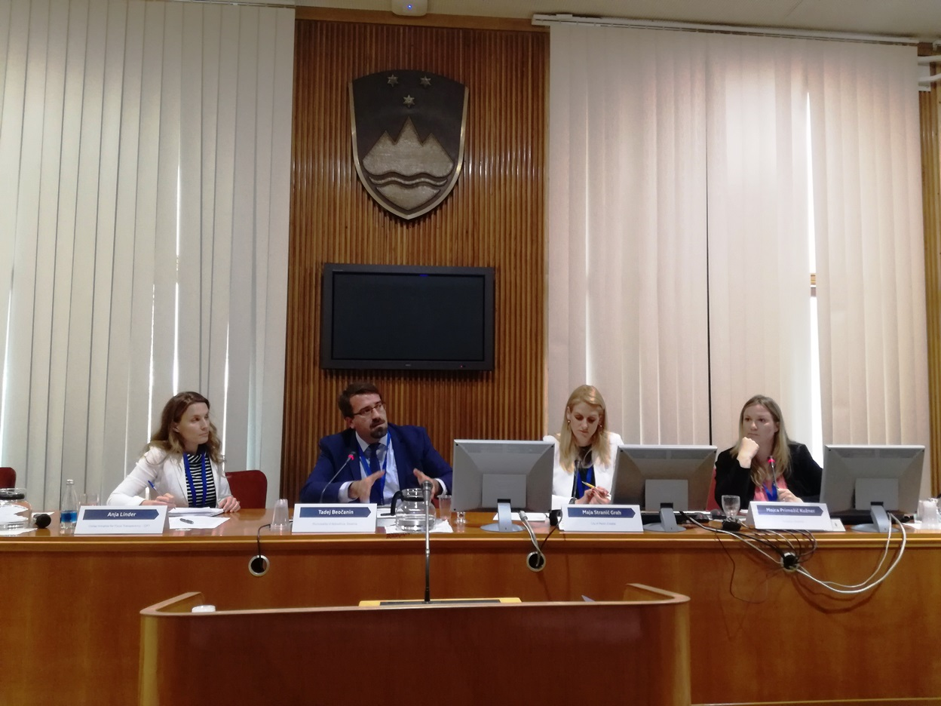
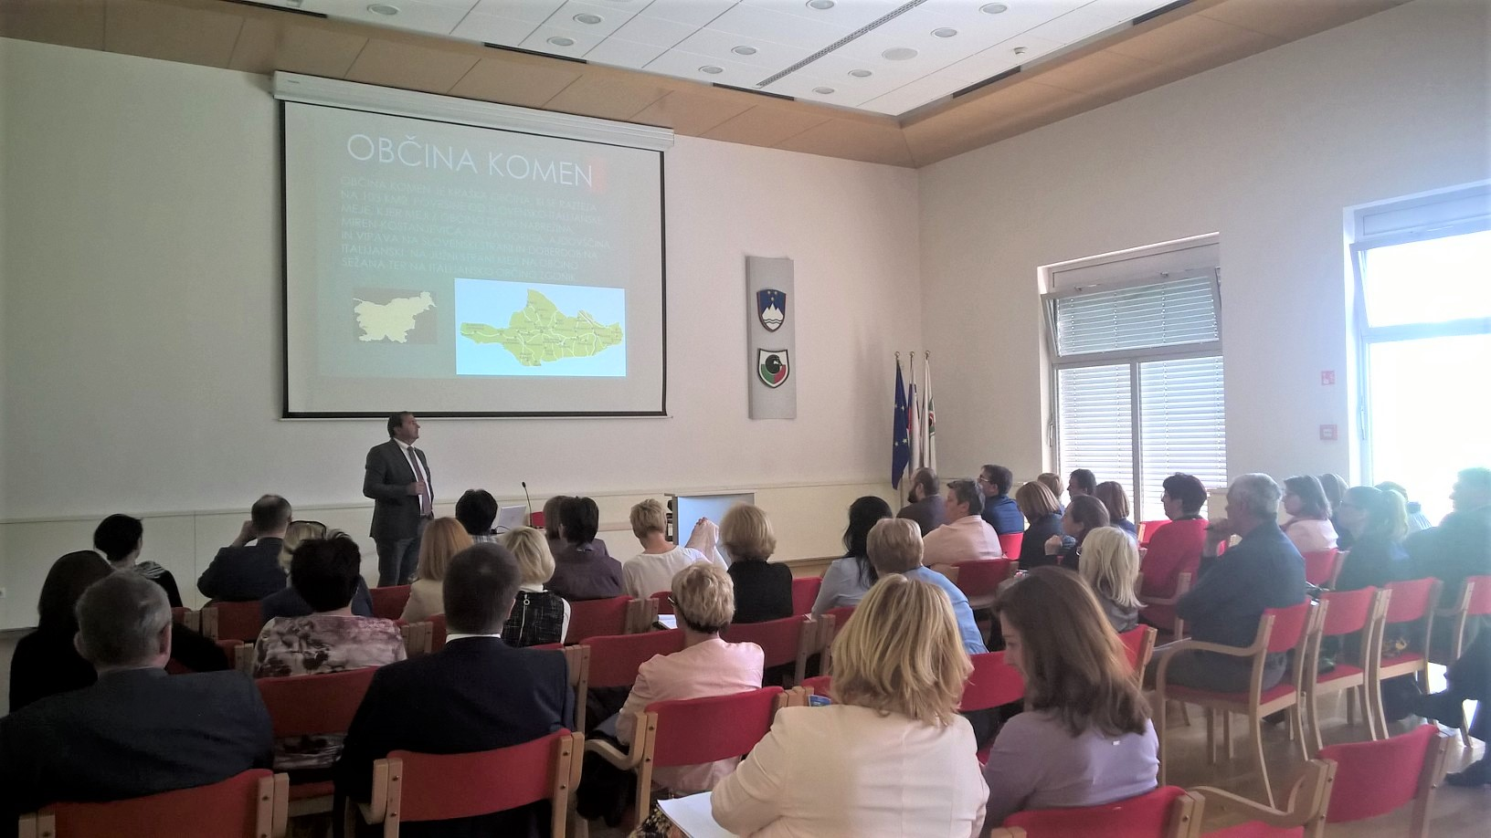
My organization and GIFT
Our cooperation is not formalized. But this does not mean that there is none. On the contrary:
We work together for the past 3 years. Our experts have been invited as speakers to the events where GIFT was organizer or co-organizer of the event.
We have co-organized a regional conference for SW Europe about participatory budgeting in Ljubljana in May 2017.
We use GIFT principles of transparency as a fundamental rawmodel for the promotion of the long term goal of our state budget transparency.
We are using GIFT‘s principles on participatory budgeting as information for promotion of a good practice in local communities budgetary process.

Slide 3
Reaching out to the public with technology
State budget has reached a certain level of openness of the information on public spending – but there's still a lot of room for improvement.
Citizens budget is currently a static document but treasury is working on a projector make it more dynamic.
Local communities are more and more interested in participatory budgeting. Especially because we have local elections in November 2018 and candidates are looking for the new ideas.
Local communities that are in participatory budgeting for a longer period are starting to introduce informatization in the process.
http://www.mf.gov.si/fileadmin/mf.gov.si/pageuploads/slike/prora%C4%8Dun/Infografika_PRORACUN_2018.pdf

Slide 4
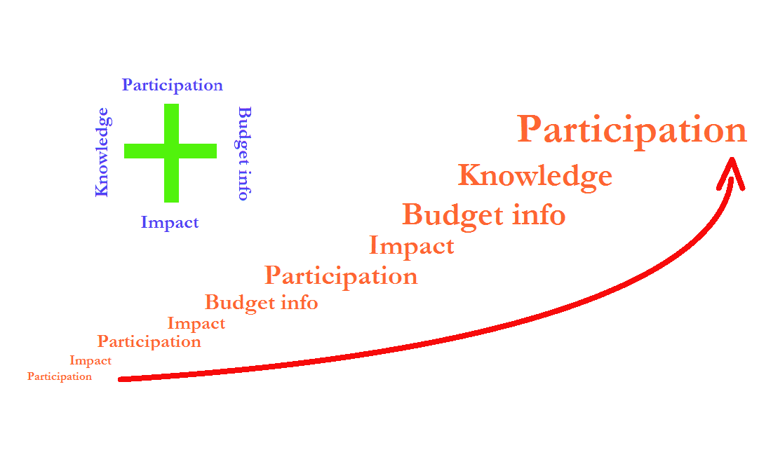
Motivating citizens on budgets

Slide 5
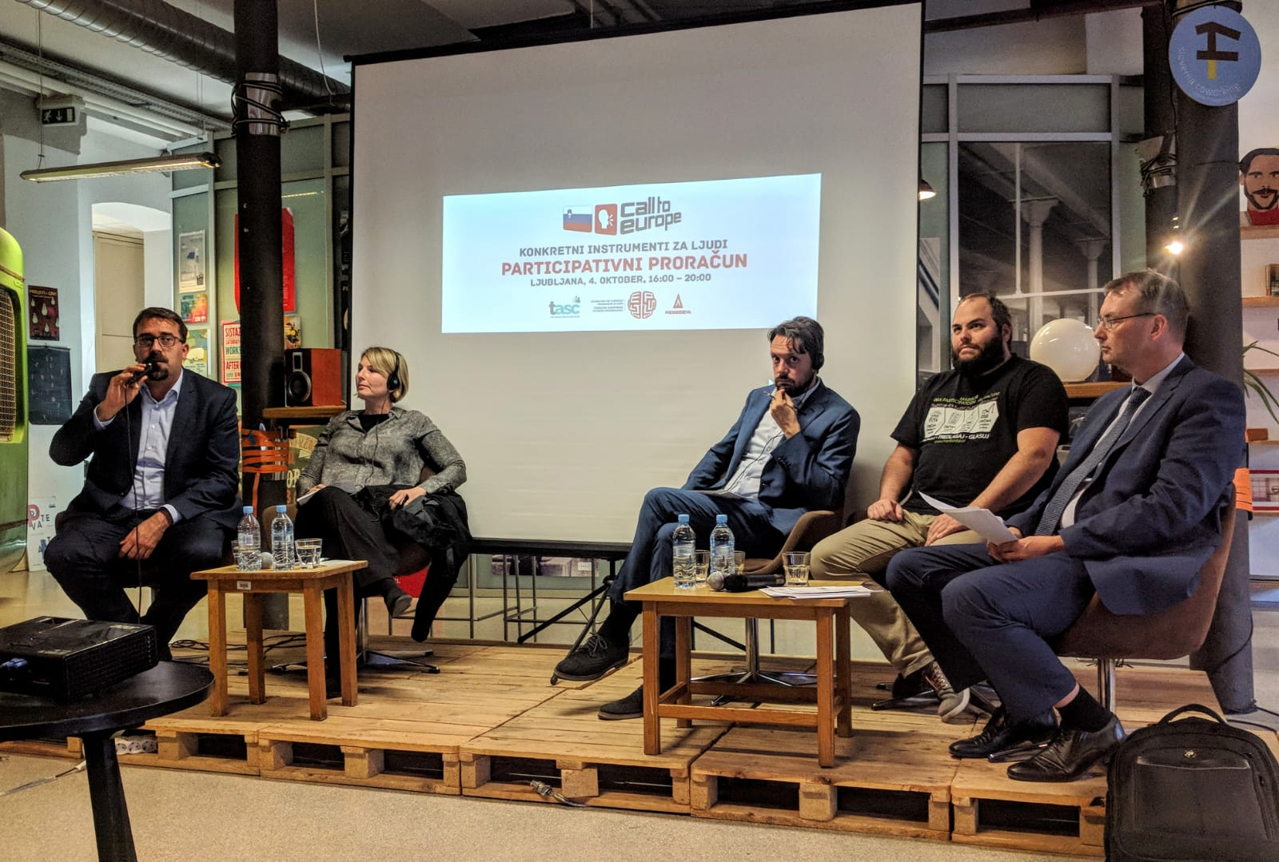
Your organization´s gift to GIFT
Auditing budget procedures at local level and promote participation as an example of a good practice.
Perform a study on impact of participation on turn out at local elections and active citizens public involvement.
Constant promotion within the civil society (NGOs, LCOs, etc.)
Folowing the IBP‘s OBS results and promoting participation.

