Slide 1
Information systems in PFM
28 August 2020
GIFT Stewards Meeting
Notes:
Functional PFM systems depend on accurate and timely information sharing and an efficient accounting system. Both have been revolutionised by financial management information systems (FMIS): “automated solutions that enable governments to plan, execute and monitor the budget, by assisting in the prioritization, execution and reporting of expenditures… and revenues” (World Bank 2011).

Slide 2
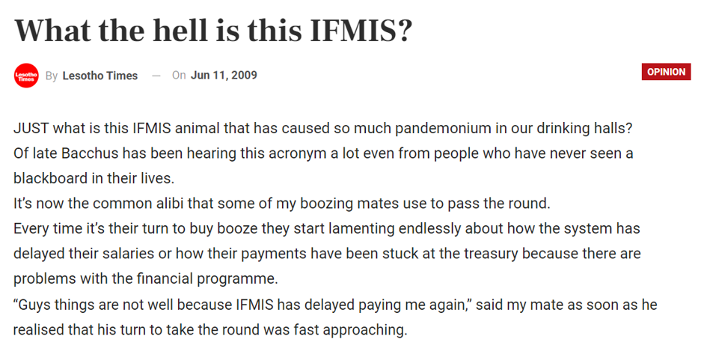
FMIS challenges
$8 billion spent on FMIS projects and FMIS-related ICT solutions; recording, reporting, information sharing, and data analysis remain suboptimal
Notes:
However, despite these noble objectives and over 8 billion… Dependence on simultaneous PFM reforms
Mismatch between system design & local context
Integration has presented its own challenges
Data capability gaps
Institutional coverage limited
Often do not produce accurate and timely reports
Donor funds remain outside the system
Dependence on reforms: Success depends on simultaneously introducing other complex PFM reforms including introducing SCOA and TSA.
Mismatch: systems mostly off-the-shelf, implying they are not designed to suit the local context, and requires existing manual process to fit in with predetermined design (and rely on external IT support)
Integration: many countries have tried to go integrate core budget functions with payroll, public investment management,procurement, debt mgmt) by introducing one central database.However this expensive and complex approach has met with little success given little flexibility to intro new technology; whole system out when one module out; restricted to IT solutions from single vendor
Data capability gaps: limited understanding of accounting standards and budget practices, inability to migrate and convert data for decision making.
Inst cover: Many countries have tried to introduce fmis to general govt,Given problems at central level, unsurprising that this presents challenges, including: lack of user buy-in, connectivity issues, HR capacity
Donor funds: Progress in incorporating donor funds slow in most countries, limiting the comprehensiveness of the FMIS for heavily donor-dependent countries

Slide 3
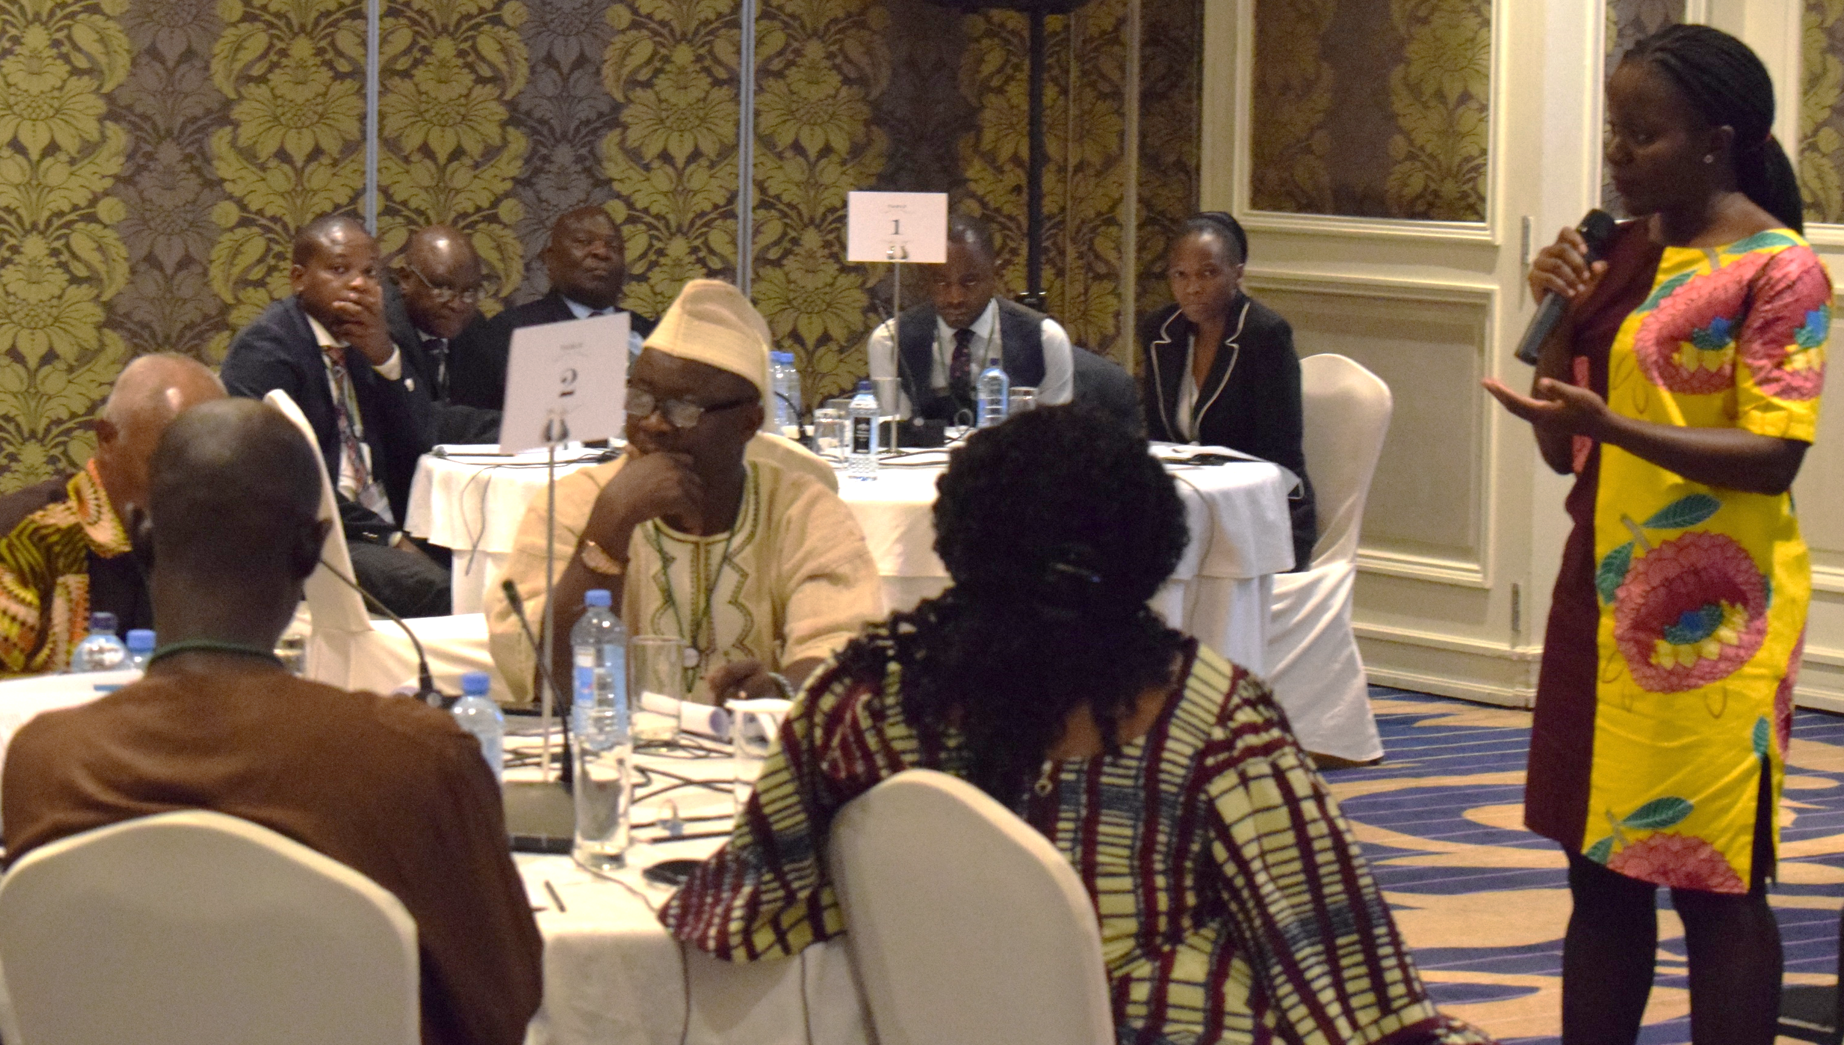
CABRI’s Response: policy dialogue on information systems
Data skills for effective utilisation of FMIS
Challenges and successes in integration
Considering alternatives: the modular approach and transversal systems
PFM in the age of digitalisation and big data
Extending the institutional coverage
FMIS in times of crisis: balancing flexibility and accountability
Notes:
Given the persistence of these challenges and the need for practitioners to exchange firsthand accounts of practical and operational issues just discussed, we will hold a PD, which provides platform for practitioners to learn from the experiences of their peers, and where appropriate, apply lessons. Our PDs comprise….
During this PD, we will look addressing some of the discussed including:
Alt approach: Given difficulties&cost associated with integration,worth seriously considering alternatives, such as the IMF’s modular approach, pragmatically recommends developing country FMISs limited to core functions. and SA’s transversal system. Unbeknownst to most, South Africa has never had an IFMIS and has instead operated transversal systems, which although now outdated, served the country well.
Digitalisation&big data: use this as opportunity for practitioners to discuss what digital revolution and e-govt means for PFM
Times of crisis: And finally, what we will begin discussing today: how can FMIS increase efficiency, effectiveness, and equity in governments’ responses to COVID-19.I’ll leave it to the panellists, who will share challenges and lessons learnt using information systems to track and monitor revenue and expenditure, make data-driven decisions during and ensure accountability following crises.

Slide 4
Extending FMIS’ institutional coverage
Guinea, CAR, Ethiopia and Ghana
Phasing rollout incrementally and allowing for adaptation
Many stakeholders in the expenditure chain lack budget and accounting expertise, requiring targeted training
Entities with internally generated funds have little incentive to use FMIS
Performance audit is necessary to ensure the platform is robust, secure and fully operational at a reasonable speed
Wider institutional coverage of an FMIS allows for rapid and accountable responses in a crisis

Slide 5
Data capability gaps in FMIS design and use
Guinea, CAR, Ethiopia and Ghana
Skills transfer is limited due to recourse to foreign IT experts but also opportunities to learn from older and more experienced staff members for various functions.
Capacity building is oriented towards data capture at the expense of data analysis.
Data analytics is underused due to the lack of relevant skills and know-how such that trends and correlations are scarcely undertaken, which prevents optimizing decision making

Slide 6
Thank you

