Slide 1
OFDP Evaluation
Secretaria de Orçamento Federal
Federal Budget Office

Slide 2
Still a working in progress...
Open Data Plan for 2017/2018 - Executive Decret
Open Data Law is on its way througt National Congress
PIlot main focus: Focus: Brazilian Federal budget classification scheme mapping to OFDP datatype options
Data used: Brazil’s Federal Budget 2015/2016

Slide 3
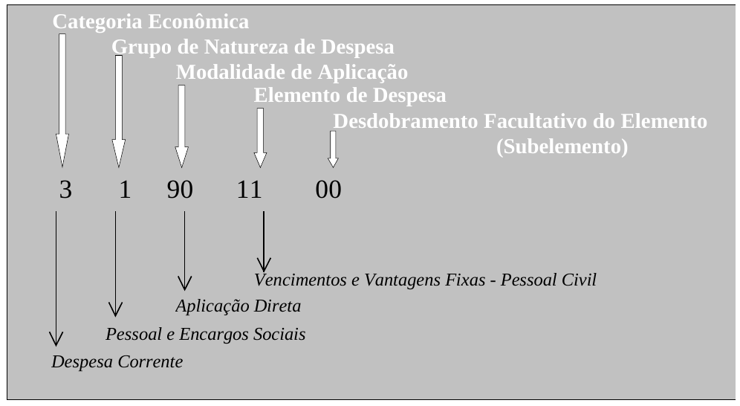
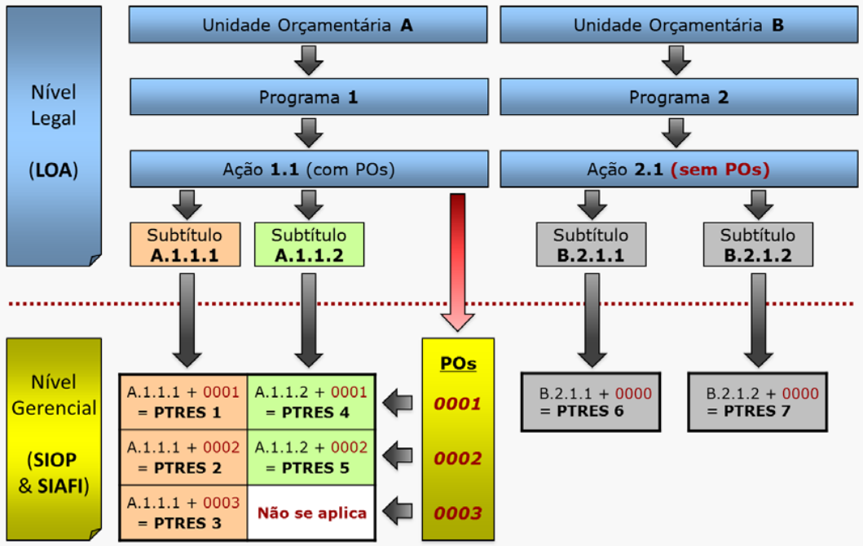
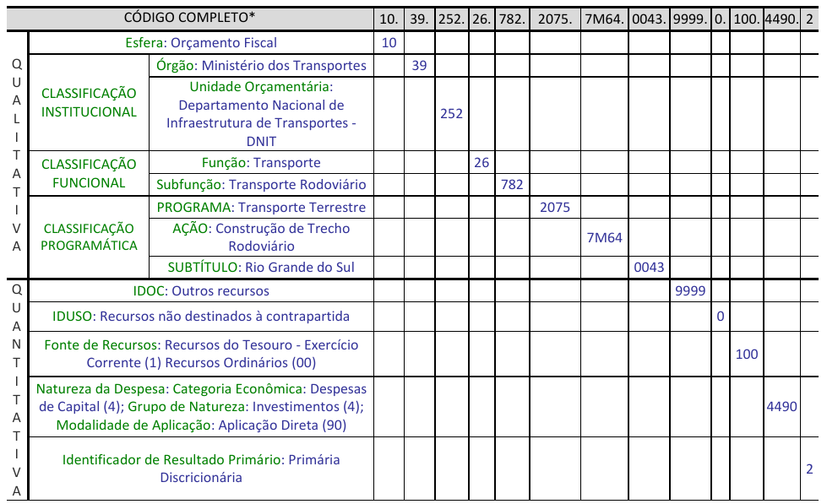
Budget Classifications in Brazil

Slide 4
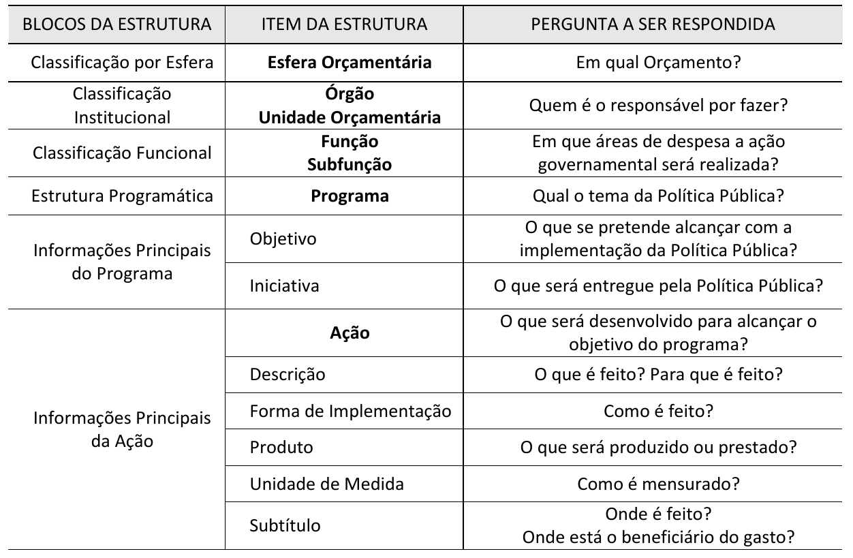
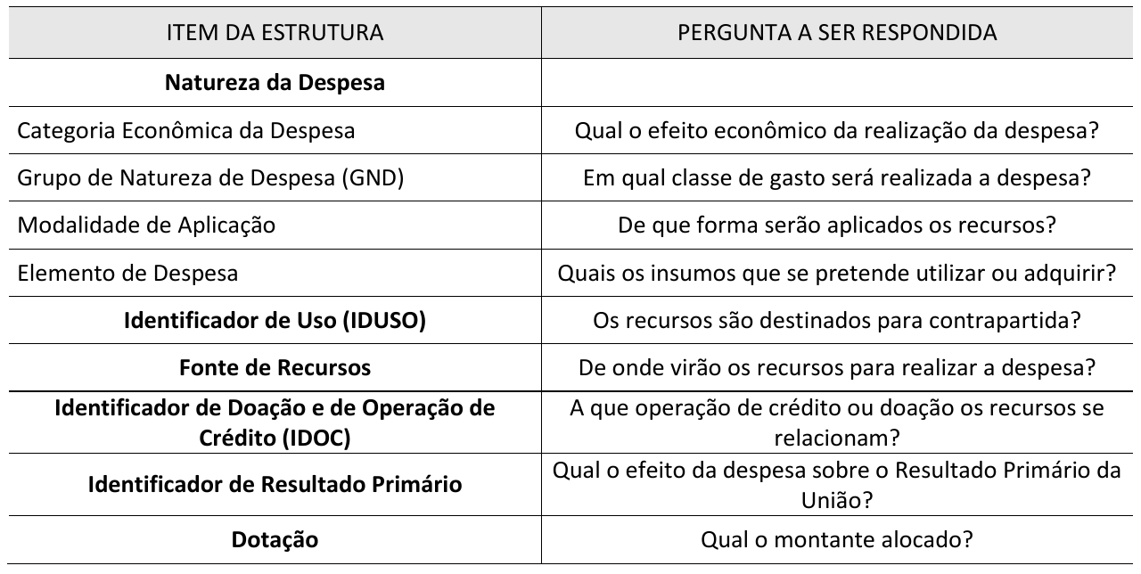
Budget Classifications in Brazil
Qualitative
Quantitative

Slide 5
Considerations so far

Slide 6
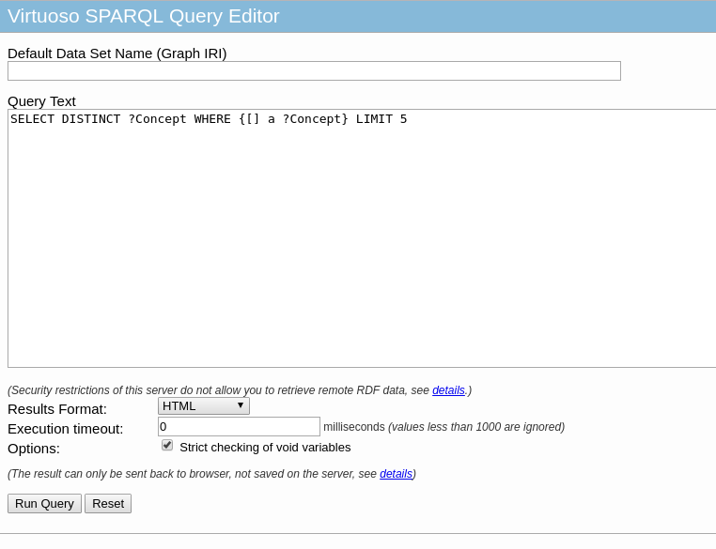
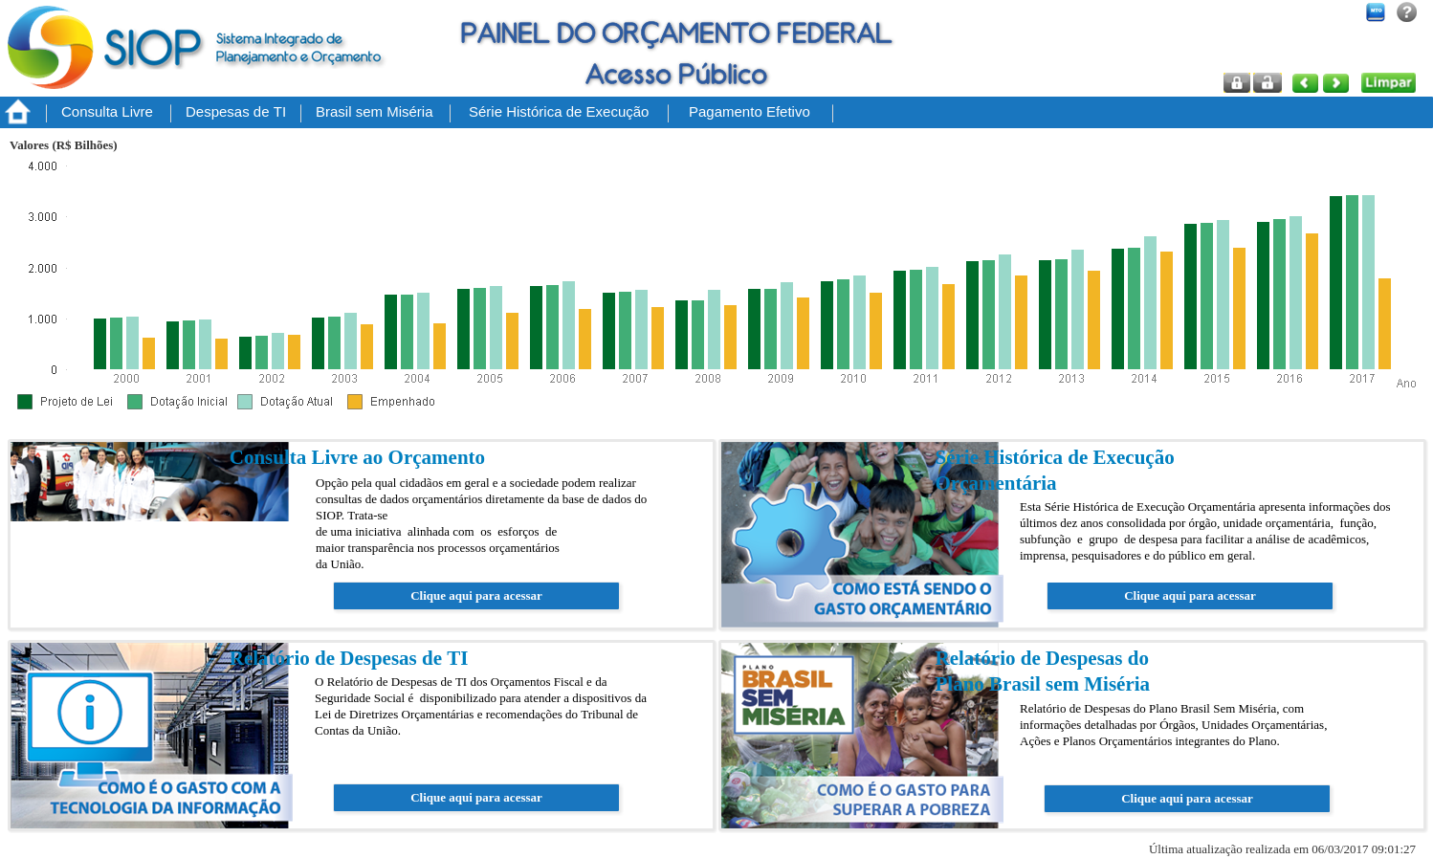
Brazilian Budget Panel / Open Data in RDF
Our two main online open data transparence products at SOF now
www.siop.gov.br

Slide 7
Considerations until here

