Slide 1
Updates on U.S. Spending Transparency Improvements
Amy B. Edwards
Senior Advisor, Financial Transparency, Office of the Fiscal Assistant Secretary
U.S. Department of the Treasury

Slide 2
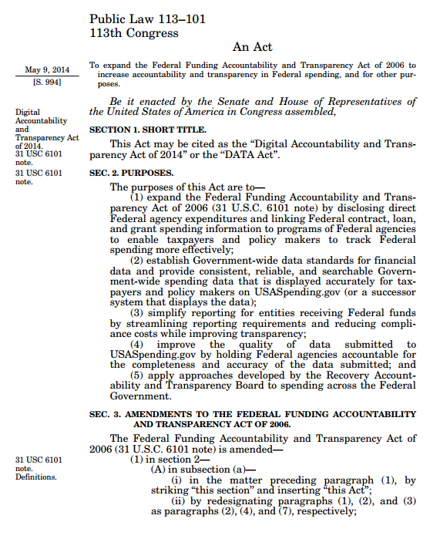
Background of the DATA Act
Increasing demand for data
Barriers to using existing data
Siloed systems
Complex data
Lack of consistency
Data quality concerns
First U.S. open data law:
Digital Accountability and Transparency Act of 2014 (DATA Act)

Slide 3
Digital Accountability and Transparency Act (DATA Act)
Goal
Track $3.8 trillion dollars in annual spending on a quarterly basis and link data from the budget, accounting, procurement and financial assistance databases into one common format
Challenge
Collect, store, and display more than 400 data elements from over 100 federal agencies
Grants
Procurements
and
Contracts
$3.8
Trillion in
Federal
Spending
Loans and Other Assistance
Other
Agency Expenditures
Better Data. Better Decisions. Better Government

Slide 4
DATA Act Challenges
Large, Intricate Data Sets
One-Size Fits All Approach
Lack of data standards, multiple stakeholders managing different data sets, multiple vendor solutions
Requirements and solutions must work for 100+ federal agencies
Strict Mandated Timelines
Diverse Data Users
Short, legislatively-mandated timelines outlined in the law
Federal agencies, journalist, oversight bodies, industry, state/local governments, and the public

Slide 5
DATA Act Information Model Schema (DAIMS)
The DAIMS is the only authoritative data standard for reporting across multiple business functions: budget, accounting, procurement, grants, loans, insurance, and others
Budget
24 data elements
Accounting
Budgetary resources and status (obligations and outlays) with accounts, object class, and program activities
48 data elements
Awards
USSGL budgetary balances (obligations, outlays, and payments) with accounts, object class, program activity, and award ID (as appropriate)
272 data elements (procurement/sub-award)
62 data elements (grants/other fin. assistance)
Award ID, dates, dollar values, award details, recipient, and sub-award information

Slide 6
DATA Act Information Model Schema (DAIMS)
DAIMS
Definition Repository
Establishes a repository of definitions for more than 400 common business terms
Information Sharing
Enables effective sharing of spending information, improving communication and decision-making
Reduces Manual Processes
Reduces the amount of manual intervention in information processing, which increases productivity and can reduce costs
Definition Publishing
Provides a means for publishing those definitions for the benefit of information exchange partners
Financial Reporting Foundation
Provides a foundation for linking financial data to other data sets to improve outcomes and identify savings

Slide 7
DATA Act Reporting Process Flow
A
Submitted by agencies from financial systems
B
C
Data
Standards
DATA Act
Broker
Agency
Certification
Data
Store
D
May 2017
Extracted from intermediary award data systems
E
F
DATA Act Information Model Schema (DAIMS)
Released in April 2016.
Contains 400+ data elements
DATA Act Broker
Full Broker released in September 2016. Agency files are combined and validated.
Certification
Senior Accountable Officials (SAO) certify FY17 Q2 data by April 30, 2017
Data Store
Once certified, agency data is transmitted to the Treasury Data Store.

Slide 8
Beta.USAspending.gov

Slide 9
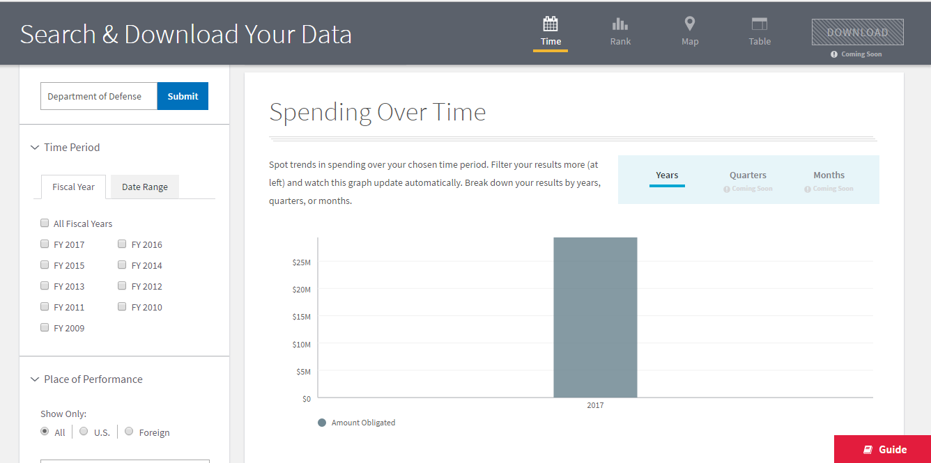
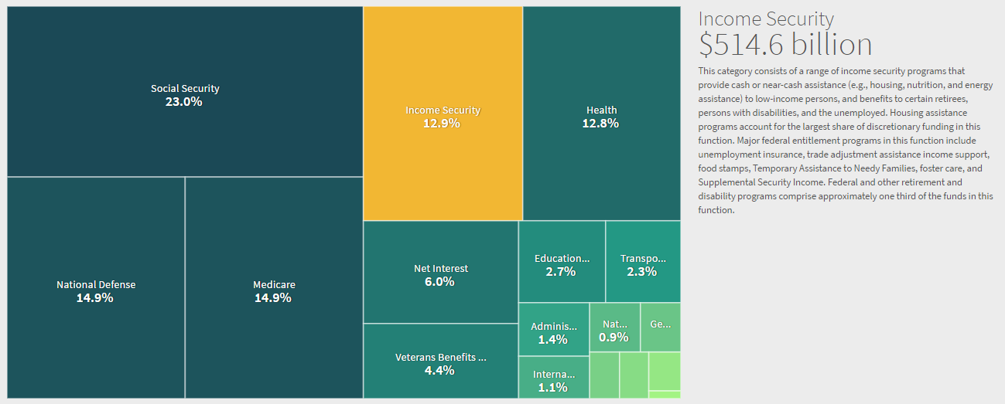
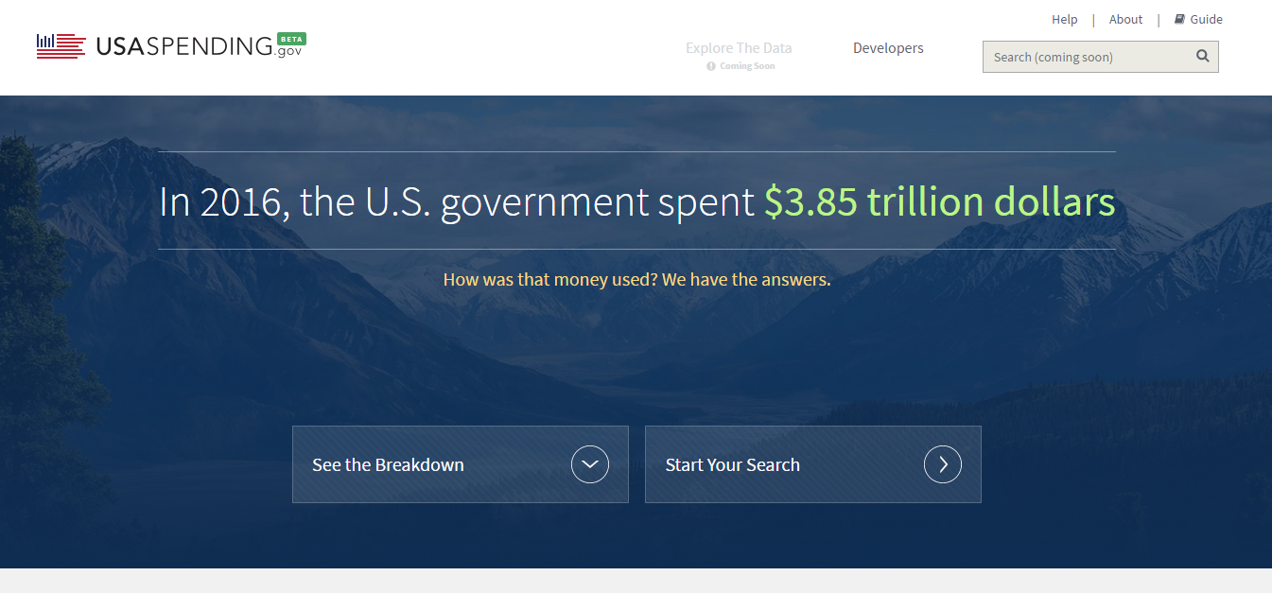
The Website: Beta.Usaspending.gov
On May 9th, 2017, The beta.USAspending.gov website launched with Q2 2017 data
In the fall of 2017, the legacy USASpending.gov website will be decommissioned and formally replaced by the current beta site.
Beta.USAspending.gov

Slide 10
Spending Explorer: Budget Functions

Slide 11
Spending Explorer: Sub-Fuctions

Slide 12
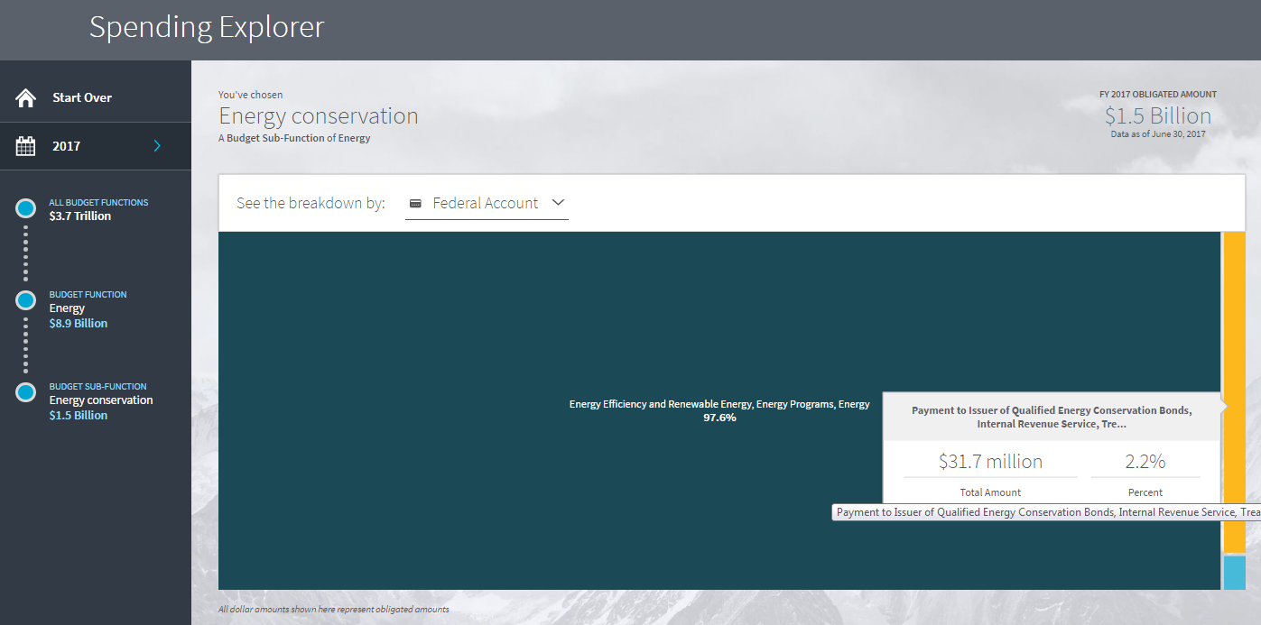
Spending Explorer: Federal Account

Slide 13
Spending Explorer: Program Activity

Slide 14
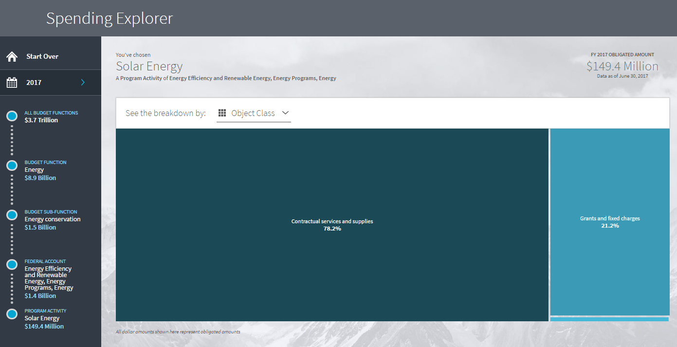
Spending Explorer: Object Class

Slide 15
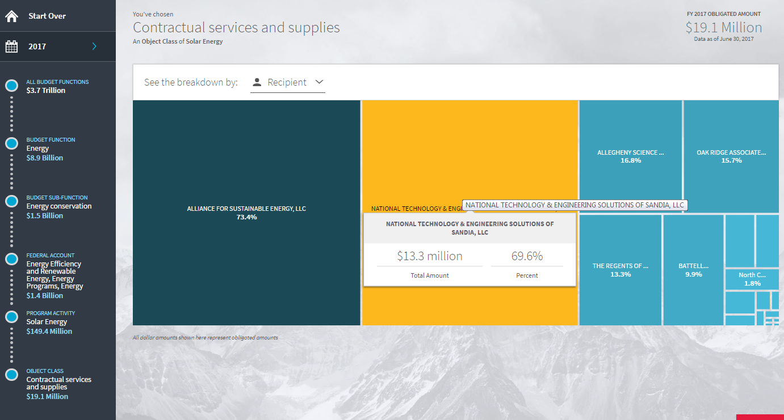
Spending Explorer: Recipients

Slide 16
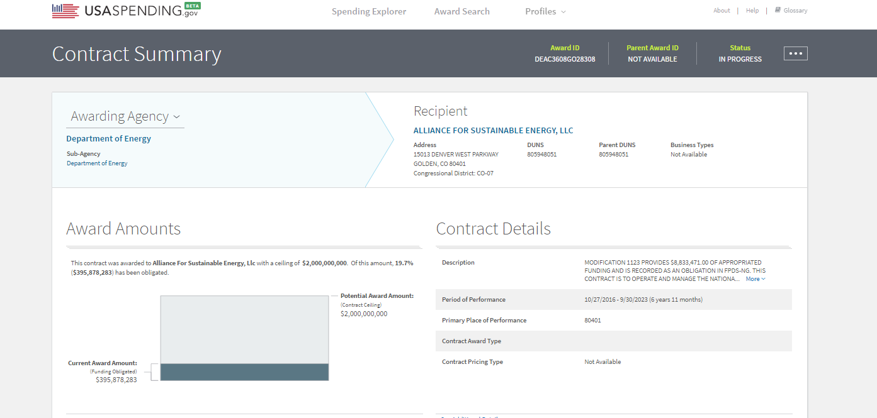
Recipient Summary

Slide 17
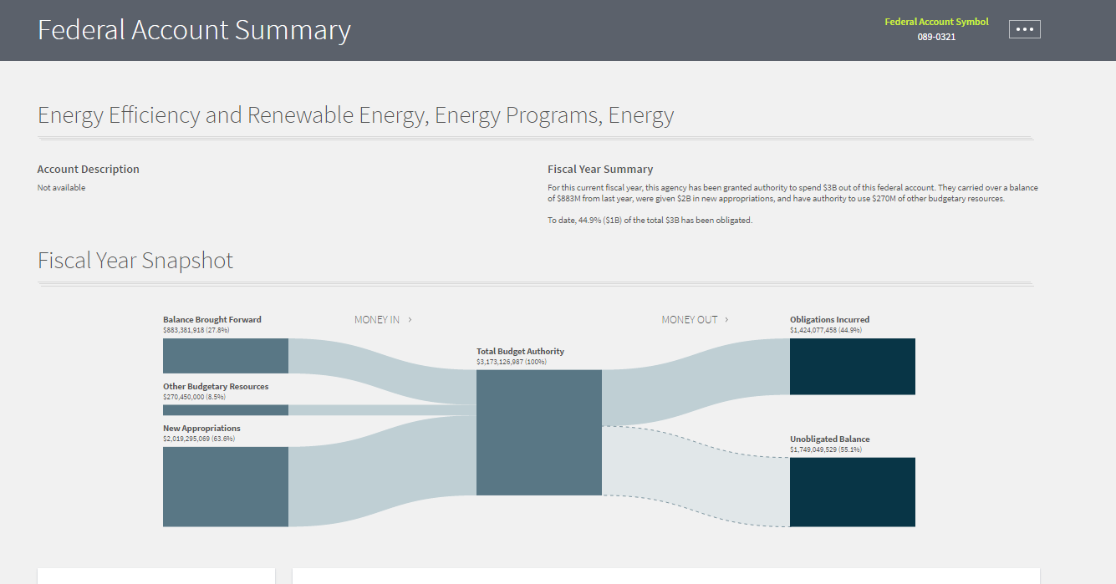
Federal Account Summary Page

Slide 18
DATA Analytics Strategy
Treasury’s DATA Act analytics program aims to “get the data moving,” using a three-part strategy.
1
Partnerships with Agencies
2
Partnerships with States
3
Resources for the Public
Encourage agency accountability and promote the use of data by educating agencies on data quality and assisting them with analytic tools to unlock the value of their information.
Encourage state-level engagement and the use of data by partnering with states and assisting them with analytic tools to unlock the value of the data
Connect the general public with consumable data by educating them on how to leverage and interpret information
Strategic Goals
Develop and implement a framework for DATA Act data visualizations and reporting
Proactively develop analytics use cases and demos showcasing the power of DATA Act data
Connect federal level spending Data with State level data to gain better understanding of the end recipients of funding
Develop trainings and learning materials around the DATA Act data and make it available on a new analytics website
Engage the open data community to promote the use the DATA Act data
Objectives

Slide 19
For More Information:
https://fedspendingtransparency.github.io
https://beta.usaspending.gov/
Notes:
Explain what the agencies and the public can see in USAspending.
Improvements planned for the future.

