Slide 1
Open Budget Survey 2019
GIFT General Stewards Meeting 25 August 2020

Slide 2
The Open Budget Survey
Measures three aspects of open budgets:
Transparency of how public resources are raised and spent,
Opportunities for participation in budget policy decisions, and
Oversight by independent legislatures and audit institutions

Slide 3
The state of global budget transparency
45 out of 100
Global transparency score average OBS 2019
Insufficient
Sufficient

Slide 4
59 out of 100
GIFT transparency score average OBS 2019
Average budget transparency score of GIFT members is just shy of “sufficient”
Insufficient
Sufficient

Slide 5
Distribution of GIFT members across the 117 countries measured in the OBS 2019
Insufficient
Sufficient

Slide 6
Trends on global budget transparency improvements have been mostly positive since 2008.
OBS Assessments | Number of Comparable Countries | Global Average Score Change
OBS 2008 to 2010 | 77 | +3
OBS 2010 to 2012 | 93 | +2
OBS 2012 to 2015 | 100 | +3
OBS 2015 to 2017 | 102 | -2
OBS 2017 to 2019 | 115 | +3

Slide 7
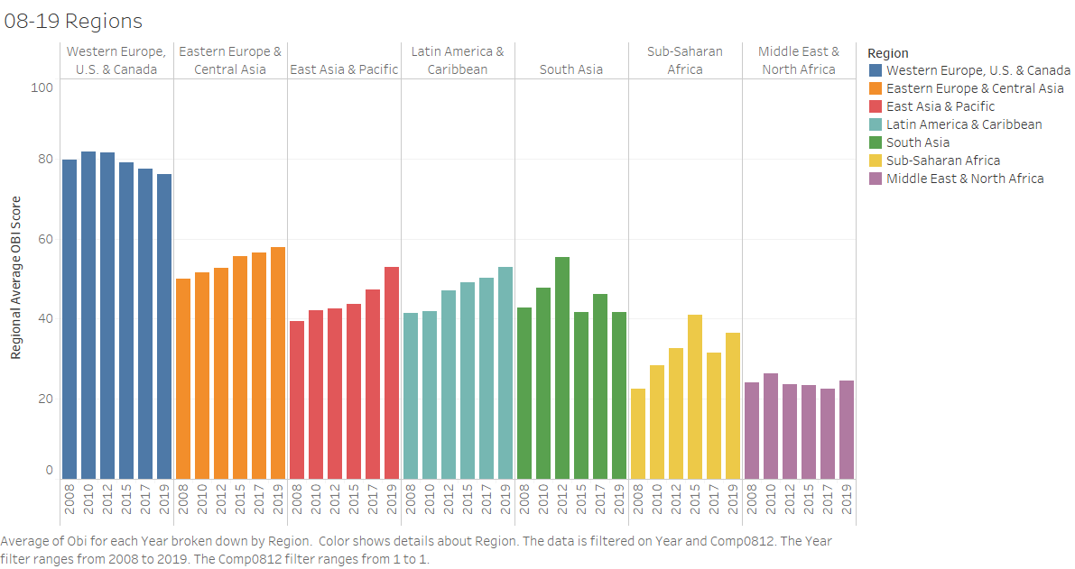
Progress on budget transparency varies by region

Slide 8
The average budget transparency score for GIFT members increased by 3 points between OBS 2017 and OBS 2019
0 members scored moderately lower | 16 members score saw little to no change |  | 8 members scored moderately higher
 | Nigeria Brazil Guatemala Paraguay Mexico Liberia Egypt Costa Rica El Salvador | Georgia United States South Africa Chile Colombia Tunisia Senegal | Croatia (+11) Benin (+10) Mongolia (+10) Philippines (+9) Dominican Republic (+9) Ukraine (+9) Argentina (+8) Indonesia (+6)

Slide 9
GIFT members rank among the top improvers on budget transparency

Slide 10
Key Budget Document | GIFT members
Pre-Budget Statement | 67%
Executive’s Budget Proposal | 100%
Enacted Budget | 100%
Citizens Budget | 71%
In-Year Reports | 88%
Mid-Year Review | 54%
Year-End Report | 100%
Audit Report | 67%
Overall, GIFT Members made 81% of key budget documents available to the public.
Of the documents not made available, more than half were still produced.

Slide 11
Findings on oversight
The Open Budget Survey also examines the roles and responsibilities of formal budget oversight actors:
Legislature
Supreme Audit Institution

Slide 12
Findings on oversight

Slide 13
Findings on participation
The Open Budget Survey examines public participation across the budget cycle and across institutions, using indicators that are aligned to GIFT’s Principles of Public Participation in Fiscal Policies.
On average, GIFT members score 7 points higher than non-GIFT members on public participation.

Slide 14
Participation mechanisms less common during budget implementation

