Slide 1
Public Participation in Fiscal Policy
Principles and selected issues
Murray Petrie
GIFT Lead Technical Advisor
petrie@fiscaltransparency.net
GIFT Stewards Meeting
Mexico City
8 March, 2017
#FiscalTransparency

Slide 2
Overview of presentation
Small changes made to the GIFT Participation Principles
Possible objections to public participation in fiscal policy
Measuring public participation in fiscal policy
Public participation commitments in the Open Government Partnership
2

Slide 3
GIFT’s work program on
public participation in fiscal policy
Originated with GIFT High Level Principle 10
Eight country case studies
A series of workshops 2012-2015
Public consultation in 2015
GIFT Participation Principles approved December 2015
Preparation of Guide to help implement the Principles
Development of indicators to measure participation in fiscal policy
Ongoing work with Open Government Partnership Fiscal Openness Working Group
3

Slide 4
What is the scope of public participation
in fiscal policy?
Covers all fiscal policy and budget making activities:
The annual budget cycle: all stages
Fiscal policy reviews and new policy initiatives outside the annual budget cycle (revenues, expenditures, financing, asset, liability management)
The design and delivery of public services
The planning, appraisal & implementation of public investment projects
Far wider and more varied than ‘participatory budgeting.’
4

Slide 5
5

Slide 6
Small changes made in finalizing the Principles
for inclusion in the Guide
Two minor changes to the text of two principles, and a change to the title of one principle.
A change to the ordering of the principles.
Provide full information on and be responsive with respect to the purpose, scope, constraints, intended outcomes, process and timelines, as well as the expected and actual results of public participation.
6

Slide 7
Minor changes to the text of two Principles
Openness: provide full information on and be responsive with respect to the purpose of each engagement, it’s scope, constraints, intended outcomes, process and timelines, as well as the expected and actual results of public participation.
A change to the title of one principle.
Provide full information on and be responsive with respect to the purpose, scope, constraints, intended outcomes, process and timelines, as well as the expected and actual results of public participation.
7

Slide 8
Minor changes to the text of two Principles
Sustainability: all state and non-state entities conduct on-going and regular engagement to increase knowledge sharing and mutual trust over time; institutionalize public participation where appropriate and effective, ensuring that feedback provided leads to review [delete ‘revision’] of fiscal policy decisions; and regularly review and evaluate experience to improve future engagement.
8

Slide 9
Principle 6 Transparency
Support each public engagement by providing all relevant information, highlighting and informing key policy objectives, options, choices and trade-offs, identifying potential social, economic, and environmental impacts, and incorporating a diversity of perspectives; provide timely and specific feedback on public inputs and how they have been incorporated or not in official policy or advice.
9

Slide 10
Change title of Principle 6 to Depth
The transparency principle has been re-named ‘depth’. This helps to avoid confusion with the openness principle, which also contains elements of transparency.
10

Slide 11
A change to the ordering of the Principles
Principle 5, Accessibility, is about facilitating public participation in general, by disseminating complete and accessible fiscal information. It had been confused with the transparency principle, which in turn had been confused with the openness principle because of the similarity of the terms.
It was therefore decided to re-order the principles, shifting accessibility from 5 to 1.
11

Slide 12
The final set of Principles
1 Accessibility
2 Openness
3 Inclusiveness
4 Respect for self-expression
5 Timeliness
6 Depth
7 Proportionality
8 Sustainability
9 Complementarity
10 Reciprocity
12

Slide 13
Possible objections to public participation
Could undermine representative government
Aim is to complement and strengthen existing governance arrangements and trust in government, not to set up parallel processes.
Culture and long-standing practice of budget secrecy
But policy making more open now, and budget secrecy can be retained where clearly warranted by public policy e.g. to avoid adverse behavioral responses.
Concerns that fiscal policy should be left to the experts
But open engagement of external experts is one of mechanisms proposed.
Fiscal policy involves ethical and distributional choices that should not be the sole preserve of ‘experts’.
Fiscal policy is inherently political and will not be left to experts in any case.
13

Slide 14
Possible objections to public participation (2)
Public engagement takes time, slows down the policy process
Participation is a right
It can help avoid policy reversals, and improve policy quality
Public participation is costly
But the ICT revolution has dramatically cut the cost of direct engagement with citizens, and created completely new possibilities for interactions.
Public participation a means for government to tap into the information, insights and perspectives distributed throughout society, lowering the cost and improving effectiveness of research, policy development, monitoring, review, evaluation
Resource costs are recognized in the Principles e.g. proportionality.
14

Slide 15
Measuring participation:
The 2017 Open Budget Survey
Public participation was added to the survey for the 2012 survey
Following development of the GIFT Participation Principles, the IBP has fundamentally redesigned the OBS questions so that they measure practices against the GIFT principles
Results from the 2017 OBS likely to be available early 2018
15

Slide 16
Measuring participation:
The 2017 Open Budget Survey
a) Public Engagement by the Executive
Formulation and Implementation phases
Principles of inclusiveness, timeliness, sustainability, complementarity and transparency
b) Public Engagement by the Legislature
Pre-budget, approval and monitoring phases
Principles of inclusiveness, transparency and complemetarity
c) Public Engagement by the Supreme Audit Institution
Audit program design and investigations
Principles of transparency & complementarity
16

Slide 17
Measuring participation:
Pilot Supplementary PEFA Indicator
One indicator covering four dimensions of fiscal policy:
Public participation across the annual budget cycle:
Budget preparation and Legislative approval
Public participation in the design and delivery of public services (two of largest sectors)
Public participation in the appraisal and implementation of public investment projects (sample of largest projects)
Public participation in oversight processes (legislative review and Supreme Audit)
Scores of a - d defined for each of the 4 dimensions.
Piloted in South Africa (Global Integrity) and in the Philippines
17

Slide 18
Citizen-centred OGP Commitments:
some examples from first Action Plans
Guatemala: citizen participation in monitoring public procurement
Philippines: institutionalize citizen-participatory audits
Dominican Republic: publish data on public complaints at the level of individual government agencies
Peru: improve mechanisms for public consultation on budget preparation, approval, implementation and reporting
Ghana: prepare guidelines to deepen CSO participation in budgetary processes
Finland: promote participatory budgeting
18

Slide 19
Citizen-centred OGP Commitments:
Mongolia’s current Action Plan
Commitment 2: improve the quality of and access to education and health services by providing more accessible information and introducing social accountability and constructive engagement between citizens and service providers
Commitment 9: with respect to the ‘Glass Account’ system, publish more granular data, and strengthen government’s capacity to respond to feedback and complaints from citizens and CSOs
19

Slide 20
Promoting public engagement in fiscal policies
through the OGP’s Fiscal Openness Working Group
The FOWG objectives are, through regular regional meetings, to:
Provide a platform for peer to peer sharing and learning among OGP members on fiscal openness
Offer OGP members efficient and coordinated access to international good practices, tools, norms, assessments, and technical expertise on fiscal openness
Support OGP members to implement their fiscal openness commitments, and develop even more ambitious fiscal openness goals and good practices including perhaps common/shared goals
Motivate additional governments to become champions and models of fiscal openness. See materials at http://www.fiscaltransparency.net/fowg/
20

Slide 22
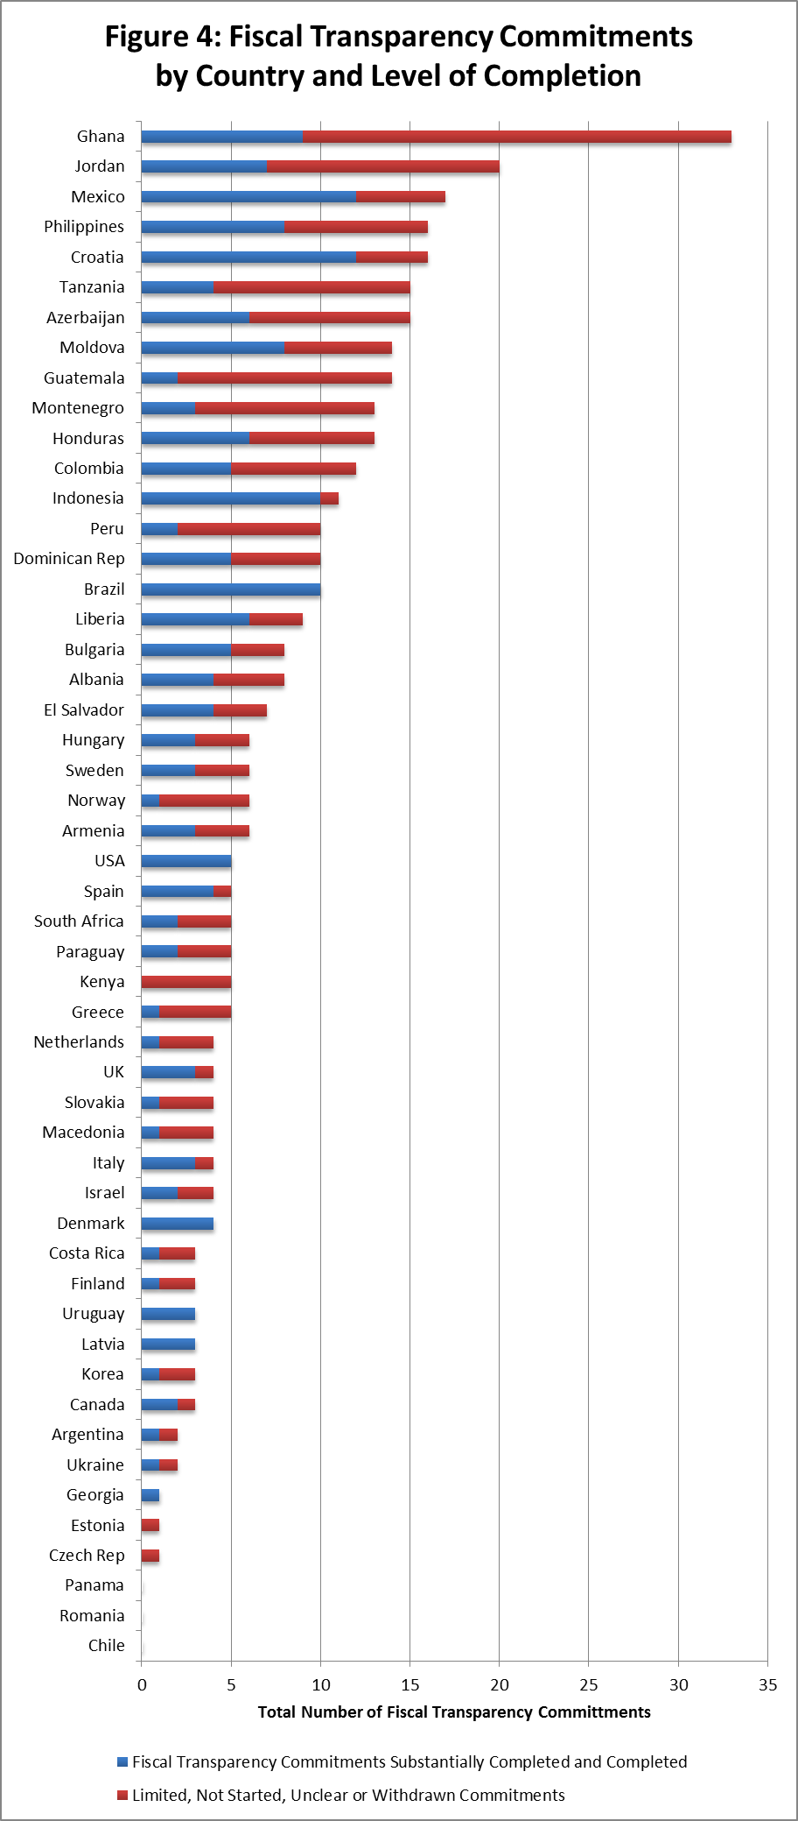

Slide 23
Some Issues for Discussion
The final changes to the participation principles
The scope in your country for developing an ambitious commitment(s) involving direct public engagement in fiscal policy design or implementation e.g. procurement, service delivery (‘citizen-centred fiscal transparency’)
What can GIFT do to support development and implementation of public participation commitments?
23

Slide 24
Engage with us
@FiscalTrans
fiscaltransparency.net

