Slide 1
Transparency in Paraguay
Presenter: Lea Gimenez
Deputy Minister of Economy and Integration – Ministry of Finance
Fiscal Transparency Commitments in OGP’s National Action Plans Workshop - GIFT
June 2016

Slide 2
1- Access to information

Slide 3
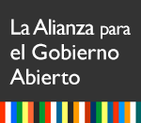
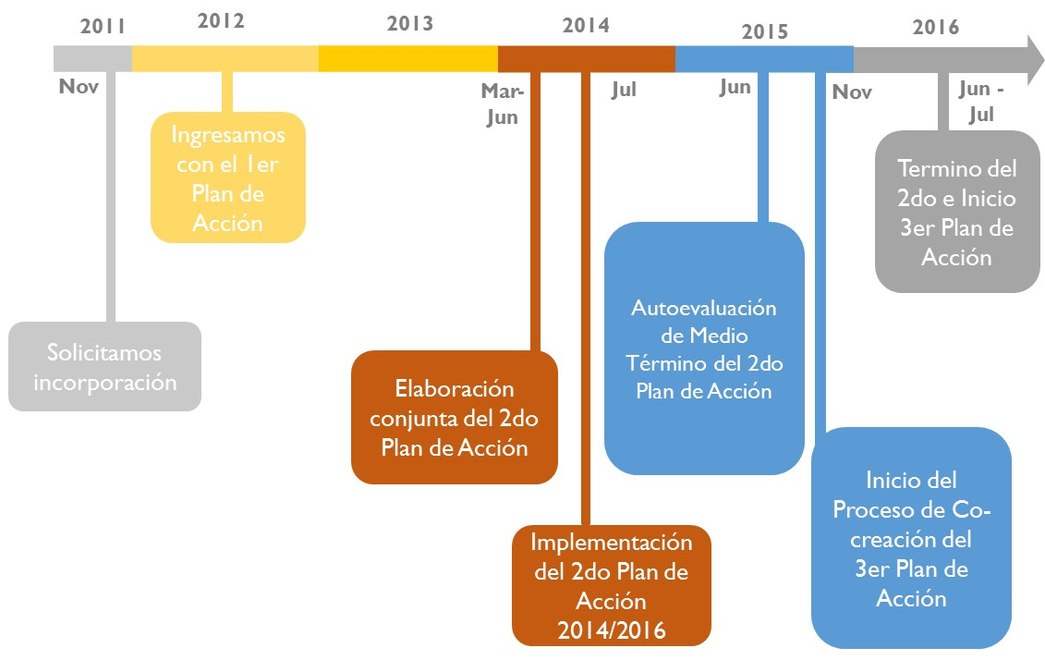
The country made important commitments to transparency and accountability of public management
…convirtiéndose en miembro de la iniciativa internacional “Alianza para el Gobierno Abierto“ (AGA)…
Área Participación Ciudadana
Área Rendición de Cuentas
Área Transparencia
...y elaborando el Planes de Acción de Gobierno Abierto...
Notes:
En 2011, Paraguay se convirtió en miembro de la iniciativa internacional "Asociación de Gobierno Abierto", que busca establecer en un gobierno, la interacción de la sociedad basada en valores como la transparencia, la colaboración, la participación, la responsabilidad, la potenciación de los ciudadanos y la integración.

Slide 4
These commitments were embodied in legal instruments ...
Ley Nº 5189/2014
“Que establece la obligatoriedad de la provisión de informaciones en el uso de los recursos públicos sobre remuneraciones y otras retribuciones asignadas al servidor público de la República del Paraguay”
“De libre acceso ciudadano a la información pública y transparencia gubernamental”
Decreto Nº 4064/2015
Ley Nº 5.282/2014
Reglamenta la Ley 5282 y establece, entre otros, la conformación de Oficinas de Acceso a la Información Pública y la creación de un Portal Unificado de Información Pública.
Notes:
A partir de los compromisos asumidos, Paraguay promulga las leyes de acceso a la información pública y establece un esquema de trasparencia gubernamental.

Slide 5
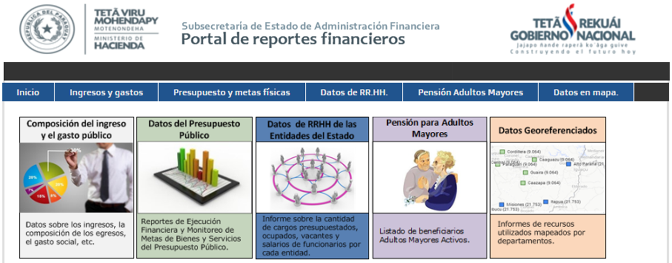
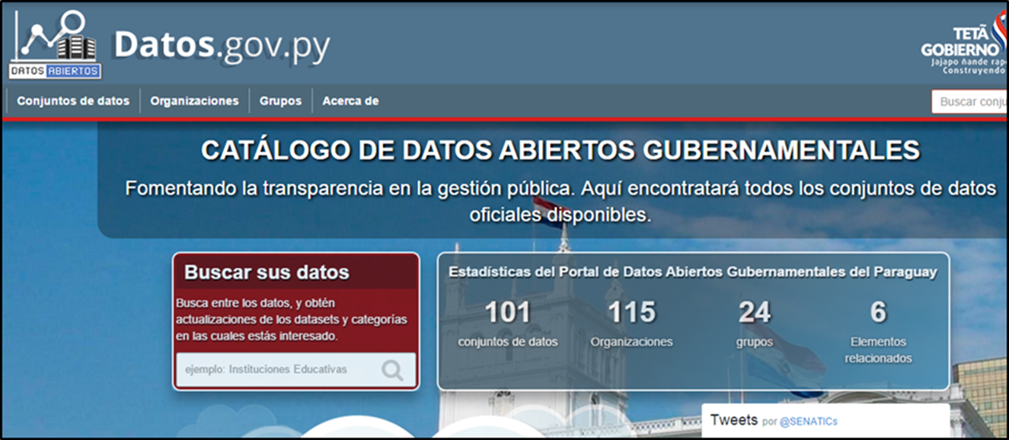
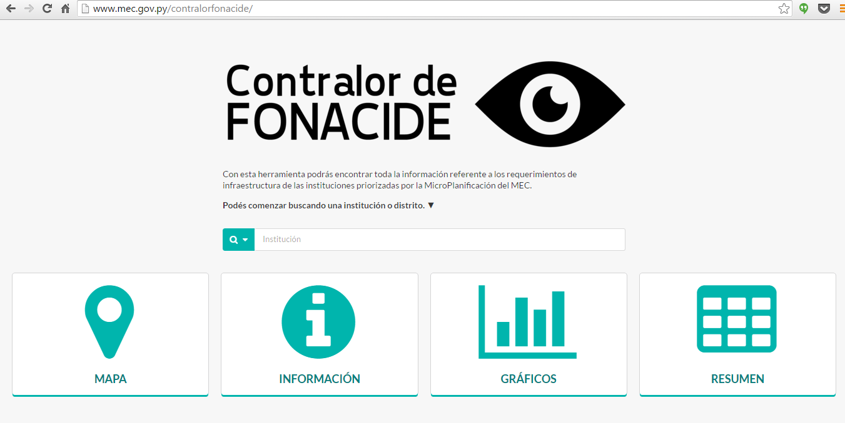
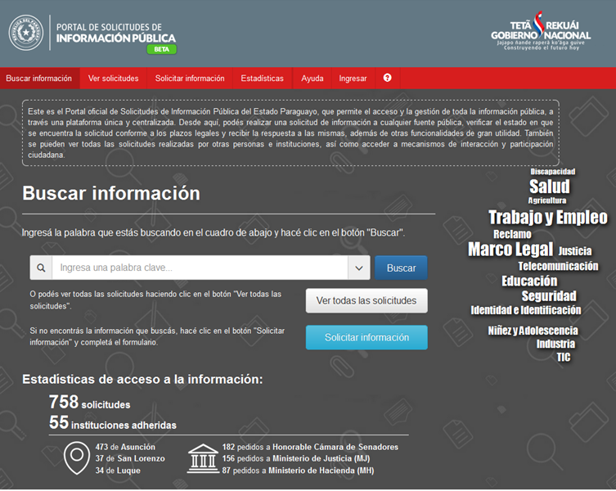
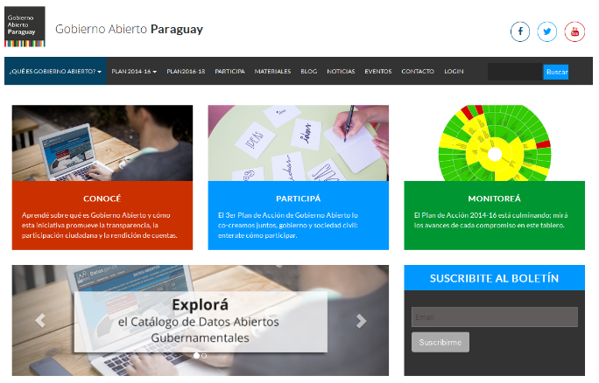
... tools and processes ...

Slide 6
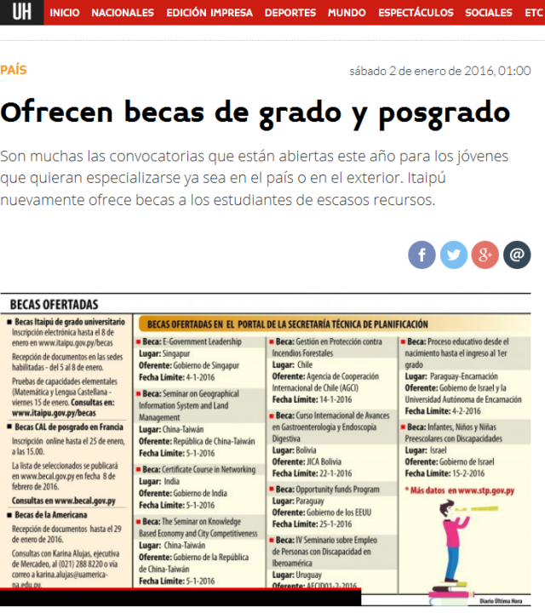
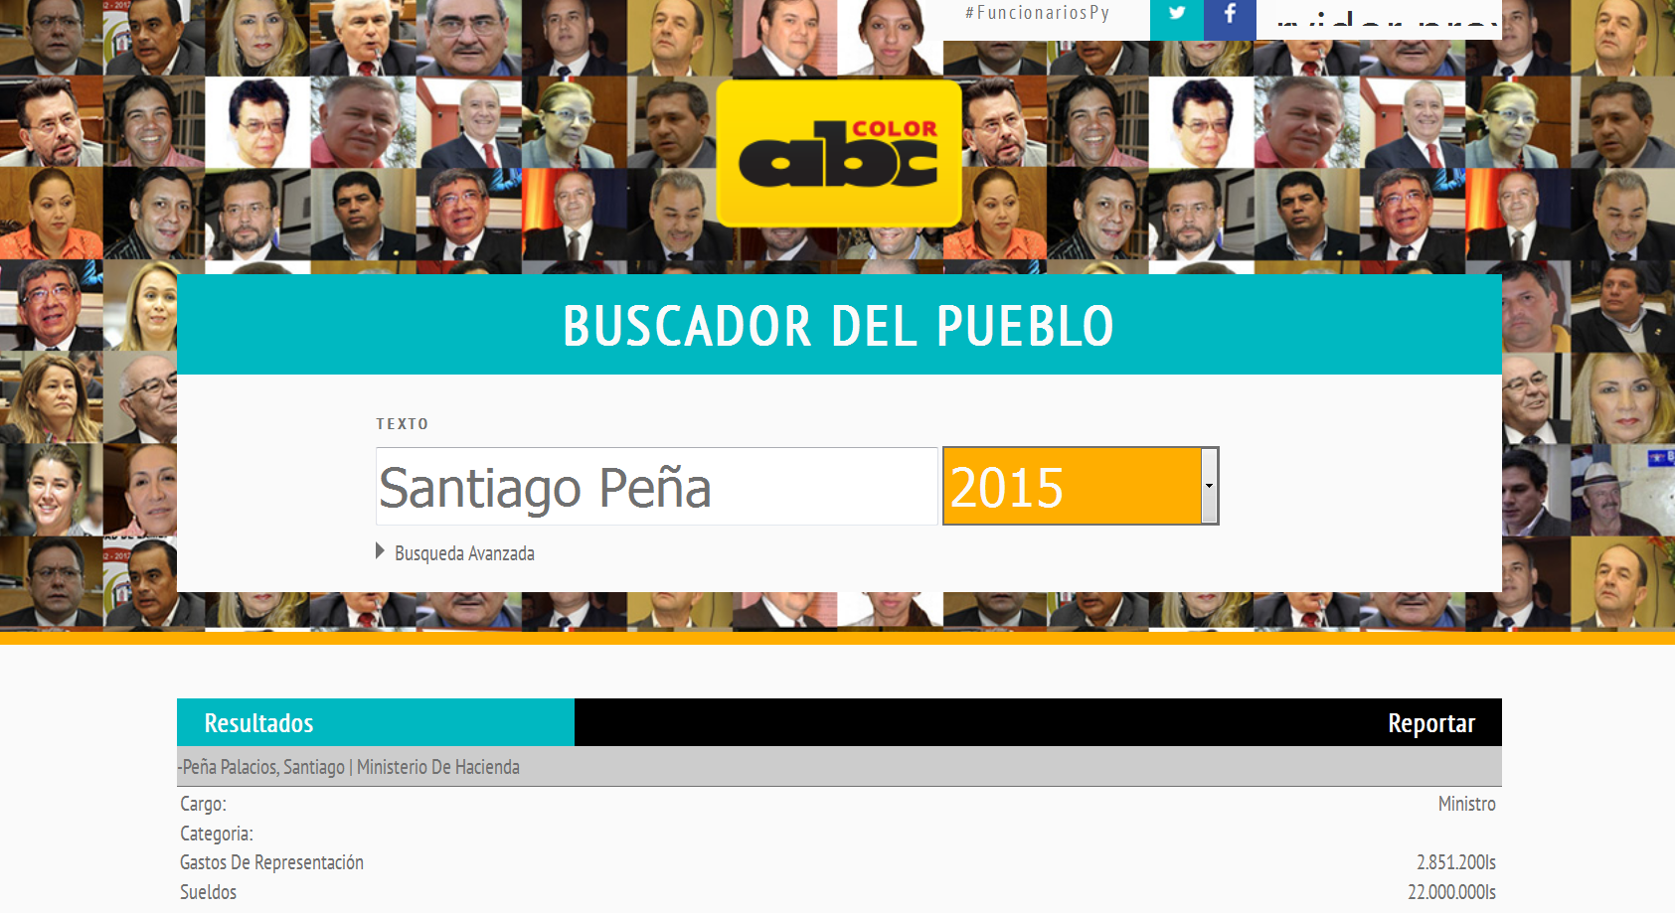
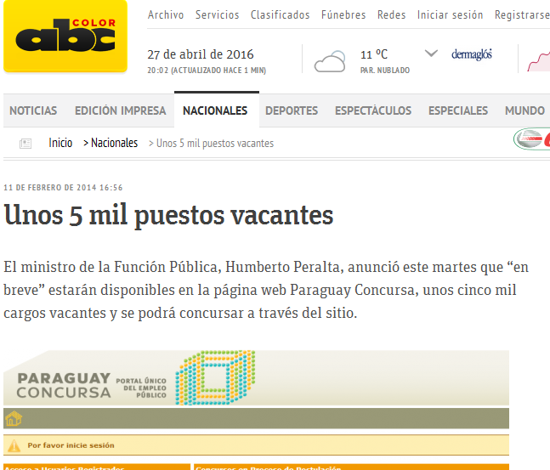
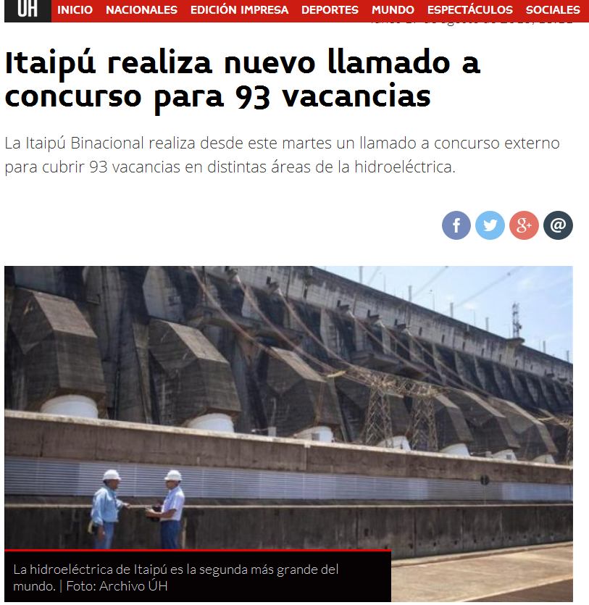
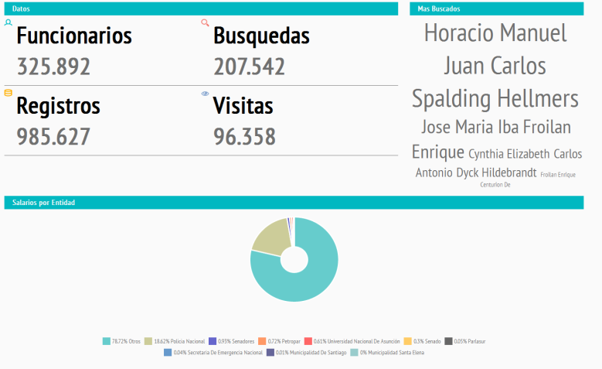
... that allowed citizens have unprecedented opportunities to access, share and disseminate information

Slide 7
2- Citizens’ participation and the creation of a critical mass

Slide 8
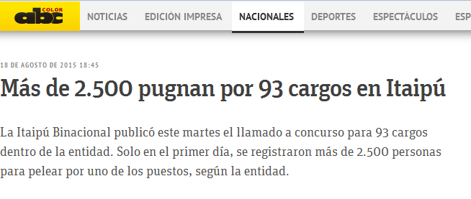
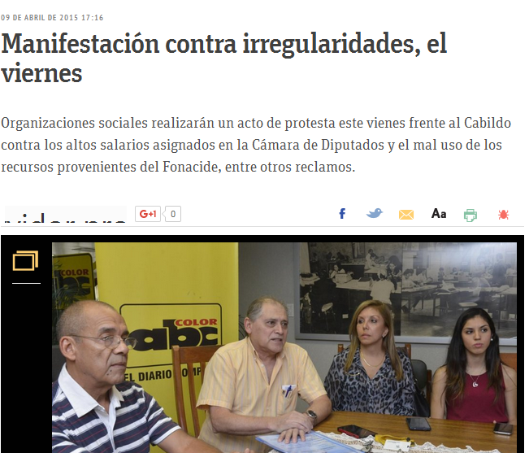
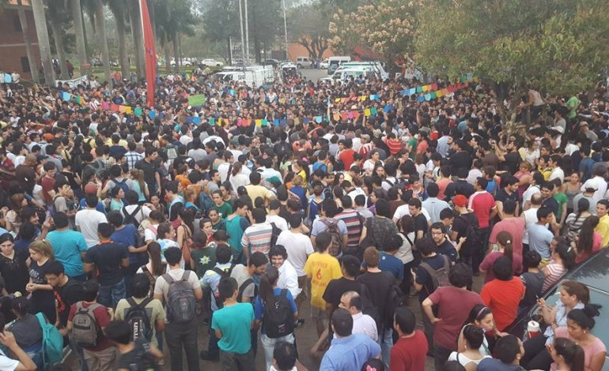
Citizens reacted overwhelmingly and immediately ...

Slide 9
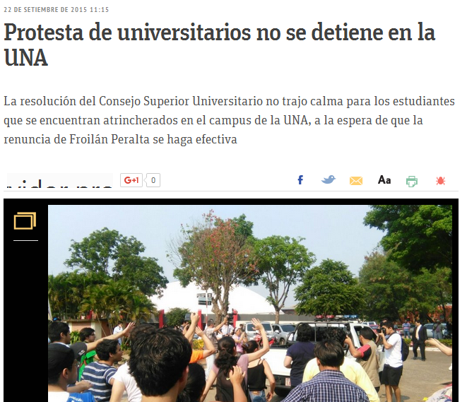
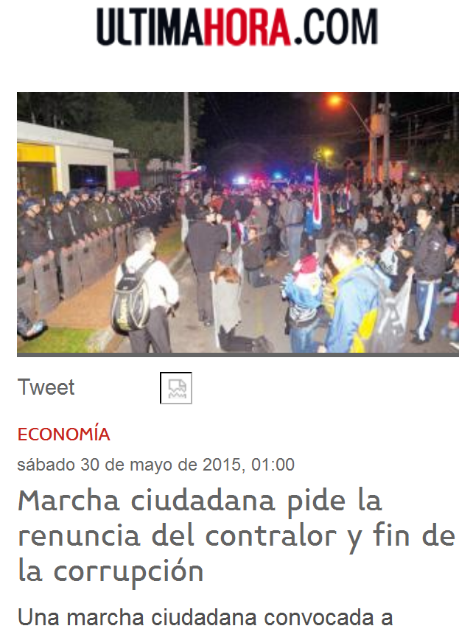
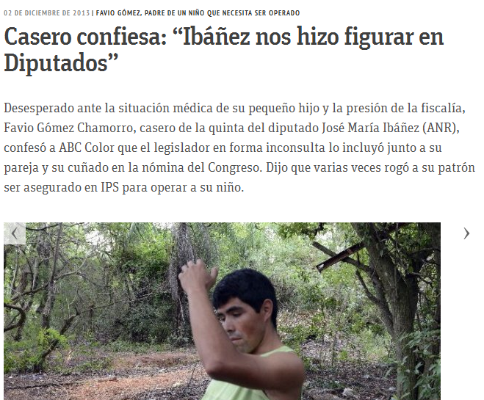
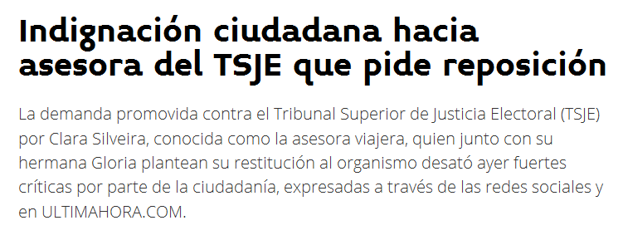
... They were urged to speak out against acts of corruption ...

Slide 10
3- Results

Slide 11
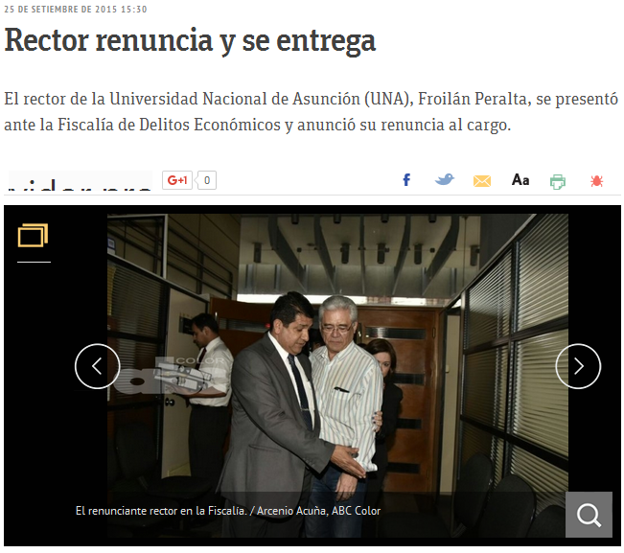
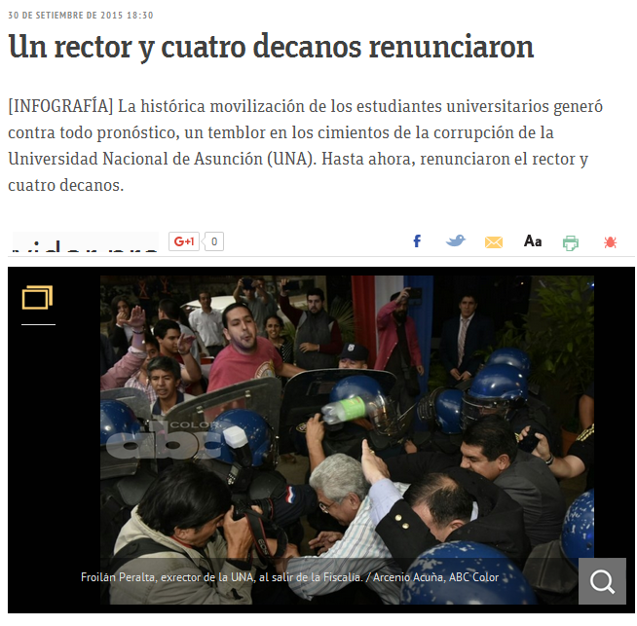
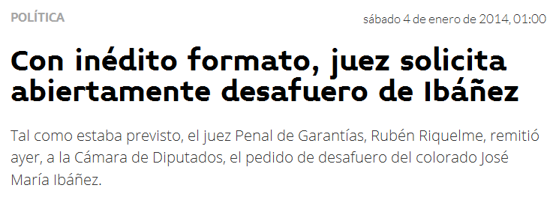
The public reaction to cases of corruption had immediate and historical results

Slide 12
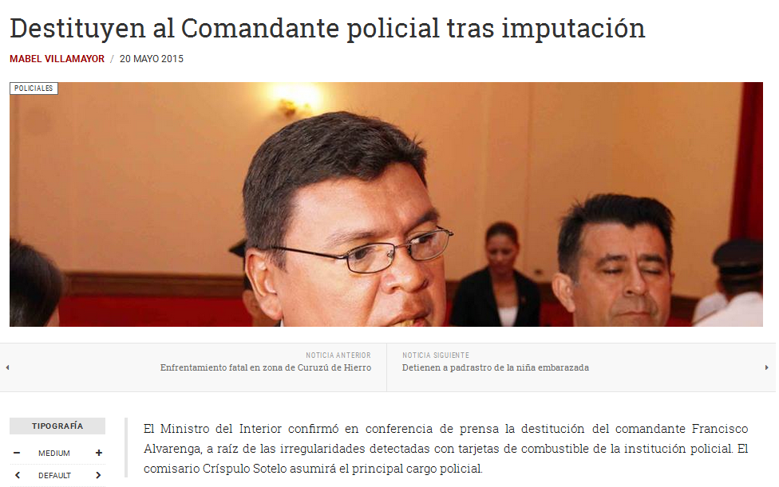
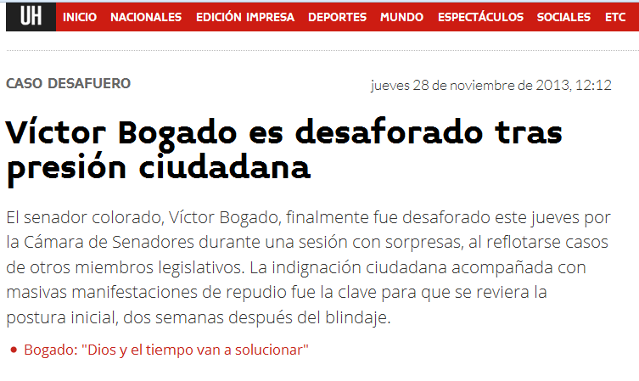
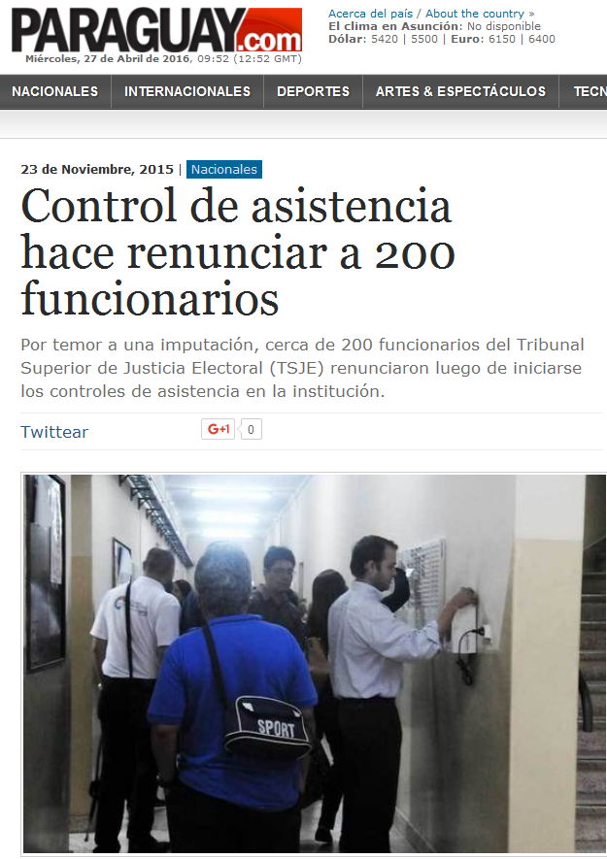
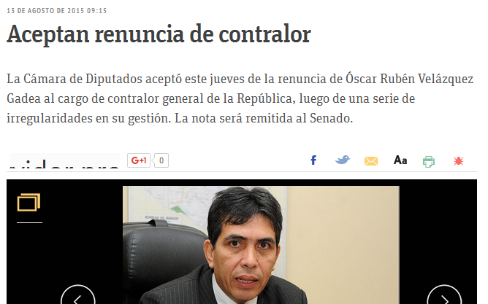
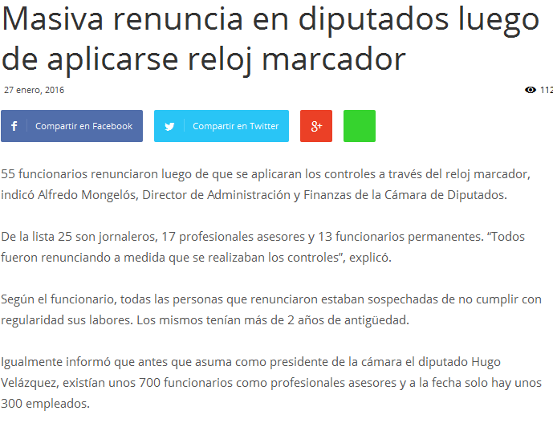
... people and groups considered "untouchables" in the past were reached by public pressure ...

Slide 13
Paraguay embarked on a process named by the press as the “Information Spring”
For the first time IN HISTORY, the government of Paraguay made de citizens the real comptroller of public funds.
With this, Paraguay initiated a process of:
transparency of cost,
strengthening administrative control and public procurement, and
increasing penalties for misuse of public funds.

Slide 14
In recent years, the "rules of the game" in Paraguay have been changed drastically.
This commitment to transparency has had a domino effect. This commitment represents a structural change that will be very difficult to undo.
The country has made a genuine commitment to the democratization of information, to growth with social inclusion, and to having an empowered civil society.
Citizens are hungry for more.

Slide 15
Annex 1: Open Government Action Plan 2014-2016

Slide 16
Open Government Alliance
1
“A more accessible, participatory and transparent government, permanently interacting with people” – Open Government Vision in Paraguay.
In Nov-2011 Paraguay requested its incorporation in the Open Government Partnership.
The Government set up an Action Plan for 2014-2016.
The Open Government Action Plan for 2014-2016 contains 3 thematic areas and 9 commitments.
These 3 thematic areas are the following:
Transparency
Public Participation
Accountability

Slide 17
Open Government Action Plan 2014-2016
2
The commitments to transparency are:
The introduction and implementation of the “Law of Free Access to Public Information and Government Transparency” – enacted in Sep-2014.
Design and implementation of a policy to digitize and open up government data.
Building capacity among citizens to monitor public sector budget management .
Transparency and access to information of landmark public projects.
Monitoring the 2014-2016 Action Plan for Open Government.

Slide 18
Open Government Action Plan 2014-2016
3
The commitments to civic participation are:
Implementation of channels for social dialogue and citizen participation through consultation and monitoring of public policies.
Creation and strengthening of 50 Municipal Development Councils.
The commitments to accountability are:
Citizen Control Board of the National Program for Poverty Reduction.
Creation of a Legal Procedures Electronic System for public access to public procurements.

Slide 19
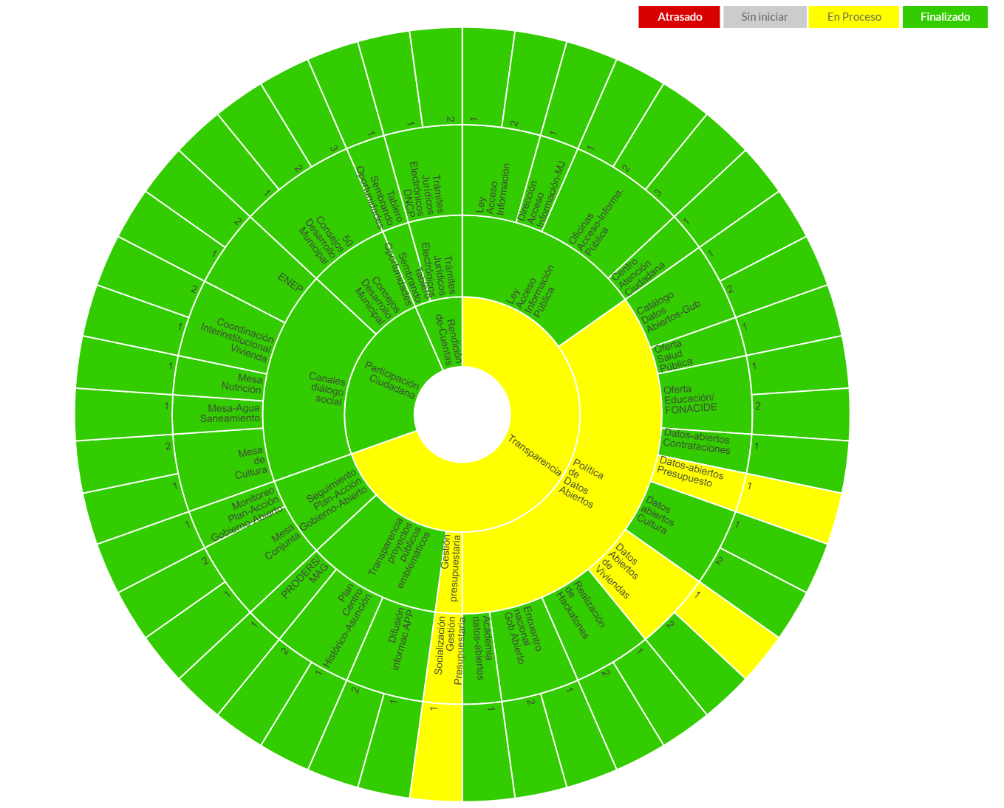
Open Government Action Plan 2014-2016: Where are we now?

Slide 20
Annex 2: Draft Open Government Action Plan 2016-2018

Slide 21
Open Government Action Plan 2016-2018
4
The Draft Open Government Action Plan for 2016-2018 is now available online.
The Open Government Action Plan for 2016-2018 contains 10 commitments:
Increase citizens and civil society’s ownership of the Free Access to Public Information Law and Open Government Principles as a means for improving standards of living.
Continue implementation of open data policy through civil society capacity building (use of data) – Ministry of Finance.
Improve citizens’ monitoring of public works and services – Ministry of Finance.
Increase government accountability by making available to the public timely data, reports and tools for monitoring the government’s activities and management of public resources.
Strengthening citizen participation in the design of public policies at the municipal and departmental levels.

Slide 22
Open Government Action Plan 2016-2018
5
The Open Government Action Plan for 2016-2018 contains 10 commitments:
Improving the quantity and quality of public information available on the environment and natural resources.
Improving the quality of public health services.
Citizen participation in monitoring and control of investments in education (FONACIDE, school kits and scholarships) – Ministry of Finance.
Citizen and private sector participation in activities aimed at poverty reduction.
Improving citizen control capabilities.

Slide 23
Open Government Action Plan 2016-2018
6
The Actions for 2016-2018 in which the MF is involved, are the following:
Interactive Technological Tool (web and mobile) to improve citizens’ monitoring of budget, budget execution, payroll, public debt, public investment, and land registry.
Promote dissemination and citizens' use of open data from the MF.
Develop Platform “Comptroller FONACIDE” with data on school meals, data linked to public procurement (DNCP), reports of the Comptroller General (CGR) and the Ministry of Finance (MF), including a citizen control module via a mobile app.
Key stakeholders: educational and media communities.

Slide 24
Annex 3: Open Government Action Plan - MoF

Slide 25
Fiscal Transparency in the Ministry of Finance
7
BOOST Paraguay
In 2013, the Ministry of Finance adopts BOOST Data Base.
Paraguay was the first country in Latin America and the Caribbean in disseminating budget data using BOOST, under World Bank´s Public Expenditure Review.
BOOST is a tool that consolidates information about country’s public expenditures at the most disaggregated level possible, and presents it in a friendly format through a PivotTable.
Allows easy access to a large amount of data.
Expands the possibilities for analysis of and can be used to improve the quality and efficiency of public expenditures.
Able to support the efforts of governments in the area of budget transparency by facilitating public expenditure analysis by various actors in society.

Slide 26
Fiscal Transparency in the Ministry of Finance
8
System Provision of Information and Reports – SIPR (for its acronym in Spanish):
SIPR is a tool that is integrated into the Integrated Financial Management System (SIAF – for its acronym in Spanish), which generates structured information in a management level.
It provides reports for Control Bodies and structured information to promote Citizen Participation and Social Control of public management.
SIPR components are:
Tools to facilitate data analysis.
Provision of information to authorities and civil society.
Interfaces between Marangatú (Tax Administration System), SOFIA (Customs Administration System) and SIAF.
Generation of audits trails.

Slide 27
MF commitments for greater transparency
9
From 2015 the MF publishes its Financial Information using the GSFM 2001.
Paraguay has just been accepted to become a Member of the OECD´s Global Forum on Transparency and Exchange of Information for Tax Purposes.
Paraguay has also adhered to Article IV of IMF Standard for Data Dissemination.
IMF´s press release regarding its 2006 Mission to Paraguay in Feb-2016 stated:
“The authorities are moving forward with welcome reforms to enhance financial supervision (…) With the introduction and implementation of the Law of Free Access to Public Information, the authorities have begun to establish much greater transparency in public processes to increase public accountability and strengthen governance. This is an important step to improve the quality of institutions in Paraguay on a lasting basis.”

Slide 28
Challenges ahead for greater transparency
10
Next steps:
Civil society capacity building in the use of data.
Citizen participation in monitoring and control of investments and expenditures (Tablero de Control Ciudadano, Contralor de Fonacide with App).
Make available to the public the Budget Bill, not only during its discussion in Congress but also throughout the fiscal year.
Make available to the public a simple and clear summary of the Budget Bill and the Approved Budget, written in language accessible even to non expert audience.
Annual Budget Execution Report, available to the public within six months from the end of the relevant fiscal year.

