Slide 1
Guide to the Principles of
Public Participation in Fiscal Policy
Olivia Radics & Tania Sanchez
Lead Stewards’ Meeting, Washington D.C.
June 20-21, 2016
#FiscalTransparency

Slide 2
Origins of the Guide
GIFT High Level Principle 10 asserts citizen right to direct participation in fiscal policy:
“Citizens and non-state actors should have the right and effective opportunities to participate directly in public debate and discussion over the design and implementation of fiscal policies.”
GIFT’s work program is to address gaps in norms on how governments should engage the public.
Work program includes:
Eight country case studies;
A series of workshops between 2012 and 2015;
Public consultation process in 2015;
Drafting and approval of the GIFT Principles of Public Participation in 2015-2016.
Preparation of an associated Guide to help implement the Principles in practice.
2

Slide 3
Aim and Structure of the Guide
Aim of the Guide is to aid the implementation of the GIFT participation principles through practical examples and step-by-step explanation of functioning mechanisms.
A catalogue of viable approaches to integrate public participation into fiscal policy.
Six practices have been selected as the initial group of cases, with a view to add further examples to these practices over the next year.
Guide takes the form of a PDF version as well as an online, multimedia platform.
3

Slide 4
Audience
Ministries of Finance and other central government executive departments or ministries;
Legislative committees engaged in the formulation and review of the budget;
Citizens and community members interested in engaging in the way public funds are raised and used;
Civil society organizations, private sector entities, research institutes and academics that are actively seeking to engage with governments.
4

Slide 5
Work Program and Timeline for Guide
Project team within GIFT Support Unit started work on the drafts for a first group of six practices (February – June 2016).
External Review Group has been established and is consulted on the drafts and the development of the online platform. Members include:
MoF officials;
Officials representing the Lead Stewards (IMF, World Bank);
CSO specialists.
First draft of initial six case studies is to be completed by June 2016.
Online platform development: June – September 2016.
First Edition of Guide to be ready for October 2016 launch of GIFT Participation Principles.
5

Slide 6
Practices
Public Participation in School Infrastructure and Equipment Projects in Mexico
Bottom Up Budgeting in the Philippines
Public Policy Councils in Brazil
Experts’ and Civil Society Pre-budget Consultations through the Fiscal Policy Commission in Croatia
The House of Commons Standing Committee on Finance Pre-budget Consultation Exercise in Canada
Top-Down Budgeting: Advisory Committees in the Budget Preparation and Evaluation in South Korea
6

Slide 7
Contents of the Guide
The template for each practice is as follows:
Introduction
Mechanism Implementation
2.1 Stage in the Budget Cycle and Branch of Government
2.2 Establishment and Objectives
2.3 Public Participation Process
2.4 Results
Lessons Learned and Conditions for Success
Principles of Public Participation in Fiscal Policy
Factors to Consider When Selecting a Mechanism
5.1 Fact Sheet
5.1.1 Type of Government
5.1.2 Brief Description of Civic Space
7

Slide 8
Example
The House of Commons Standing Committee on Finance Pre-budget Consultation Exercise in Canada.
Budget cycle: Formulation.
Branch of government: Legislature.
This is the most visible part of engagement for Parliament in the pre-budget process. The House of Commons Standing Committee on Finance receives witness testimony and online submissions following a press release that calls for public submissions and sets the agenda for the annual pre-budget consultation exercise.. An annual public report is drafted, highlighting recommendations tied to the consultation exercise. In 2016, the Committee heard from 92 witnesses and received 175 written submissions from individuals.
8

Slide 9
Example
Introduction
Standing Committee of Finance pre-budget consultation exercise was launched in the mid-1990s
Considered to be the most consistent and visible avenue for public participation in the federal budget process in Canada.
Mechanism Implementation
2.1 Engages the legislative branch at the budget formulation and enactment stage.
2.2 Finance Committee was created with a mandate to “examine and enquire into all matters referred to it by the House of Commons, to report from time to time” and “(…) to send for persons, papers, and records” and to consider the budgetary policy of the government. In each parliamentary session, the Committee’s work may include pre- budget consultations, launched in 1993-1994.
2.3. Press release announces the pre-budget consultation process and invites written and oral submissions around a number of priority themes. Both online submissions and oral testimony – at public hearings in the capital and major cities – are accepted. Results of the consultation process are published along with the recommendations of the Committee.
2.4 In 2016, the Committee heard from 92 witnesses and received 175 written submissions from individuals.
9

Slide 10
Example
Lessons Learned and Conditions for Success
Unclear how representative or diverse the groups and individuals participating in the process are.
No efforts made to include marginalized groups.
Fixed timeframe makes it hard for some to participate.
Discussion is guided by pre-set topics.
Report is tabled too late in the budget process to have real impact.
Decisions of the Committee are formed along party lines.
10

Slide 11
Example
Principles of Public Participation
The mechanism illustrates the following principles in action, to varying degrees:
Respect for self-expression;
Transparency;
Complementarity;
Inclusiveness;
Timeliness.
11

Slide 12
Example
Factors to Consider When Selecting a Mechanism
5. 1 Type of government: Parliamentary democracy.
5.2 Civic space: Generally free and showing steady growth, with some setbacks in the 2010s.
12

Slide 13
Guide Online Platform
Type of audiences
User friendly
3. Time efficiency (Search filters)
Mapped case
5. Organizing Criteria:
- Budget cycle
- Public Participation Principle
6. Exportable report
13

Slide 14
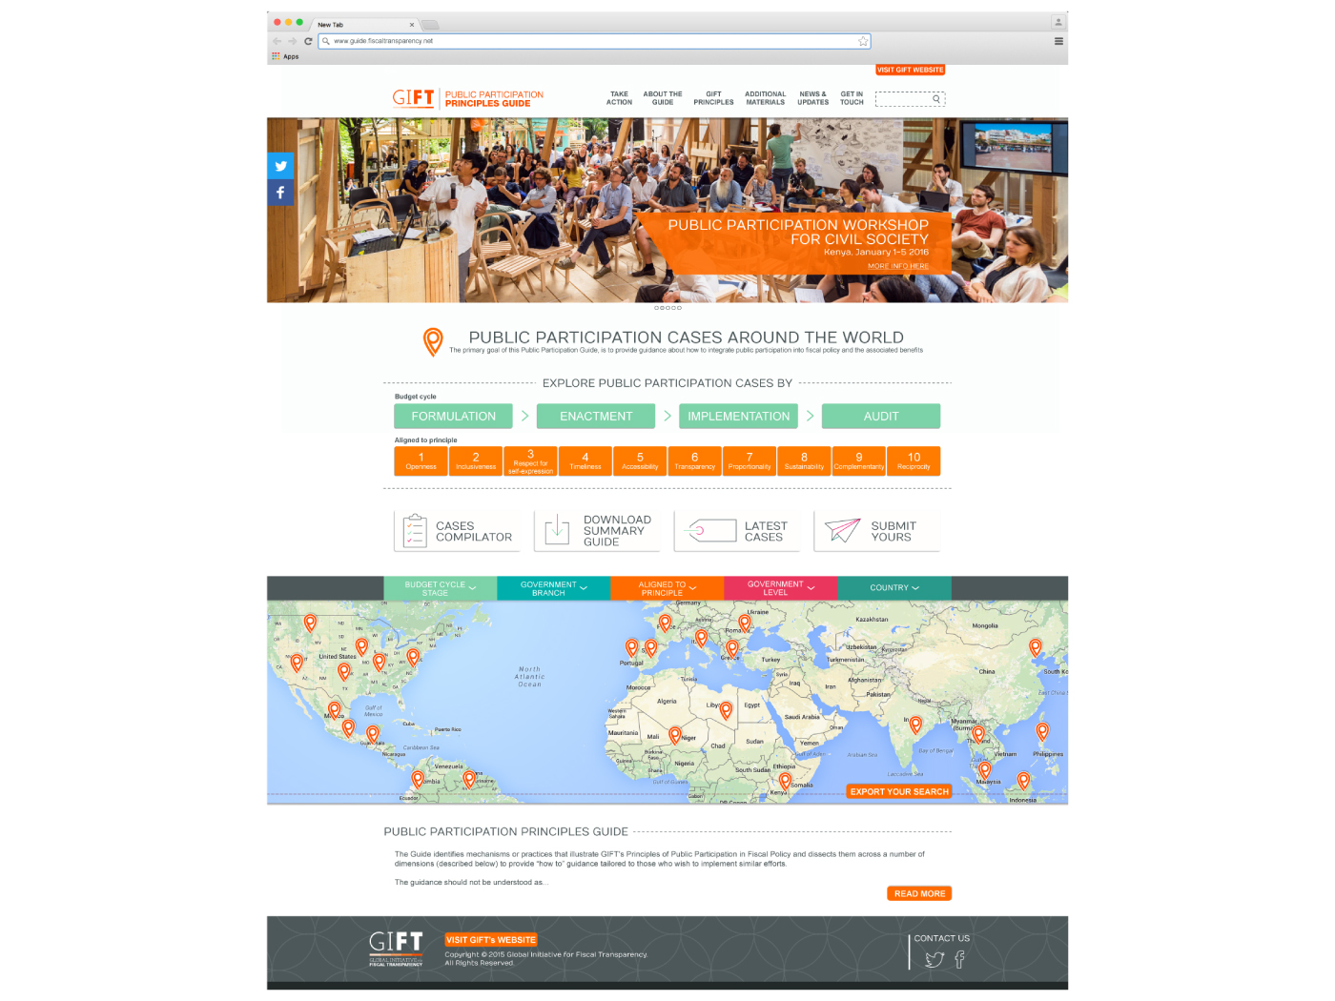
14

Slide 15
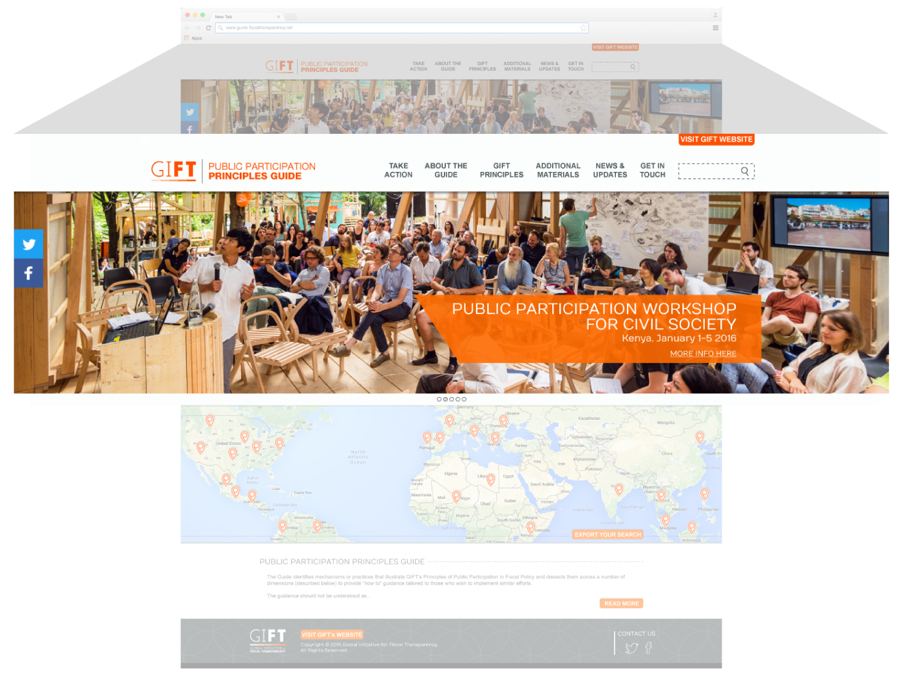
15

Slide 16
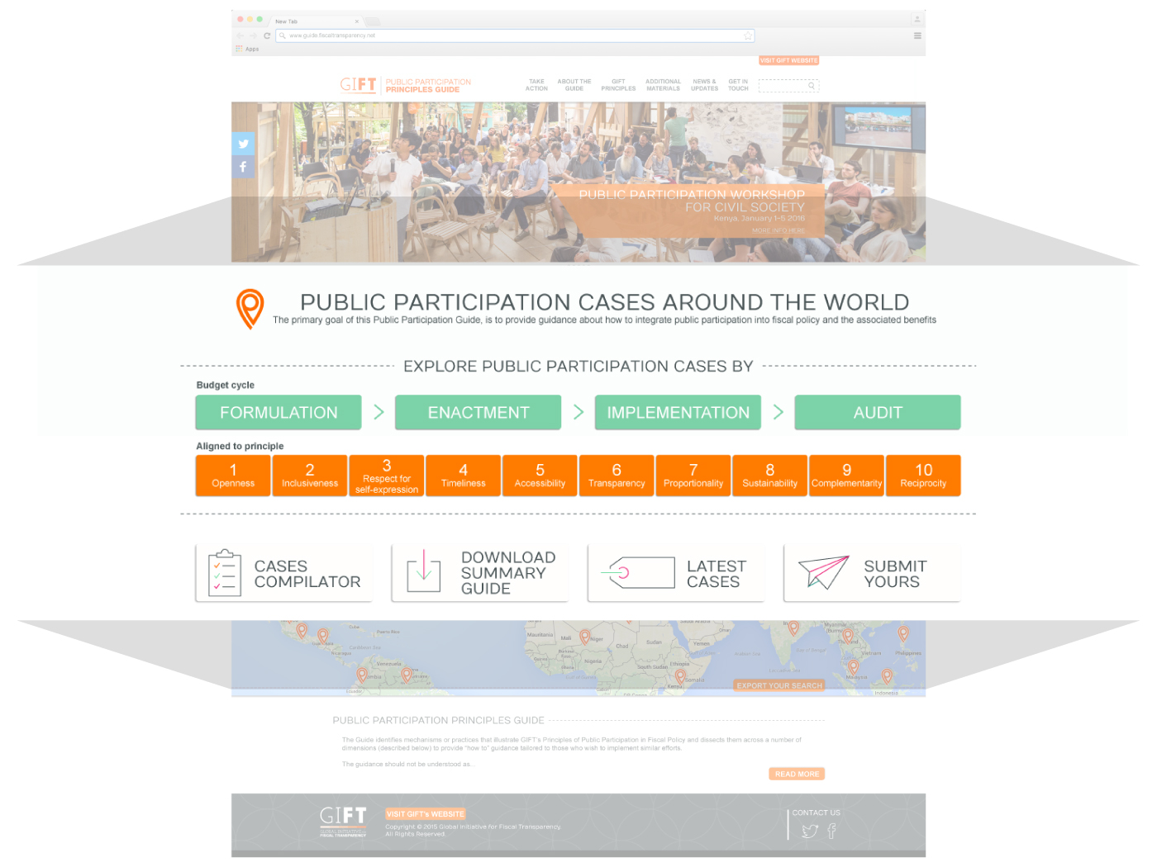
16

Slide 17
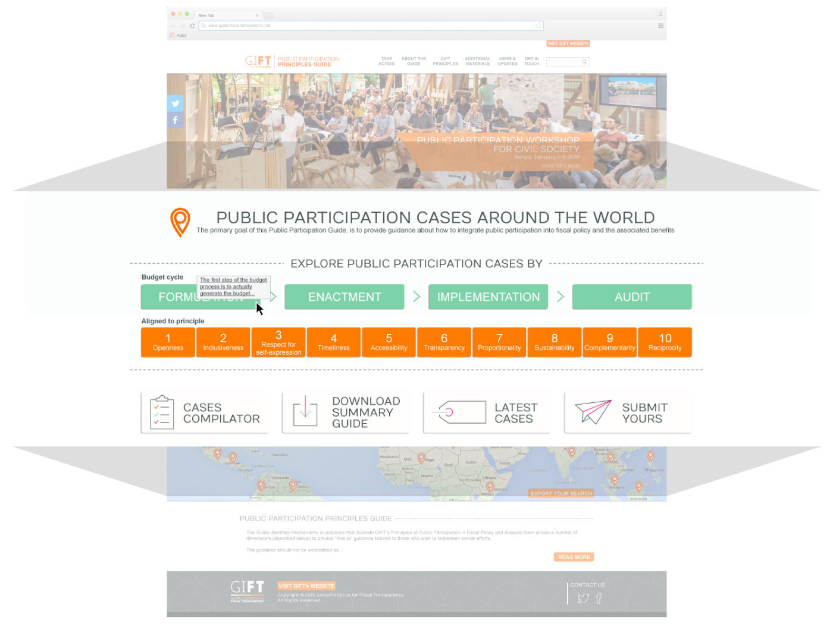
17

Slide 18
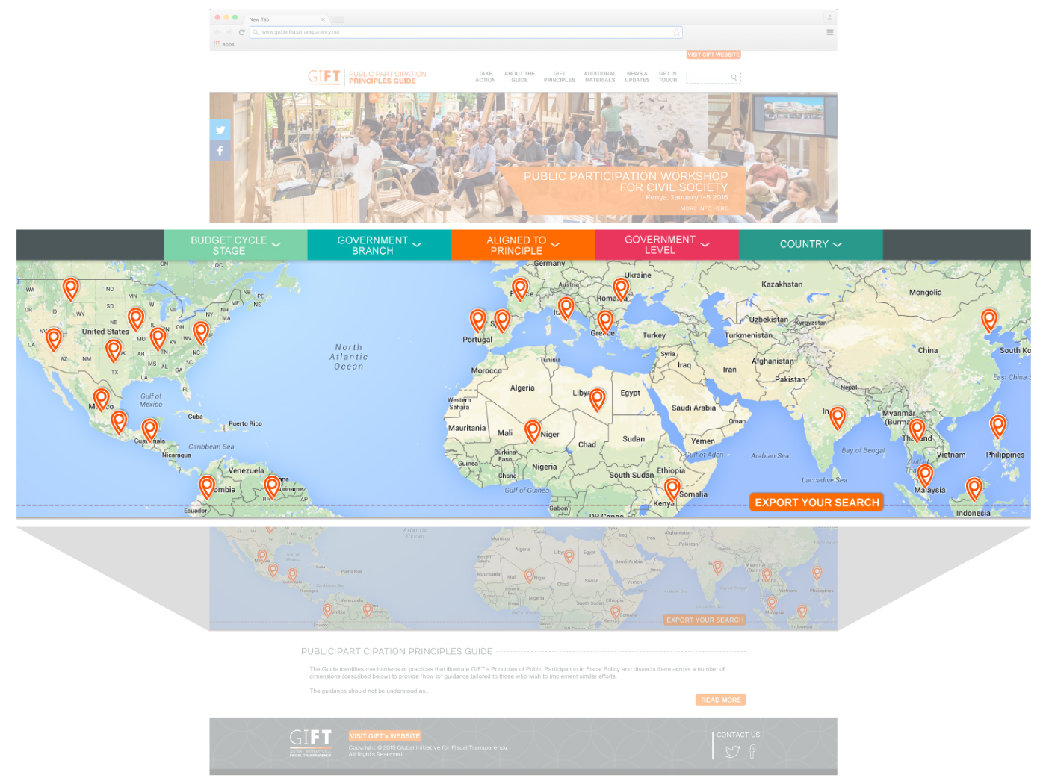
18

Slide 19
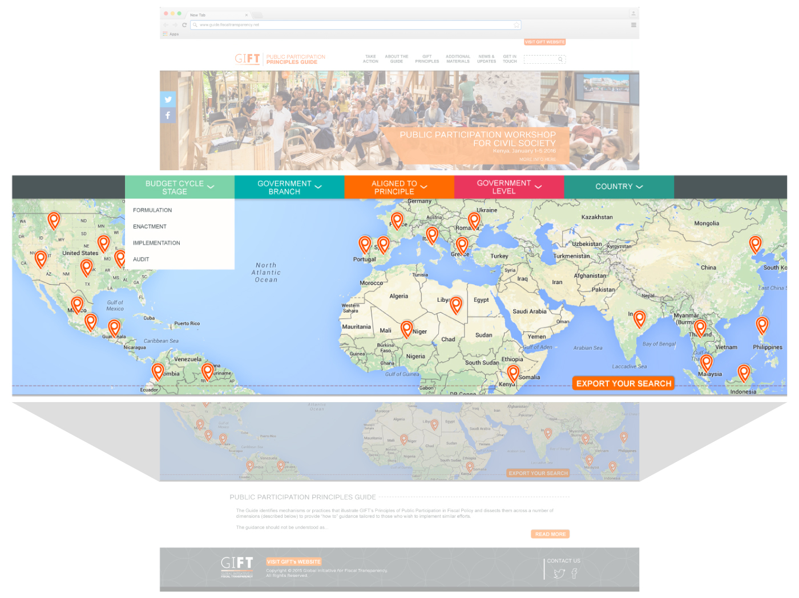
19

Slide 20
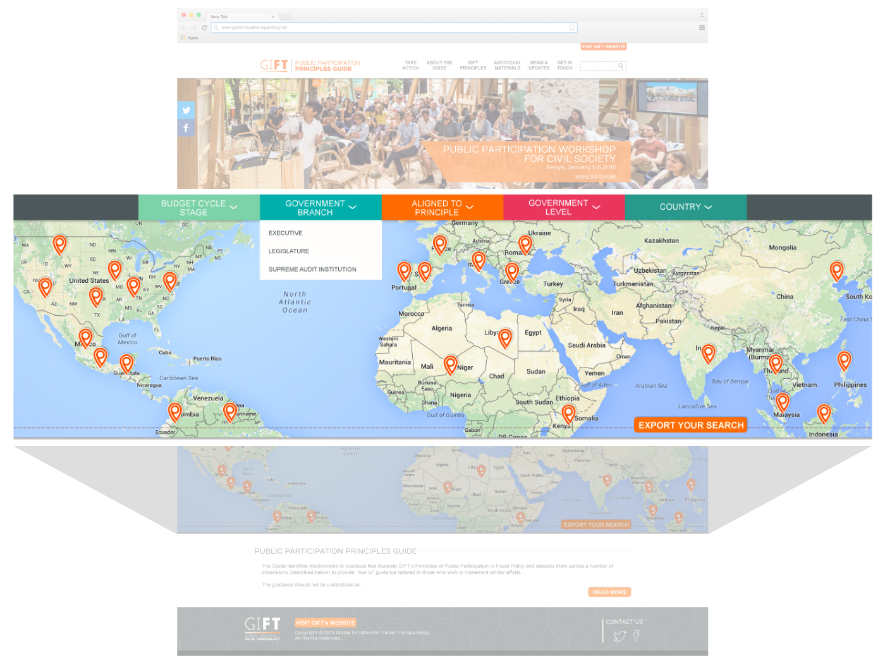
20

Slide 21
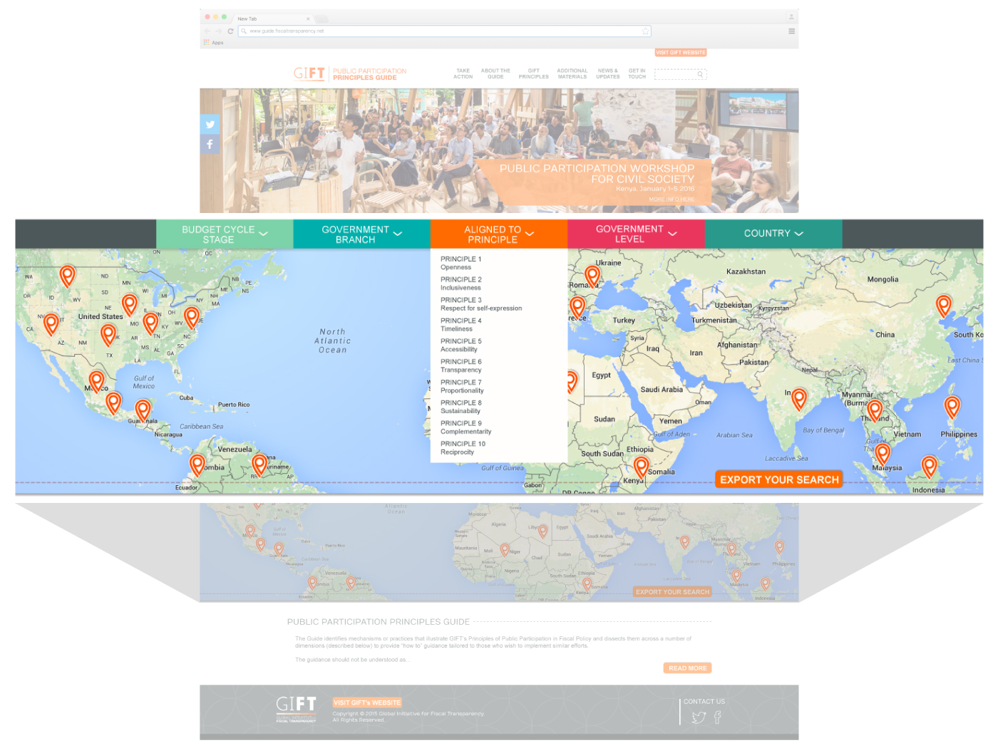
21

Slide 22
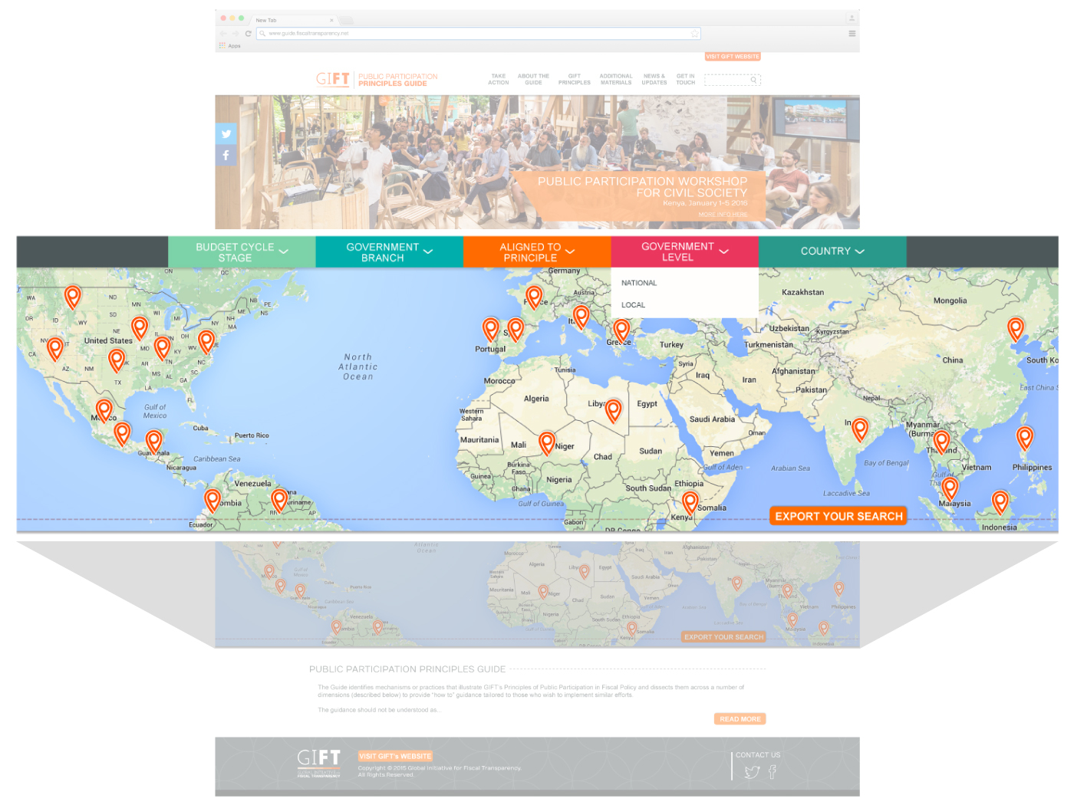
22

Slide 23
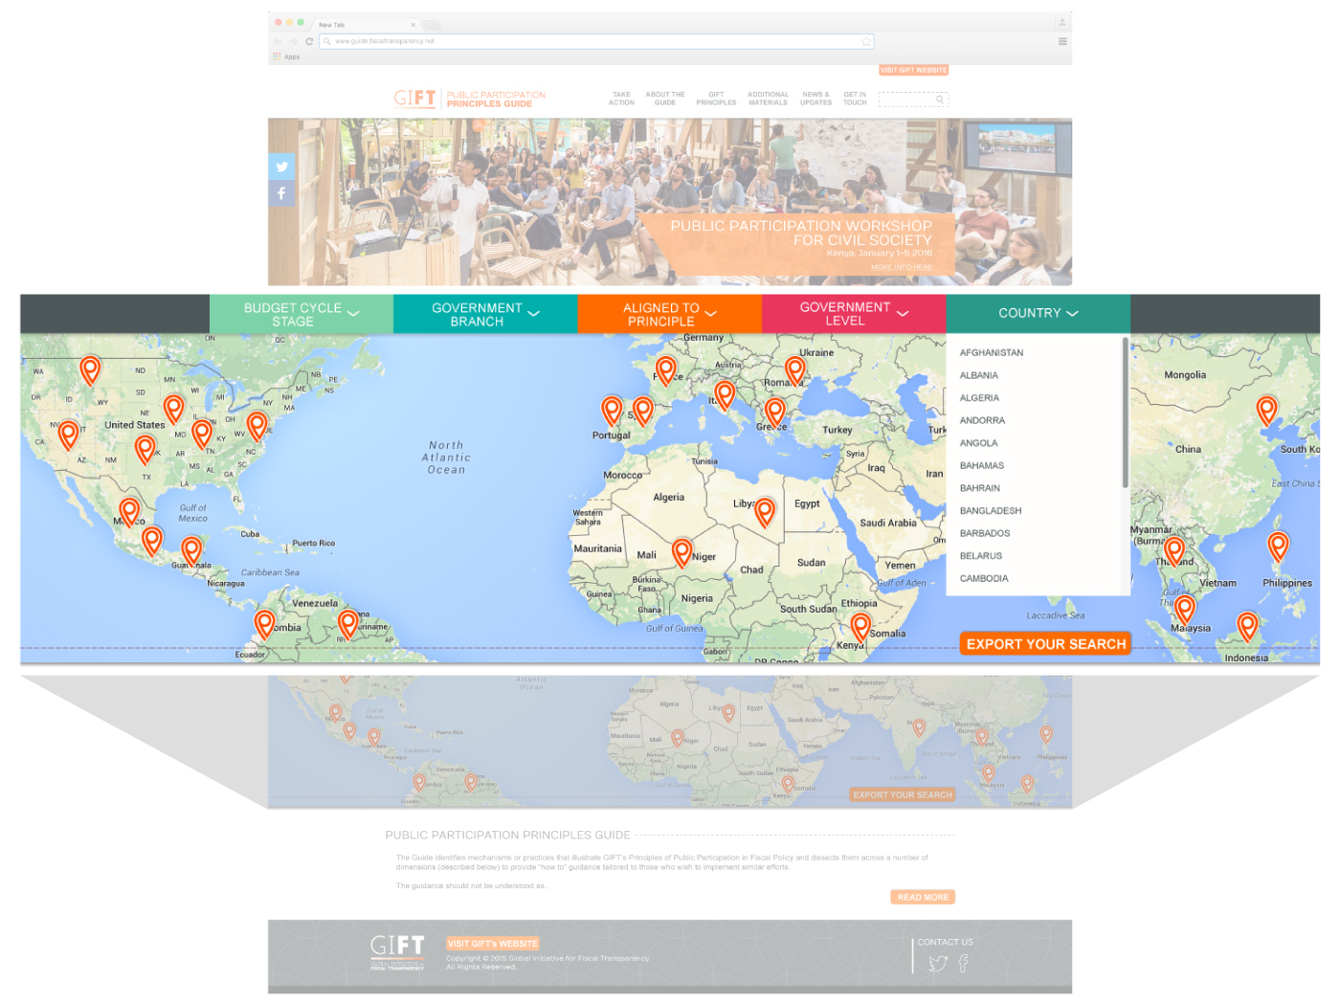
23

Slide 24
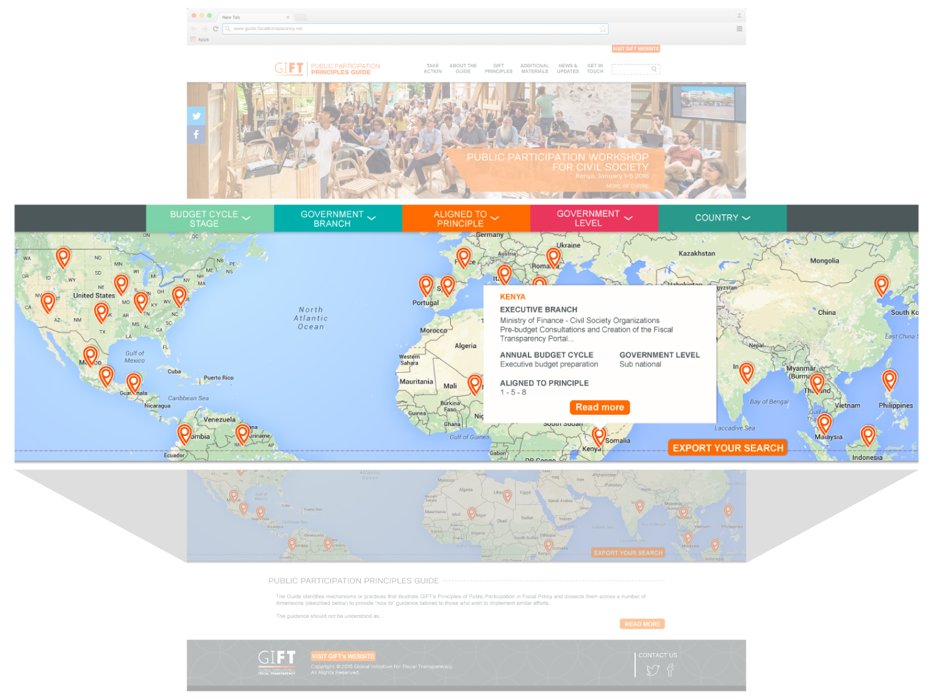
24

Slide 25
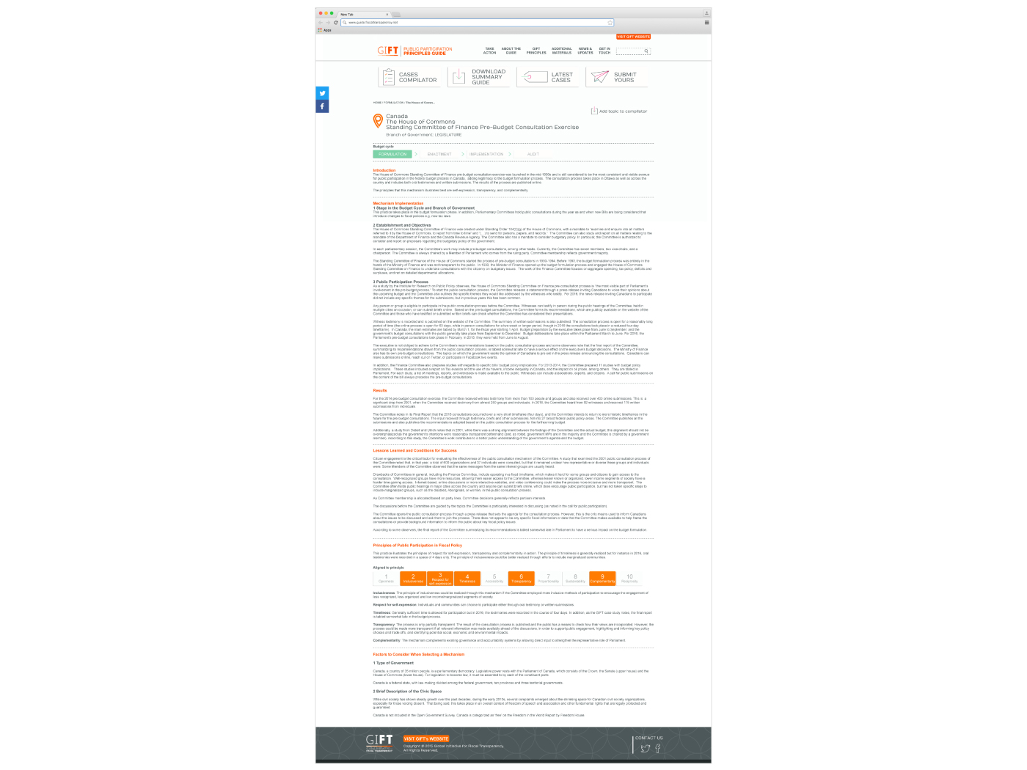
25

Slide 26
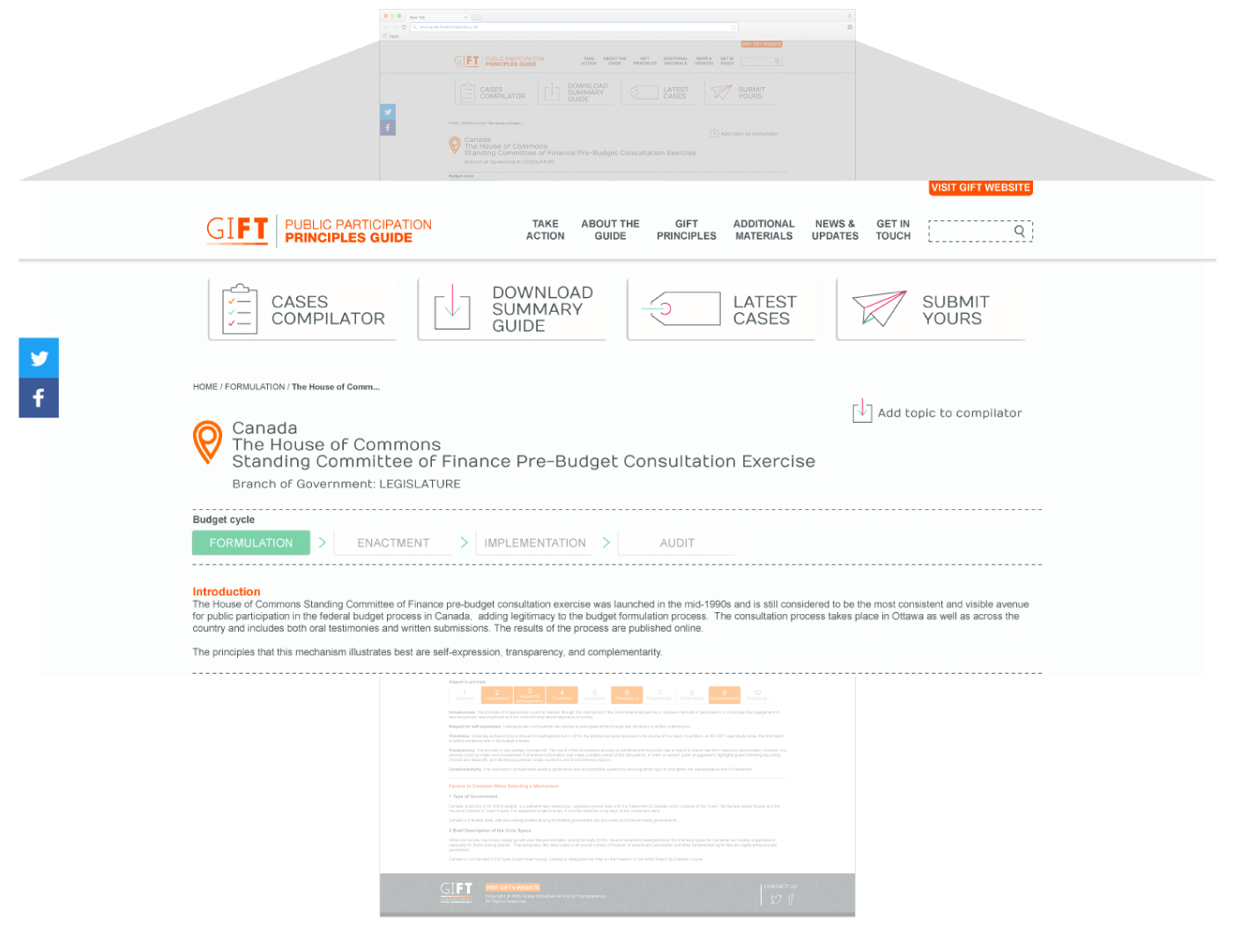
26

Slide 27
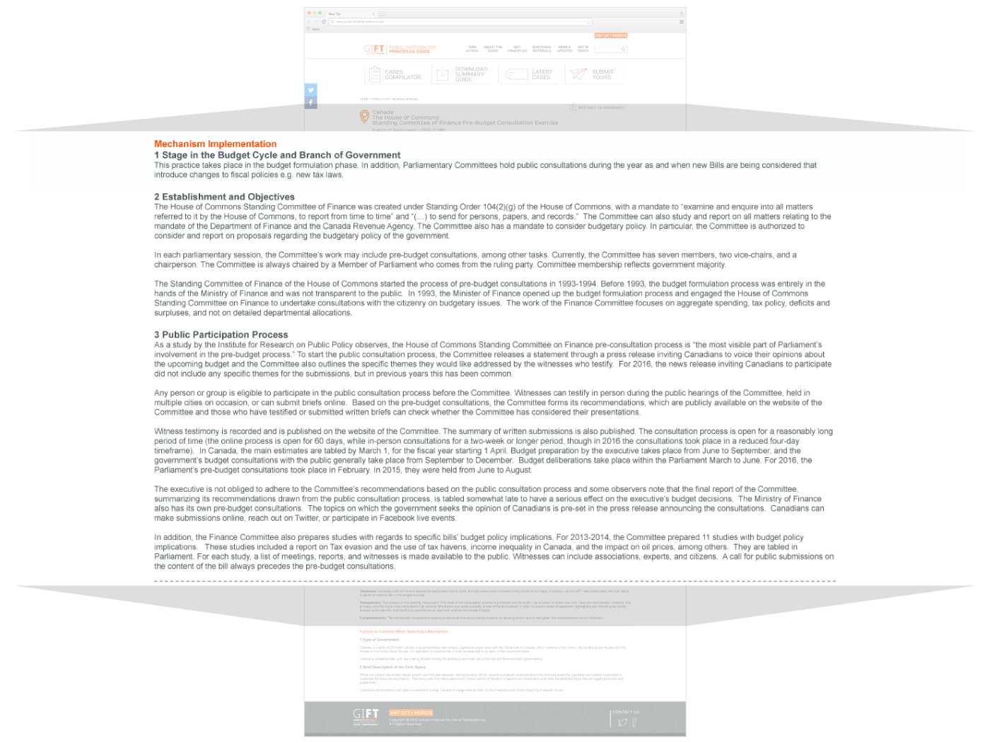
27

Slide 28
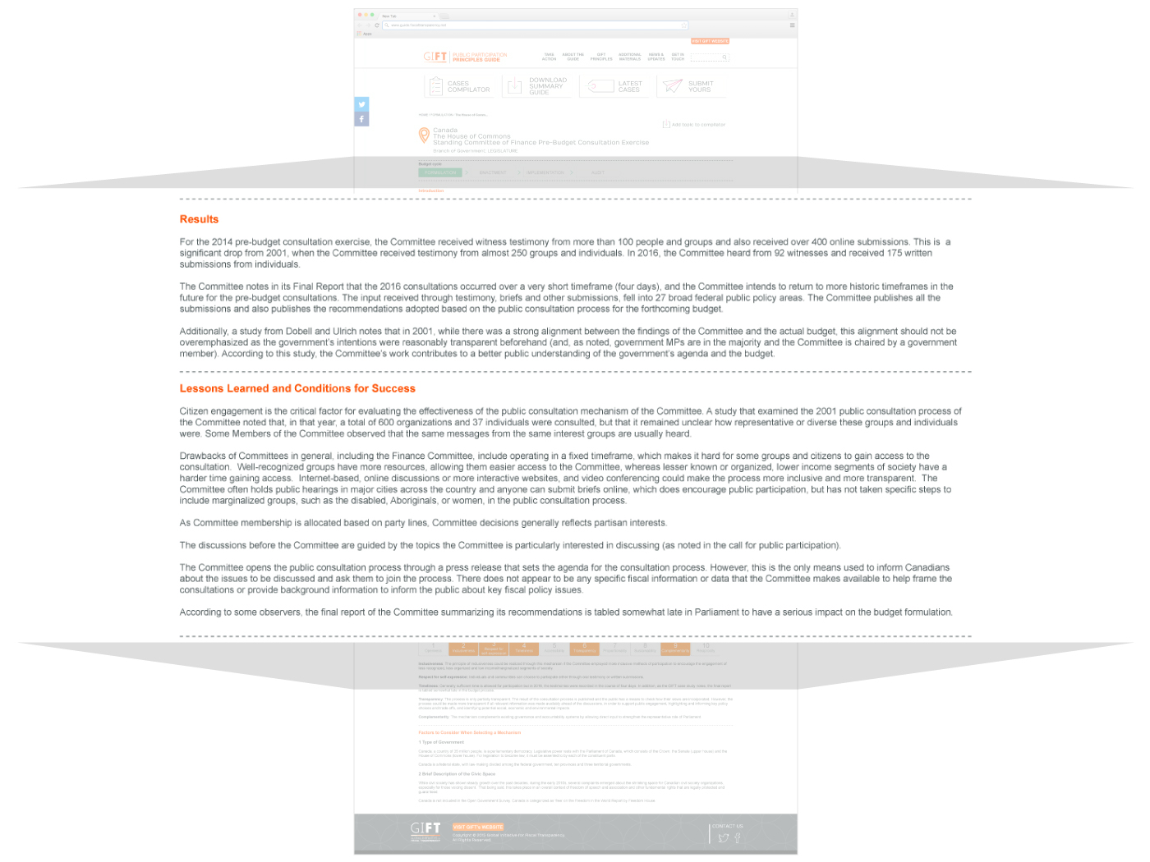
28

Slide 29
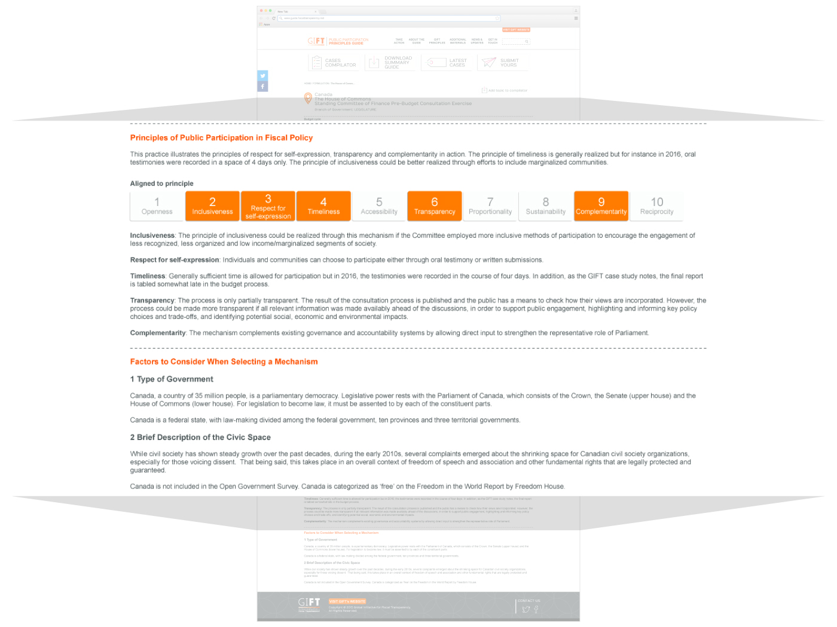
29

Slide 30
Engage with us
@FiscalTrans
fiscaltransparency.net

