Slide 1
OPEN BUDGETING
TRANSPARENCY AND PUBLIC PARTICIPATION
National Treasury: Raquel Ferreira
Public Service Accountability Monitor: Zukiswa Kota
20 June 2016

Slide 2
Open government partnership
South Africa is a founding member of the OGP
Commitment made in Country National Action Plan includes CSOs and Treasury activities in the budget process
Steward of the Global Initiative on Fiscal Transparency (GIFT)
1

Slide 3
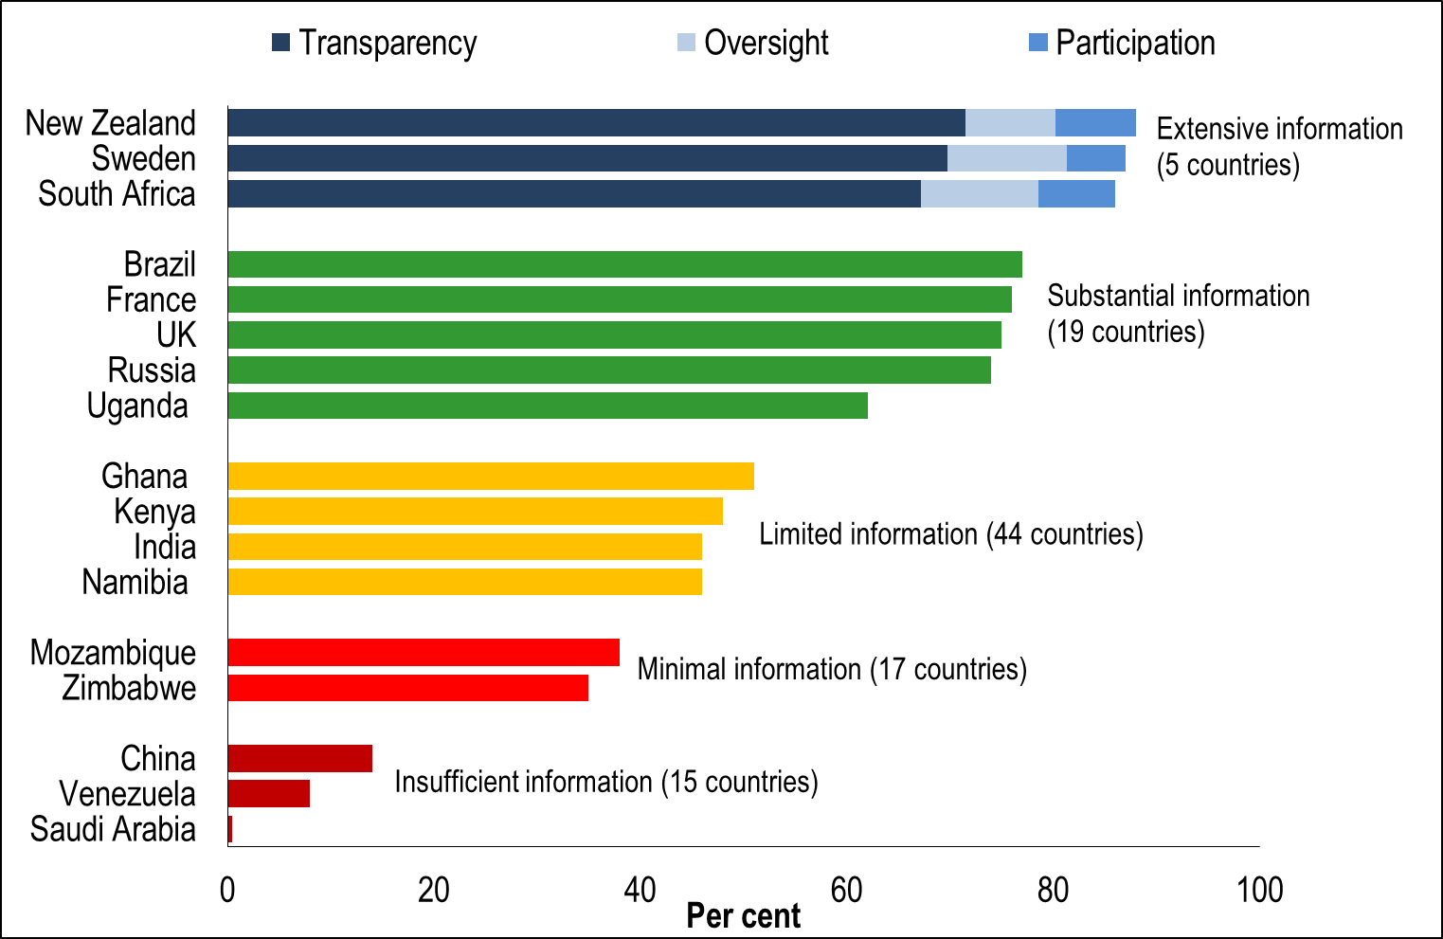
Open budget surveys
2010: South Africa ranked first
2015: South Africa ranked third (expanded questionnaire)
2

Slide 4
Open budget surveys _ cont.
South Africa scored highly in 2015 Survey in its 3 main areas of budget accountability:
Budget transparency: Ranked 3rd
Public participation: Ranked joint 5th
Institutional oversight: Ranked joint 2nd
South Africa was one of only four countries that performed solidly across all three categories
3

Slide 5
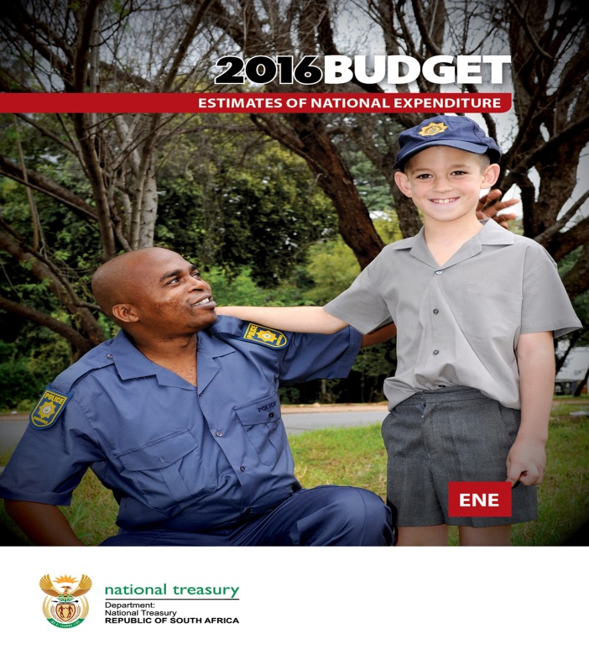
Transparency
Continued publication of extensive National Budget data
4

Slide 6
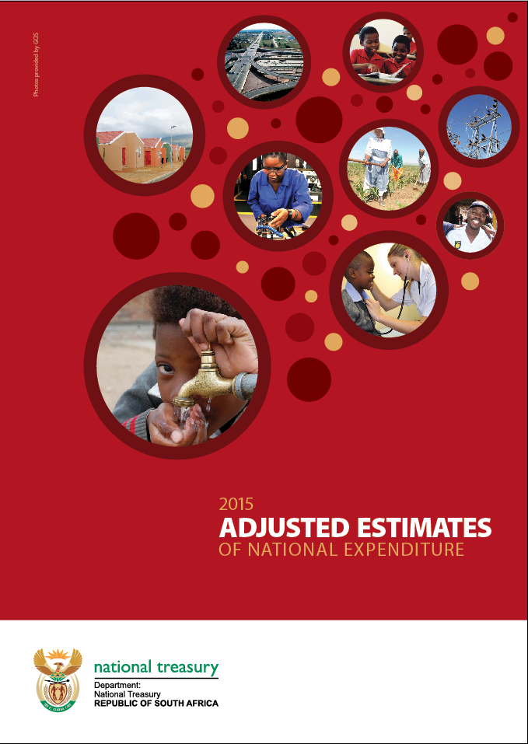
Transparency _ cont.
Continued publication of extensive mid-year National Budget data
5

Slide 7
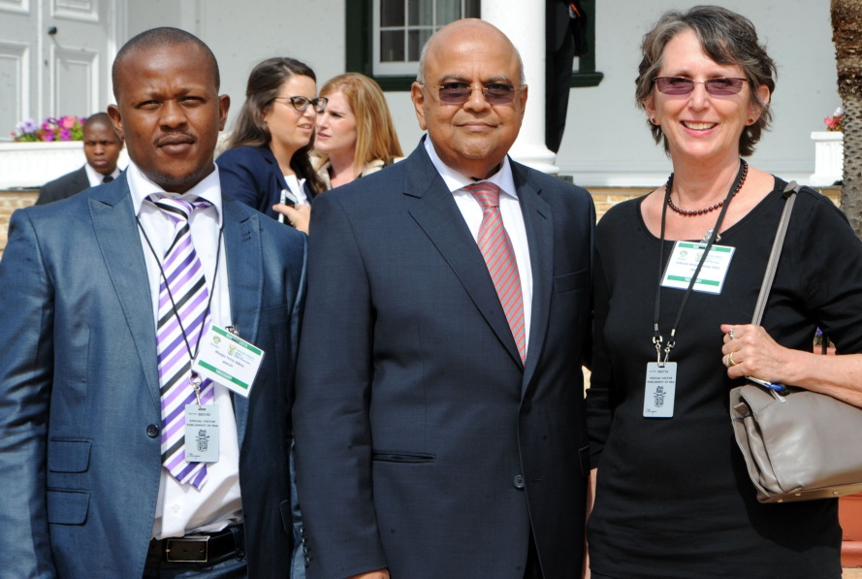
Budget tipsters
Launched in 1999 by Trevor Manuel the then Minister of Finance
Tipster 1
24/02/2016
Tipster 2
25/02/2015
6

Slide 8
Participation
SUPPORTING FACTORS:
During democratic transition year- SA Treasury was staffed by former political activists, CSO staff and academics
Facilitated strong bilateral relationships in many sectors
fostered significant assent on specific budget areas (not all and not all the time)
fostered consultative approach to budget priorities or contents
Dynamic civil society space post-1994
CHALLENGING FACTORS:
Technical nature of budget information
Necessitates concerted budget skills development outside of government - time consuming
Requires specific skills for interpretation and analysis
Requires ‘experts’ to relay accessible, accurate information
Budget timeframes are inherently narrow
Further constrains participation in budget formulation
7

Slide 9
participation _ cont.
CHALLENGING FACTORS _ cont.
Disparate availability of disaggregated budget information
Disparate availability of service delivery information or sometimes not up-to-date where available
Accessibility constrained by various factors incl. location
……POSITIVE PROGRESS IN SA TREASURY- CSO SPACE
Regular, intentional formal engagement (eg Treasury roadshows and workshops)
Regular, intentional informal dialogue (organic processes)
HOWEVER…….
Need wider, in-depth interaction (and debate?) on OGP commitments
Need more regular CSO-Treasury interaction throughout the budget process to build and deepen interactions
Need to build on critical analytical engagement through budget workshops (between and within CSO-Treasury space)
Need to reach wider spectrum of stakeholders beyond ‘tried and trusted’
8

Slide 10
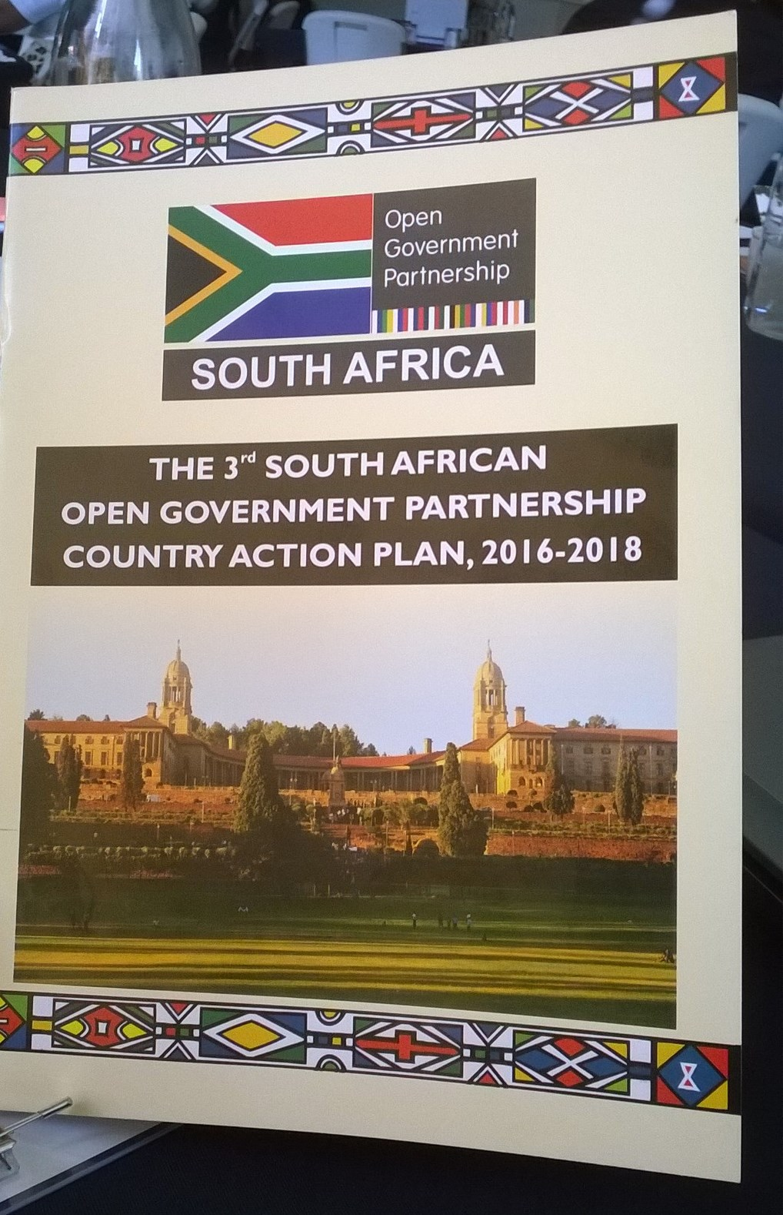
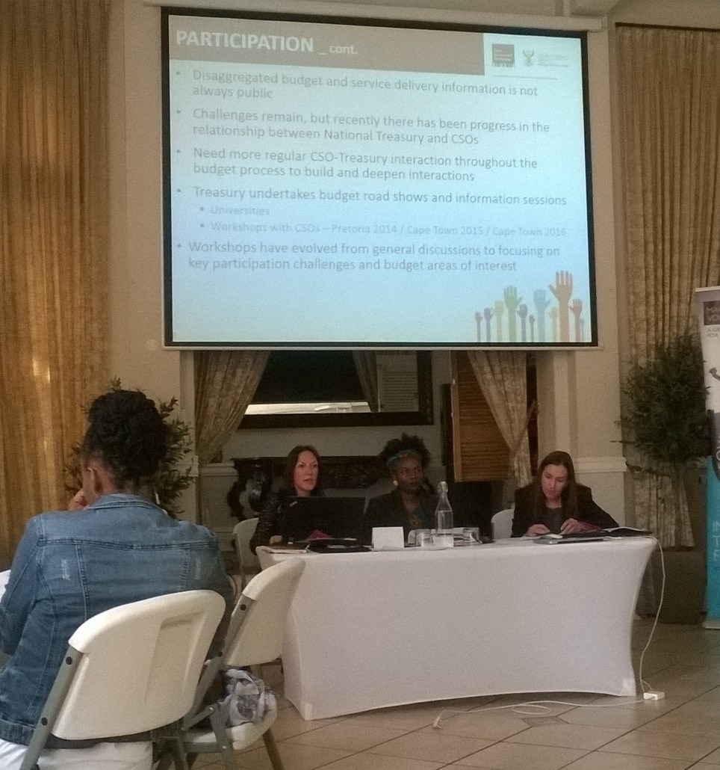
participation _ cont.
9

Slide 11
South africa’s current OGP commitments
OGP Principles: More effectively managing public resources
Output: Improved participation in the budget process
Milestones | Possible Indicators
Information sessions organised to engage with civil society and other stakeholders on budgetary and reporting issues | Number of engagements held with CSOs and other stakeholders on the budget practices and their implications per year (proposed target=2) Number Treasury budget engagements, after tabling the Budget, held per year (proposed target=10)
Civil society engagement on current procurement reforms being undertaken by the office of the chief procurement officer | Standard procurement operating procedure published (by 2016) Draft procurement bill released for public comment (by 2016) Central supplier database operational and mandatory as a source of suppliers for government institutions (national and provincial government departments from April 2016 and local government from July 2016)
10

Slide 12
South africa’s current OGP commitments _ cont.
Milestones | Possible Indicators
National Treasury will continue to provide information and support to civil society organisations to enable them to publish citizen’s guides to the budget | Number of citizen’s guides published by CSOs per year (proposed target=1)
National Treasury will collaborate with CSOs to discuss possible development of an interactive portal to furnish the public with extensive information on the budget and expenditure outcomes to make data more accessible and to aid civil society in their analysis | Development of a data portal for budgets (by 2017)
11

Slide 13
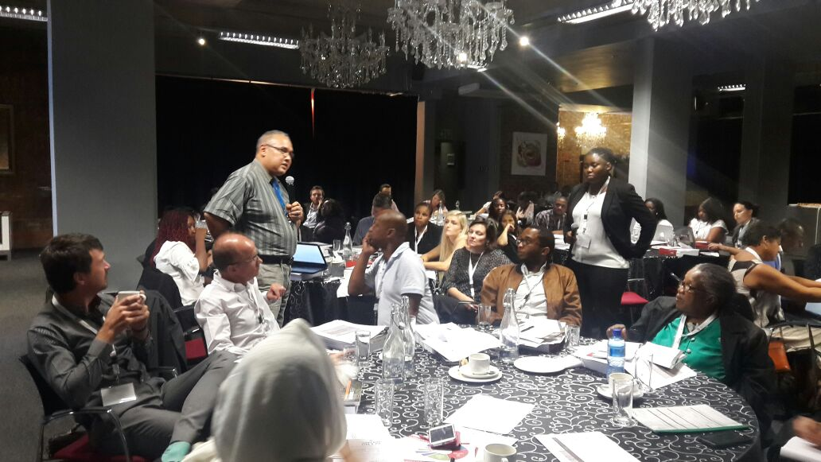
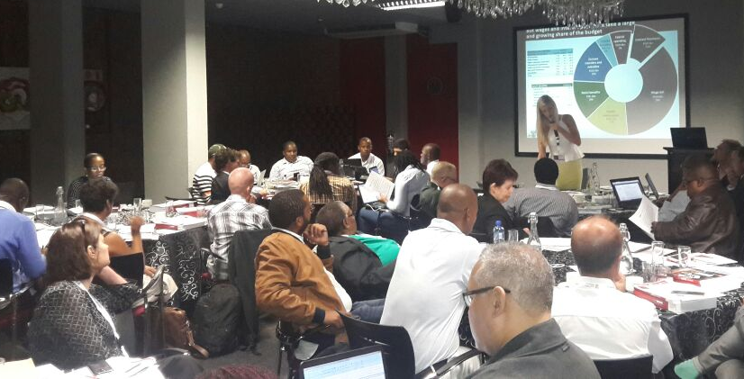
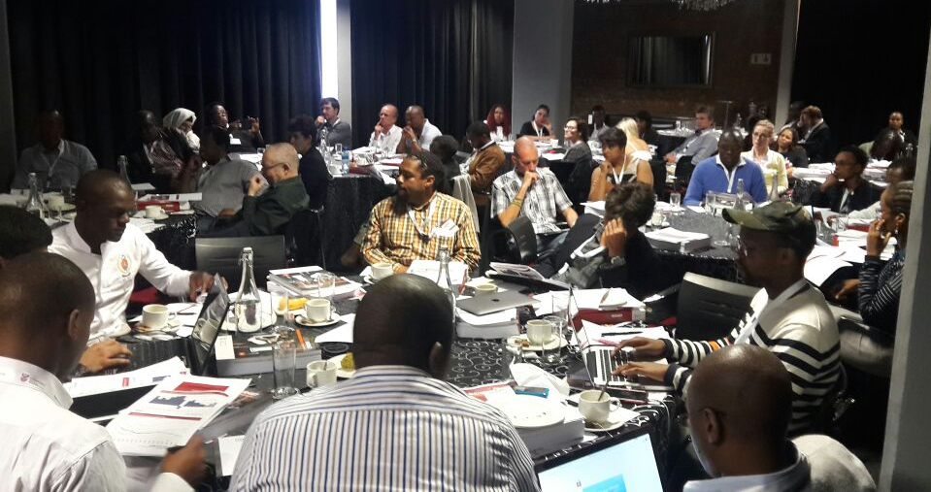
CSO Engagements
Cape Town April 2016
12

Slide 14
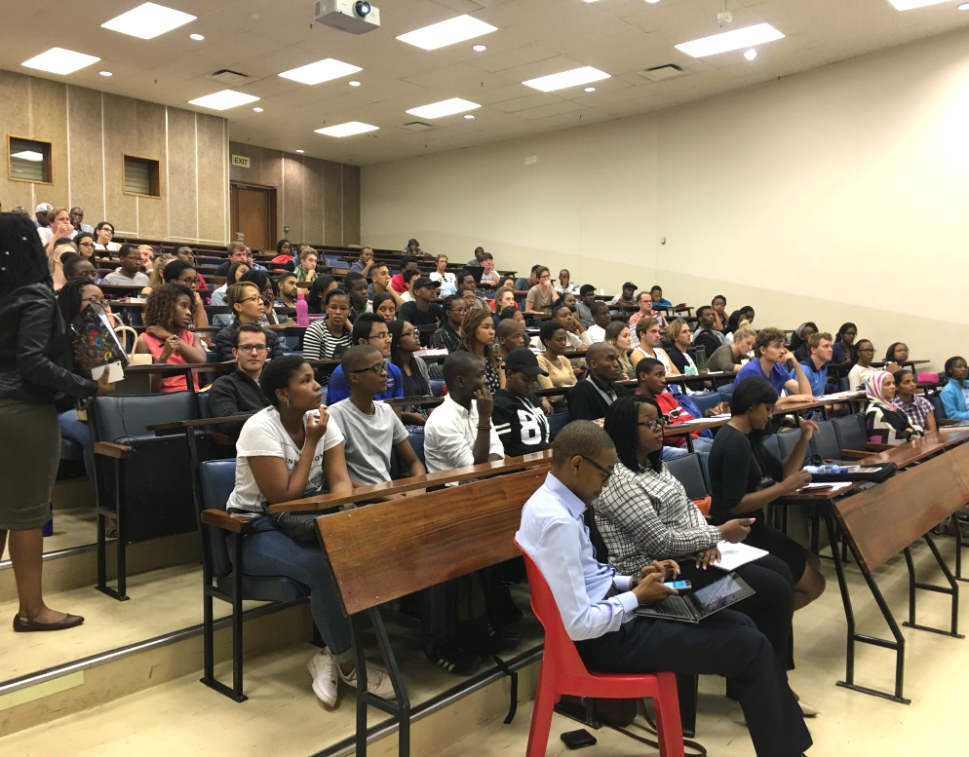
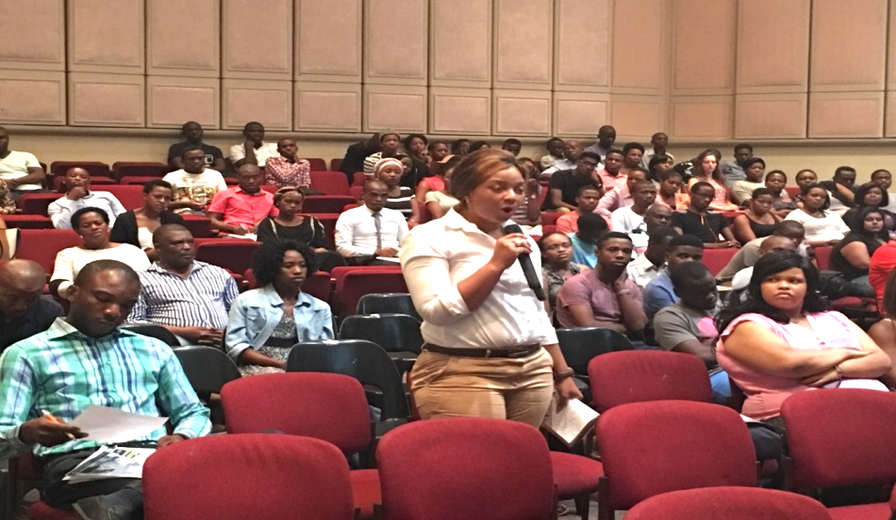
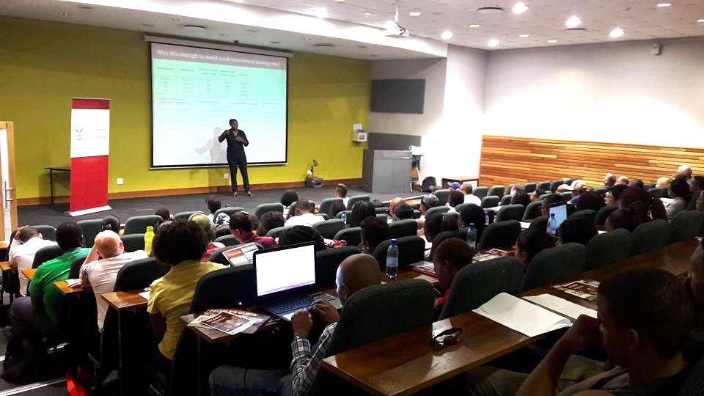
University outreach
Wits University
University of Kwa-Zulu Natal
University of Free State
University of Johannesburg
13

Slide 15
participation _ cont.
Ongoing procurement reforms
Central Supplier Database accessible online: www.csd.gov.za
eTenders portal accessible online, and in the process of being populated: www.eTenders.gov.za
Gauteng province: Open tender procurement systems along with provincial e-procurement system
Civil society has collaborated with National Treasury to release their own guide to procurement
14

Slide 16
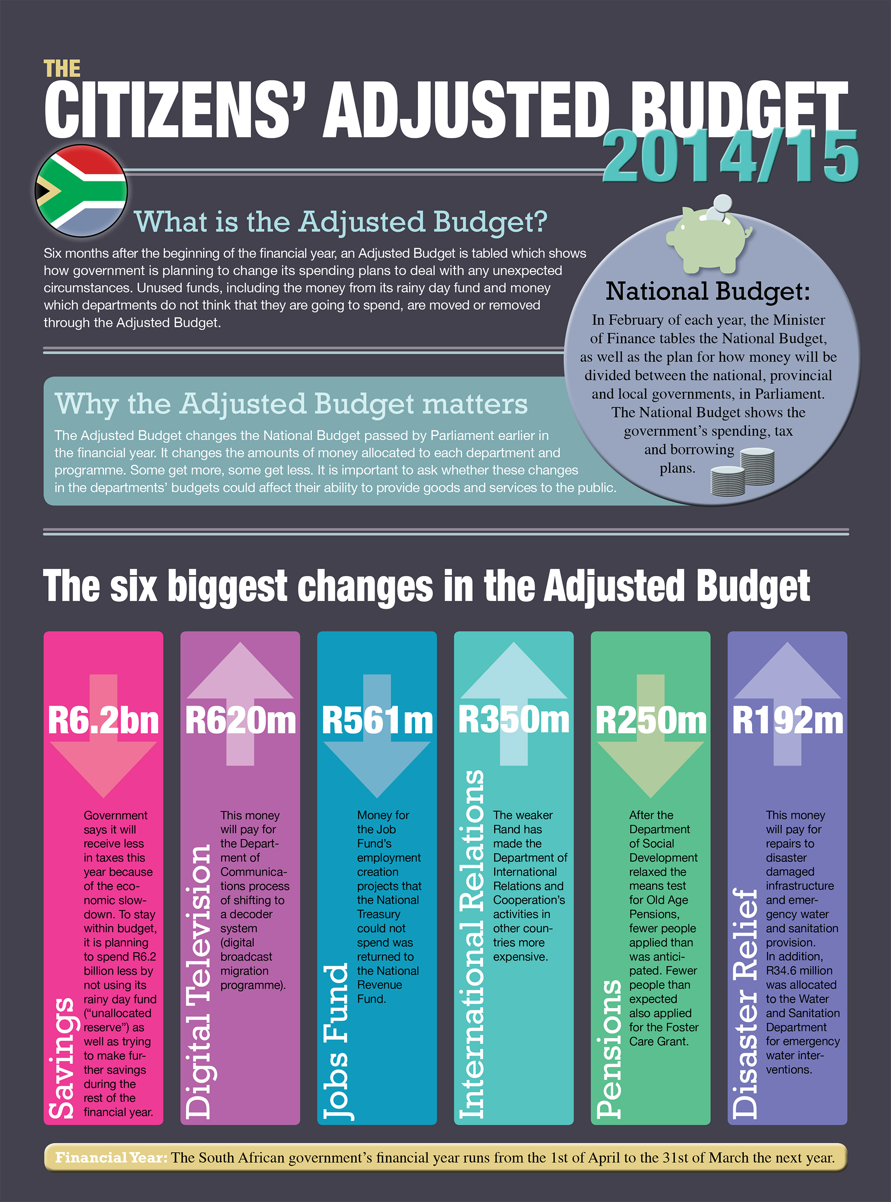
participation _ cont.
Milestones and firsts
CSOs published citizen-friendly budget publications with National Treasury support
Budget publication tables now made available in Microsoft Excel format
National Treasury’s website has had a facility for citizens to record their budget suggestions since 1999
15

Slide 17
participation _ cont.
“vote4thebudget” - 2016 online initiative by the IBP and Code4SA, provided effective online tool to South Africans to engage meaningfully on the budget and submit views directly to Parliament
16

Slide 18
participation _ cont.
National Treasury plans to launch IT portals for citizens to access disaggregated budget information more easily, starting with a local government portal
Local Government data available since 2006/07 in planning and performance documents, publications and analysis reports
NT has partnerships to make this data more accessible
Two initial focus areas are:
an informative and educational citizen’s guide to their own local municipal budgets
detailed financial data that will enable researchers and developers to develop their own Apps
The local government portal will be available by August 2016
17

Slide 19
Considerations going forward
CSOs & National Treasury committed to improving their budget interactions going forward
Common aims:
Meaningful citizen empowerment
Analytical abilities and evidence-based rigour
Interactive hubs and IT portals
Key considerations include:
Need for disaggregated budget and service delivery data
A range of views and their coordination requirements
Different nature of relationships with different CSOs and line departments
National Treasury’s role and mandate within government
Budget process interaction spaces, focussing on formulation phase
Role of social audits in achieving value for money
Extending- and sustaining- citizen-owned publications on budgets
Need wider, deeper, regular CSO engagement specific to OGP Commitment 2
18

