Slide 1
Fiscal Transparency Commitments in OGP
National Action Plans
Juan Pablo Guerrero
Washington DC
June 20-21 2016
.
#FiscalTransparency

Slide 2
Welcome to the Fiscal Openness Working Group Workshop in Washington DC
Goal of the FOWG
Objectives of the workshop
Global Initiative for Fiscal Transparency
2

Slide 3
Fiscal Openness Working Group OGP-GIFT

Slide 4
FOWG Goal & Workshop Objectives
The aim is to support the implementation of budget transparency commitments & motivate additional governments to become OGP champions in fiscal transparency (FT)
4

Slide 5
Objectives of the Workshop
Engage MoF and expert budgetCSO in a conversation about ambitious FT commitments and implementation
Identify areas of collaboration and exchange among peers
Explore the opportunity of adopting & implementing joint fiscal transparency commitments
5

Slide 6
GIFT-Global Initiative for Fiscal Transparency
Action Network: flexible framework for impact
Advance and institutionalize significant & sustainable improvements in fiscal transparency, participation and accountability in countries around the world, by working on global norms, incentives, peer-learning, and technical assistance
Funding comes from the World Bank, The Hewlett Foundation & Omidyar Network
6

Slide 7
GIFT work streams – Global norms
Global norms on fiscal transparency & public participation
High-level principles on FT, public participation (PP) & accountability (UN General Assembly, 2012)
Harmonization of norms & global standards (IMF, OECD, PEFA, OBI/IBP)
Principles on public participation in fiscal policies & advance the right to participate in budget processes
7

Slide 8
GIFT work streams – Incentives research
2) Incentives for FT & evidences of impact (feed norms & technical support)
Eight country case studies about public participation
Think-pieces on incentives for TF
Impacts of FT: review of evidence
Transparency on revenues & taxes
Country FT commitments in OGP (analysis)
8

Slide 9
Streams of work of GIFT – Peer learning
3) Technical assistance & peer learning
OGP Fiscal Openness Working Group for enhancing & implementing commitments
Support processes for TF in specific countries (TA & peer-to-peer exchanges)
Engage countries in principles & standard discussions/making
9

Slide 10
Streams of work of GIFT – TI & Data
4) Technologies & open data
Use of technologies for information disclosure & proactive dissemination (FT portals)
Open formats for budget data with BOOST (World Bank-Open Knowledge)
Community of practice: discussions, networks, webinars, blogs, videos, experiences, exchanges…
10

Slide 11
Breakout sessions of the workshop (topics proposed for breakout groups)
Use of information technologies for reaching out to users and ways to engage the public in the budget process & fiscal policies (disclosure/usability/communication issues)
Open budget: how to link FT with transactions disclosure (contracts) and eventually, with service delivery
National Government FT efforts & the roles of legislatures / local governments
11

Slide 12
Questions to discuss in each working group
Identify the main challenges to address the issue
Identify countries/experiences from which you would like to learn more about this issue
What kind of international collaboration & technical assistance would be useful?
What would be the next steps for GIFT on this agenda?
12

Slide 13
GIFT activities in 2016 (1)
a) Guide on public participation in budget making & fiscal policies (practices, mechanisms, lessons, impact)

Slide 14
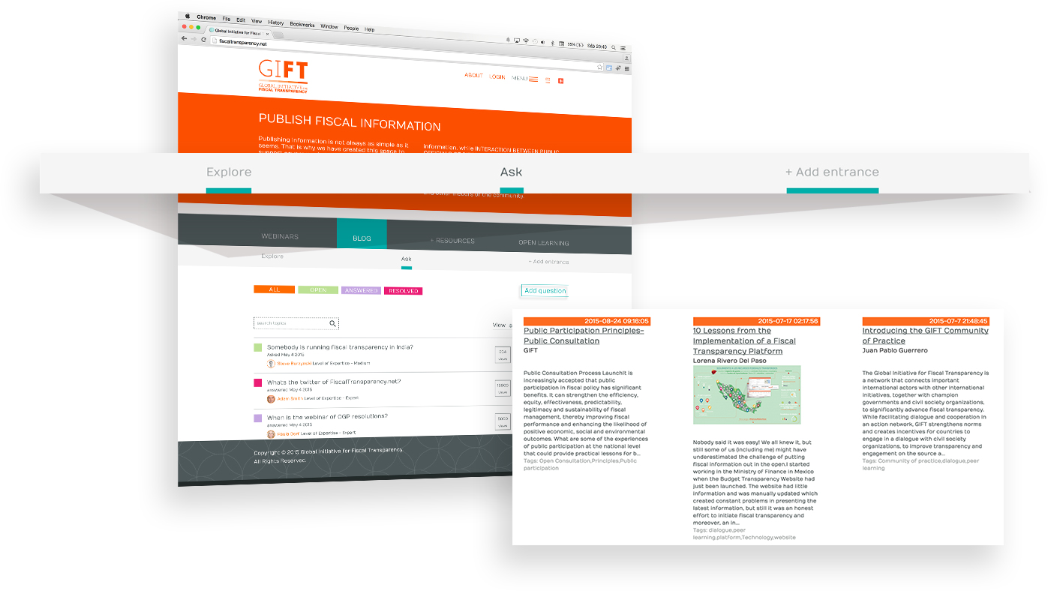
Fiscal Open Data Package (activities 2016)

Slide 15
GIFT activities in 2016
b) Open fiscal data package, to disclose fiscal information in open data formats (joint effort with the World Bank BOOST and Open Knowledge):
1. Put BOOST into an open data format; 2. ensure the connection between data and visualizations, that will also be interactive; 3. Allow the data to be linked with other open data sources.
15

Slide 16
GIFT activities in 2016 (2)
c) Provide assistance in defining and implementing fiscal transparency commitments in OGP National Actions Plans: Georgia, Guatemala, Indonesia, Mexico, Moldova, Mongolia, Papua New Guinea, Paraguay, South Africa, Uruguay, city of Buenos Aires.

Slide 17
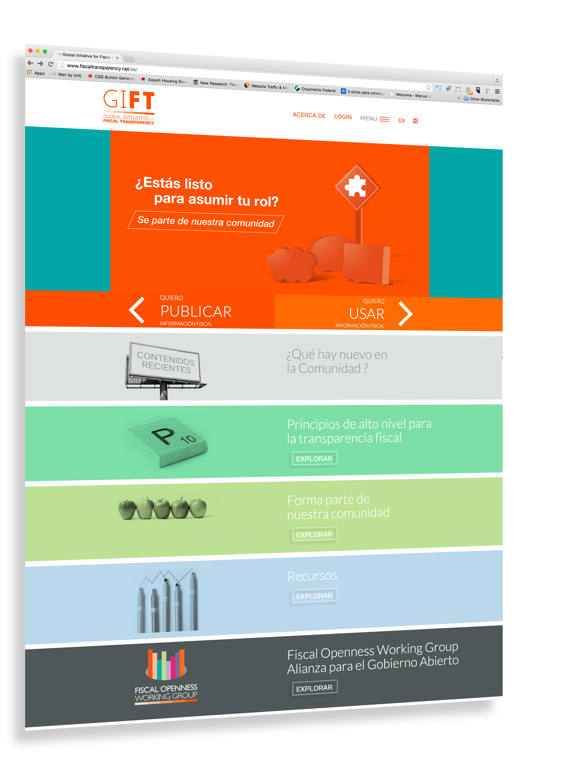
d) Workshops of the Fiscal Openness Working Group (Mexico, South Africa, Slovenia, Uruguay, Indonesia, France)

Slide 18
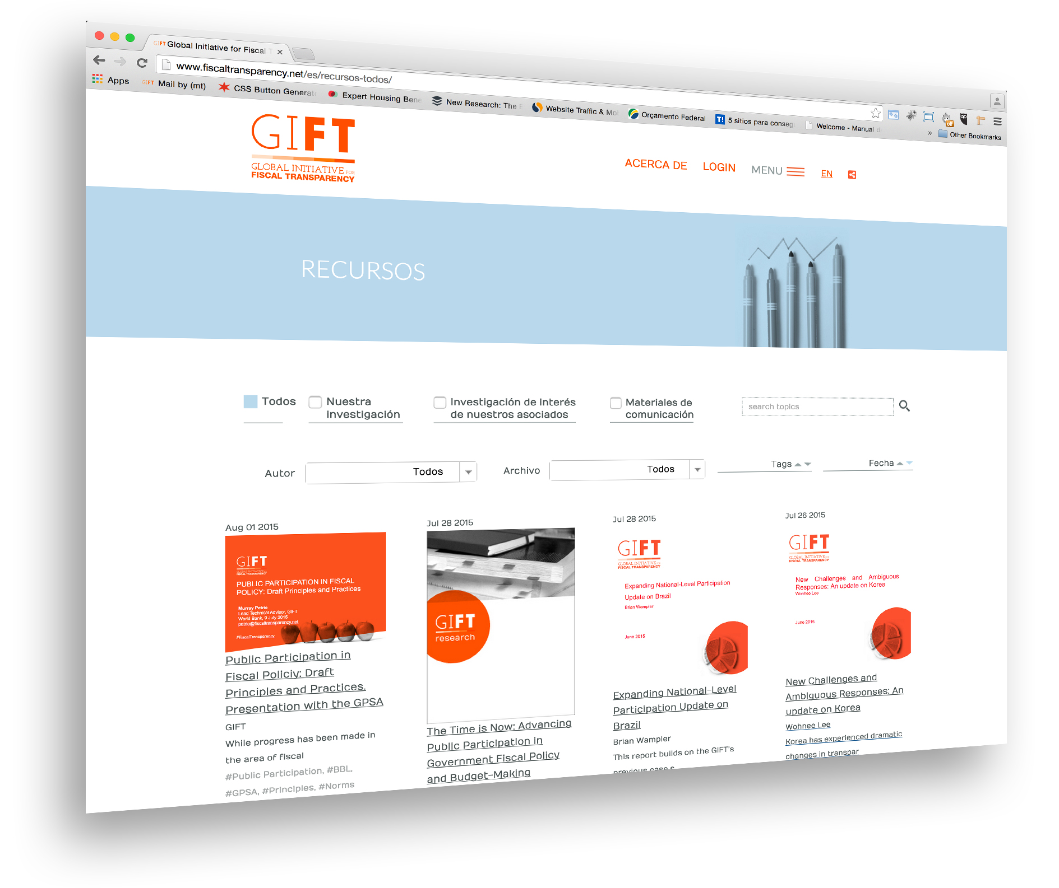
e) Independent evaluation of GIFT

Slide 19
Engage with us
@FiscalTrans
www.fiscaltransparency.net
guerrero@fiscaltransparency.net

