Slide 1
GIFT Stewards Meeting
October 10-11, 2017
MITRE Headquarters, McLean, VA
#GiftMeeting

Slide 2
A multi-stakeholder action network Meeting attendees
• 20 countries represented
• 30 stewards (out of 37)
• 16 governments (10 Stewards)
• 5 foundations
• 2 IFI
• 21 CSO/think tanks/ academia
• Hosted by a new steward: MITRE Corporation
• Promising new partners

Slide 3
GIFT – How do we work?
General Stewards Meeting: 37 stewards (44 by end of 2017; 48 in 2018)
Lead stewards: Br, Ph, Mx, WB, IMF, IBP, IFAC
Partners
GIFT Coordination Team (5) hosted by IBP ☺
Funding: WB, Hewlett Foundation, Omidyar Network
In kind contributions: SOF, DBM, MoF-ID, SHCP, STP, MoF-GT, OPP, SAI-SI, MITRE, etc. + IBP + Everyone!

Slide 4
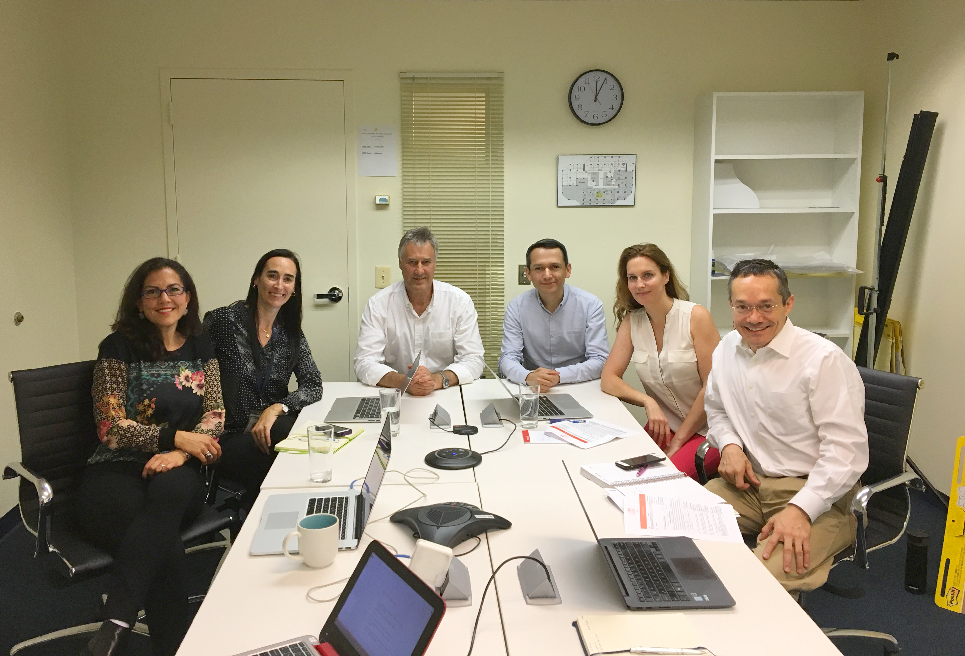

Slide 5
Meeting contents + objectives
Network updates & plans
Start a conversation on the relevance of transparency and public participation in tax policy, discussing the experience of members of the network
Learn from the experience of the US Government in disclosing budget information & spending transactions in open data and sharing GIFT’s Open Fiscal Data Package
Provide a space for discussions on:
Fiscal transparency and anti-corruption,
Granularity aspects of budget administrative classification data,
IT Working Group work plan,
Stepping up work with African countries
Communicating Reform Progress with Investors

Slide 6
Meeting program overview
Day 1. October 10
Stewards and partners: updates + plans
Public participation in tax policy and administration
Day 2. October 11
Open fiscal data state of the art
Break-out sessions- various topics

Slide 7
Suggested rules for the meeting
Speak to the microphone (translation into En, Sp, Fr)
Follow your facilitators
Please keep presentations on time (strict control of time)
Select rapporteurs in breakout groups
Be bold and provocative: leave your mark in the meeting (please do not be shy)
Engage with each other
All materials are here: http://www.fiscaltransparency.net/our-work/#toggle-id-1

Slide 8
Wi-fi Network: Outernet
Password: notice home climate kitchen
Translation channels
Channel 8 – English
Channel 9 – Spanish
Channel 10 – French

Slide 9
GIFT’s Report and Priorities for 2018-2020

Slide 10
Norms Harmonization and Public Participation
After intense period of norms’ revisions (2014-16), now country assessments with more coherent standards & elaboration of manuals + toolkits (OECD)
Public Participation Guide on Principles & Mechanisms, discussion in various communities for implementation

Slide 11
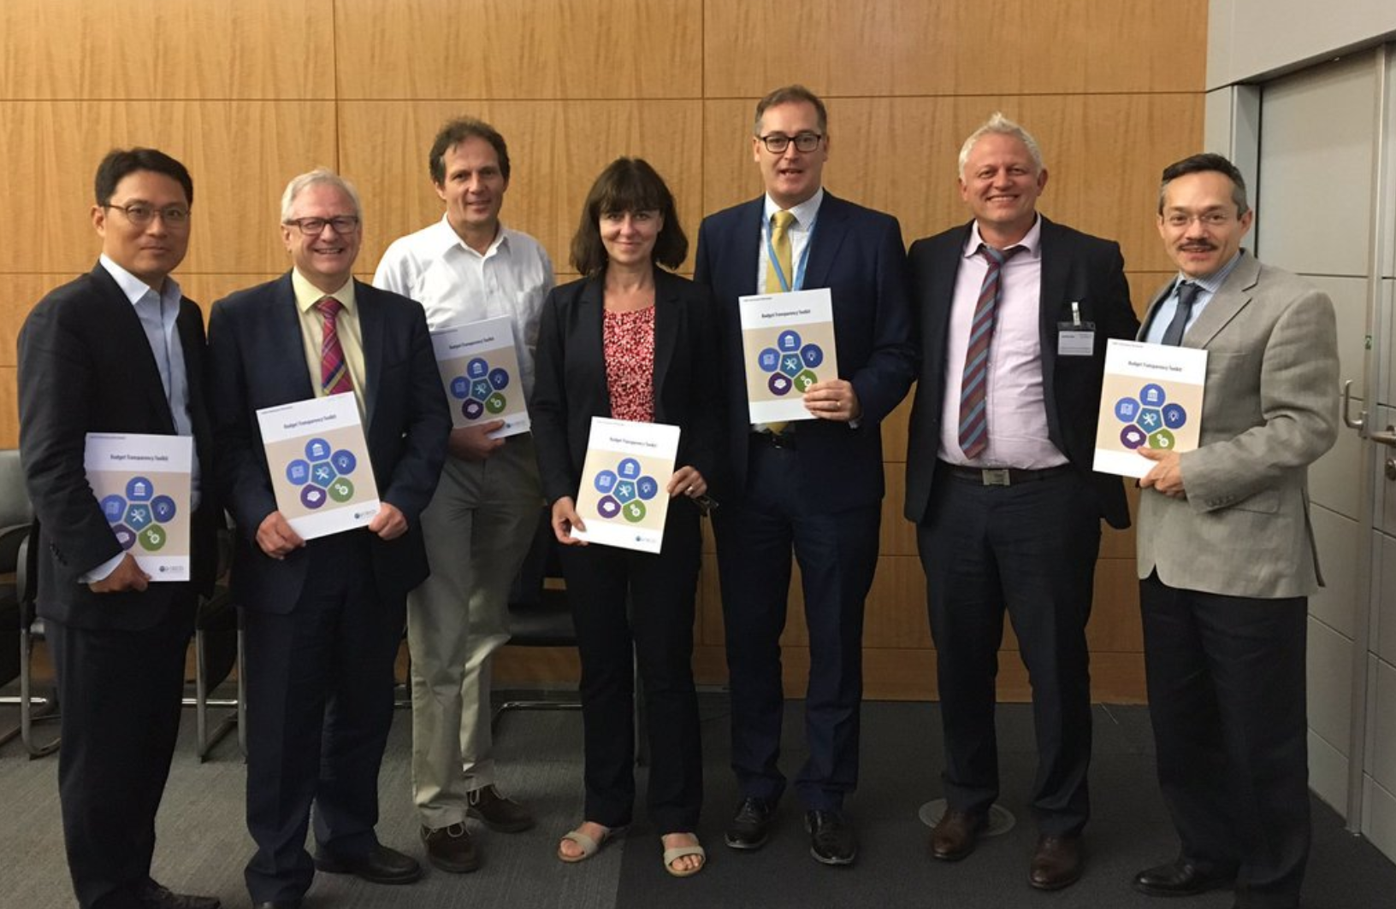
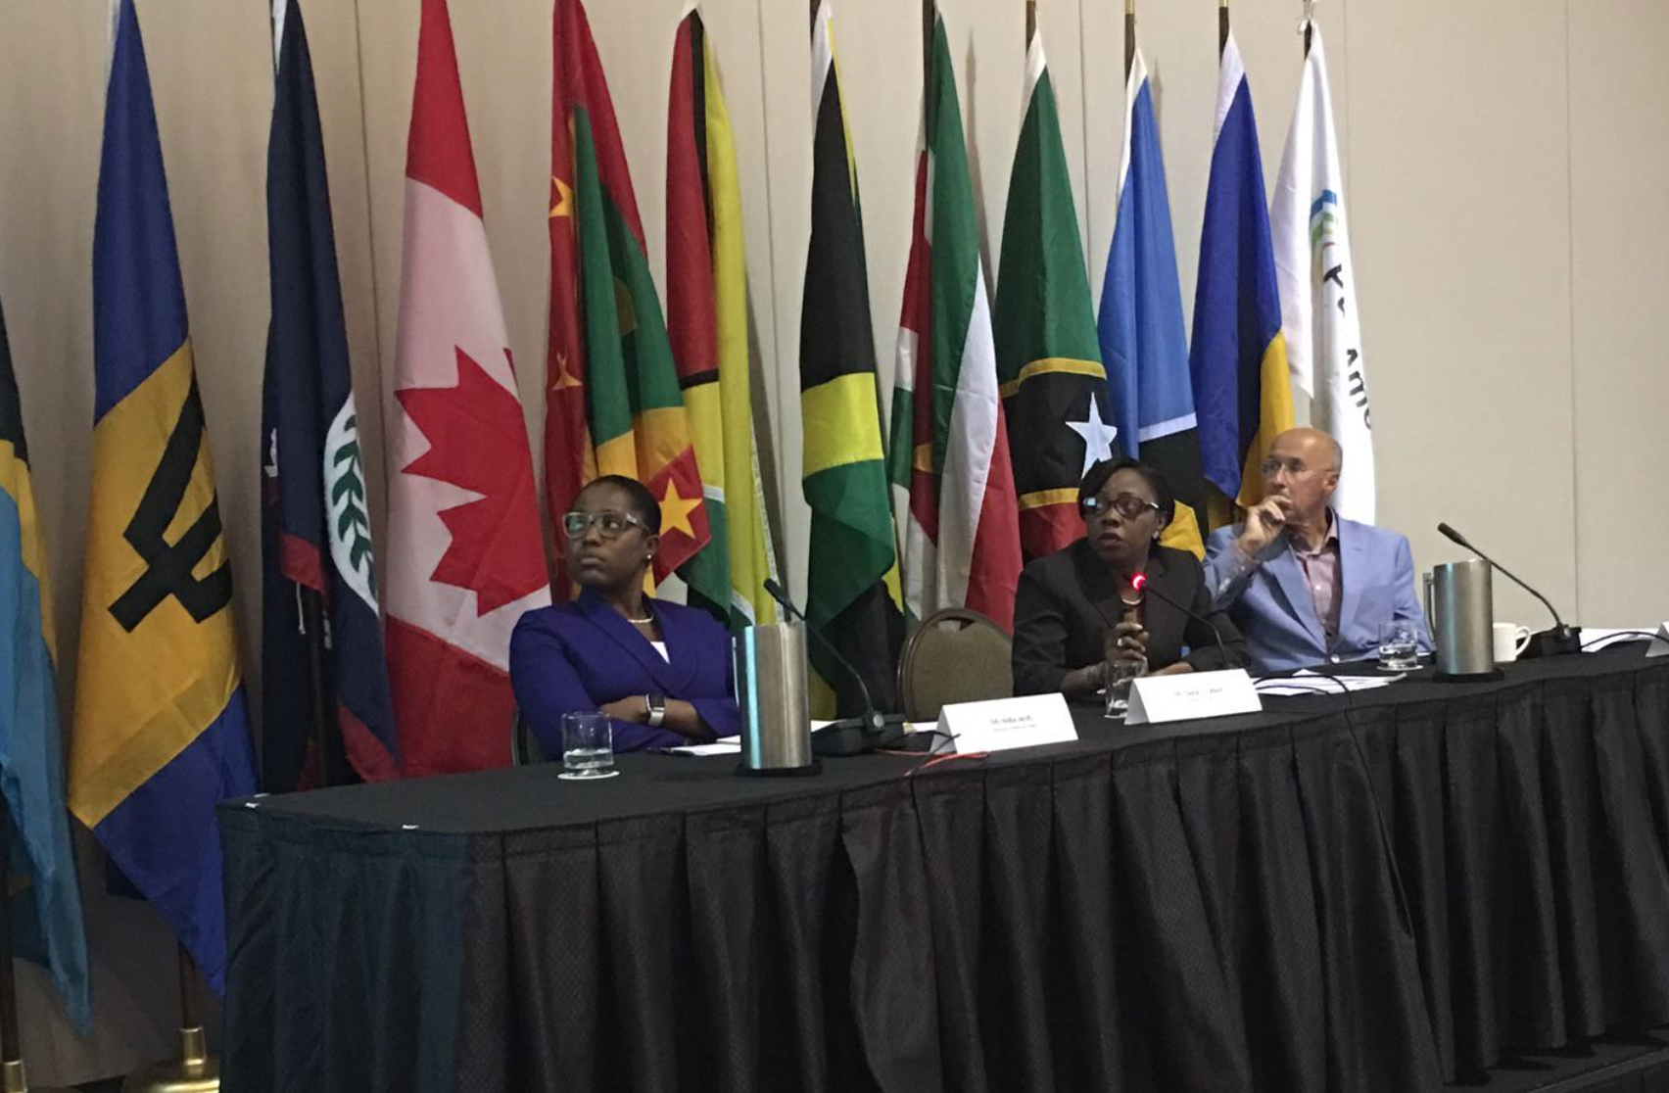
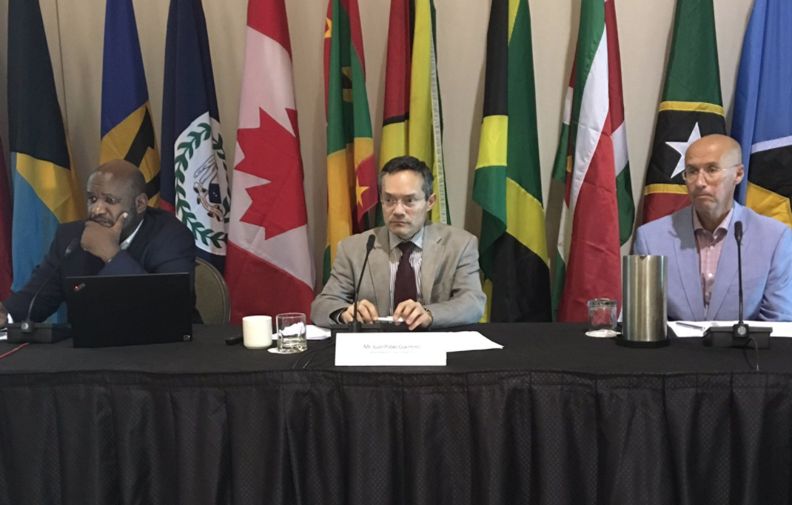

Slide 12
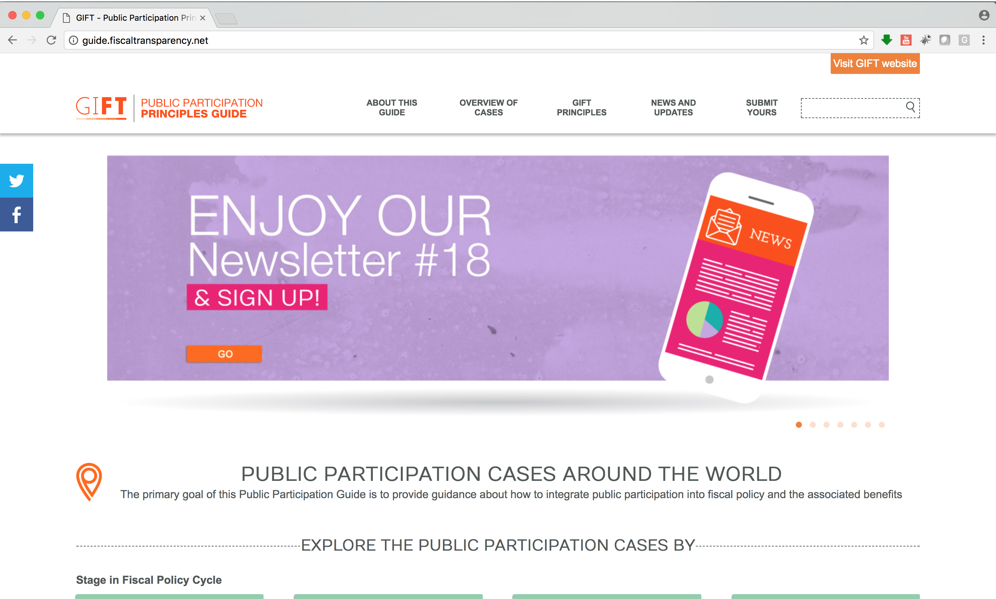
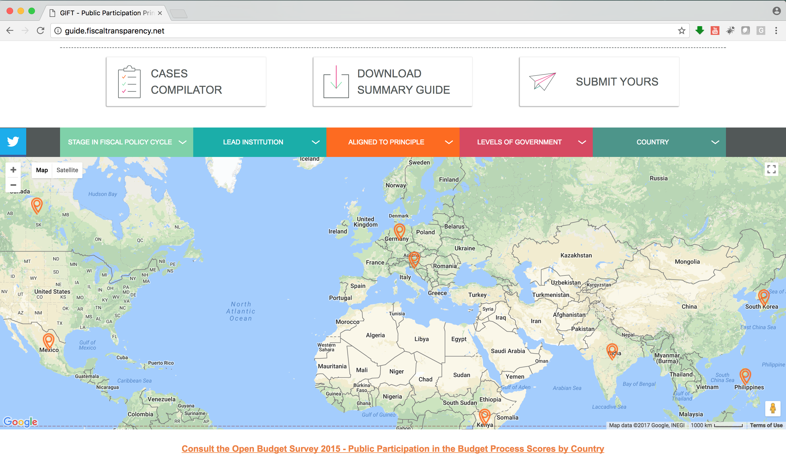

Slide 13
Peer Learning + TA: putting the public @ center of FT
Fiscal Transparency Portals, including high quality open data source
Public participation principles adoption & implementation
Engaging Open Contracting Partnership
OGP NAP comments and field missions on FT+PP

Slide 14
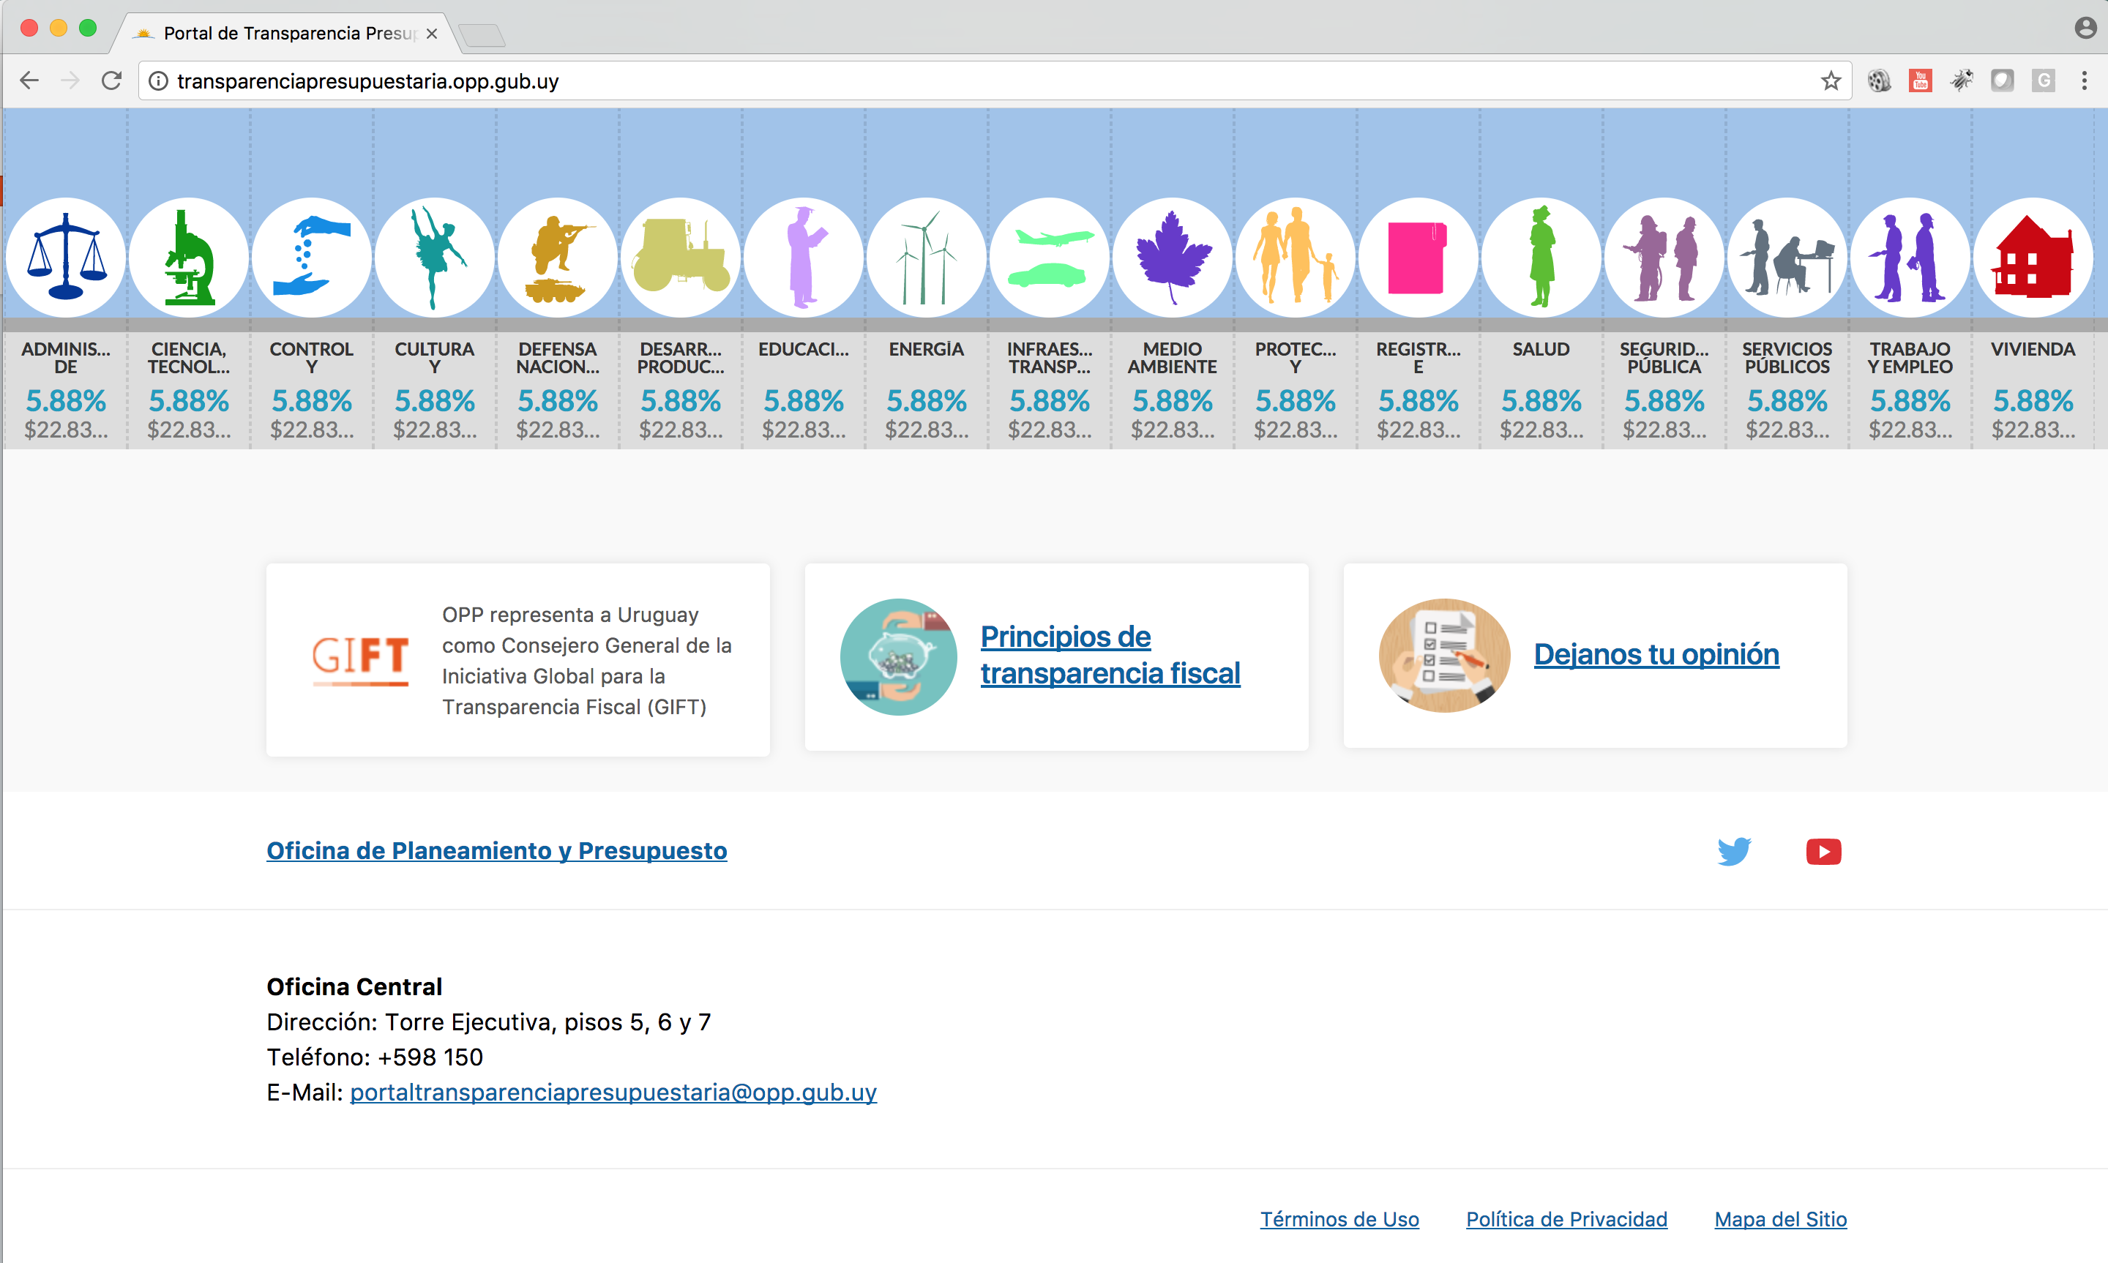

Slide 15
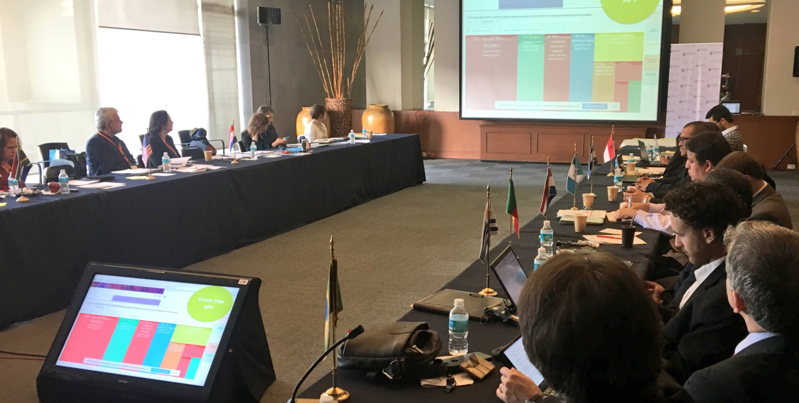
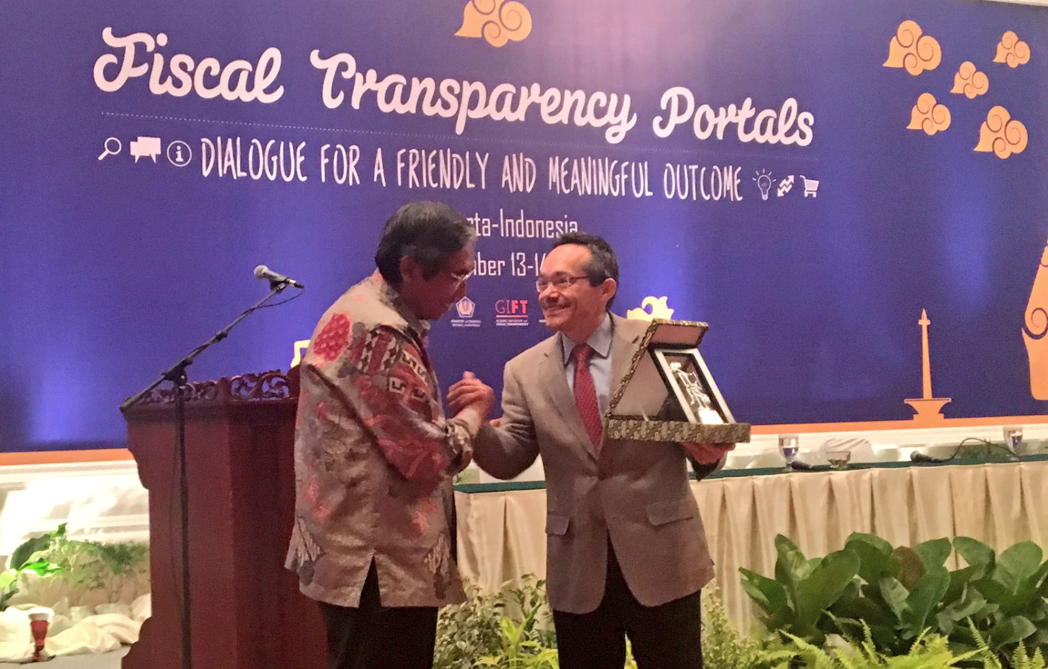
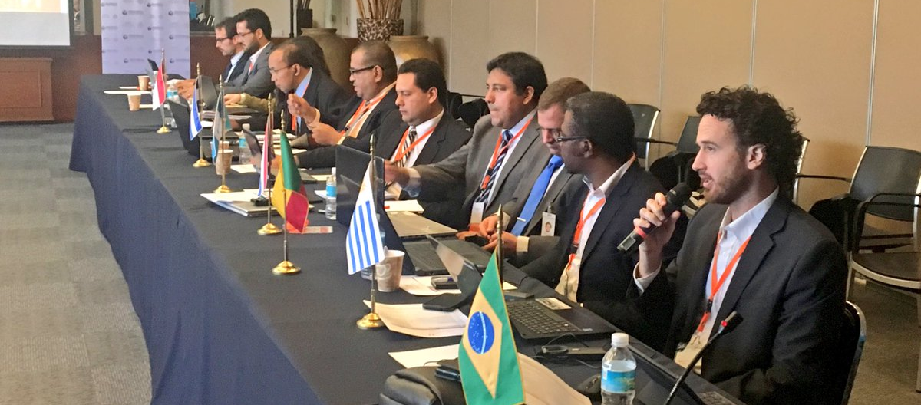
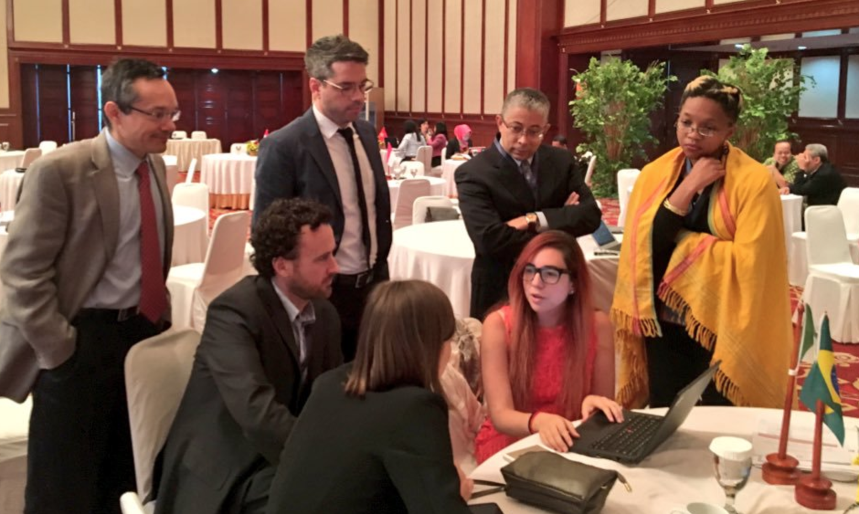
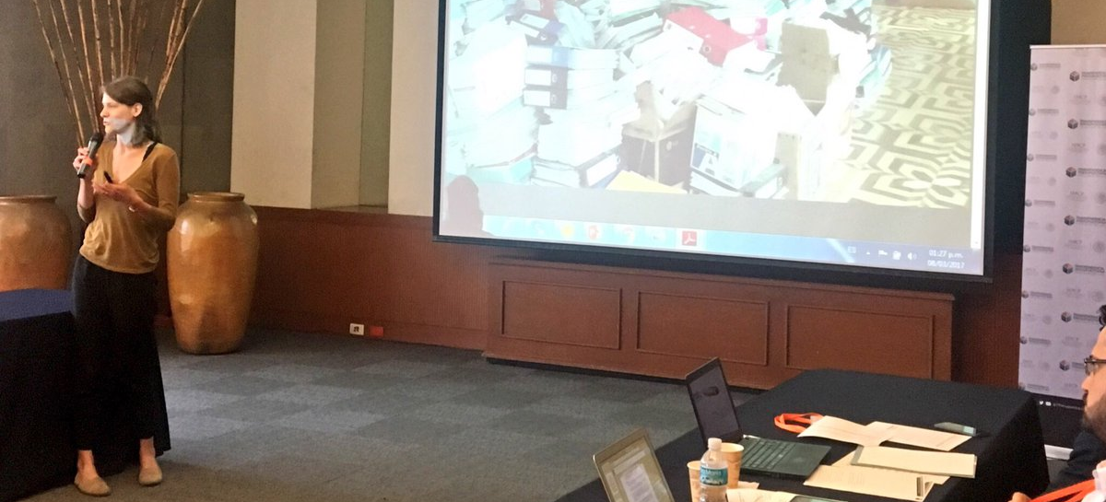

Slide 16
Incentives to motivate FT+PP reforms
Evidence on impact research, analysis on incentives, case studies, use of information, disseminated in all formats
Collaboration with Emerging Markets Investors Alliance (FT briefs) and IFAC (Accountability.Now)

Slide 19
New Technologies and Open Data
The network has developed a tool (WB-Boost team + Open Knowledge international) and is using it: Open Fiscal Data Package
Community of Practice and the IT group

Slide 20
1. GIFT Priorities in 2018-2020
Global Norms: emphasizing public participation, public service delivery & addressing the revenue side of the fiscal equation
TA + Peer-learning for country level fiscal transparency implementation (more work in East and West Africa, Central, Eastern and Southeastern Europe and Asia)

Slide 21
2. GIFT Priorities in 2018-2020
Practical tools for public participation and transparency (ICT & open data)
Development and enhancement of the impact of the GIFT network

Slide 22
Engage with us
@FiscalTrans
www.fiscaltransparency.net

