Slide 1
GIFT and IBP Pilot PROJECT on PUBLIC PARTICIPATION
Portugal Meeting: October 16th 2018

Slide 2
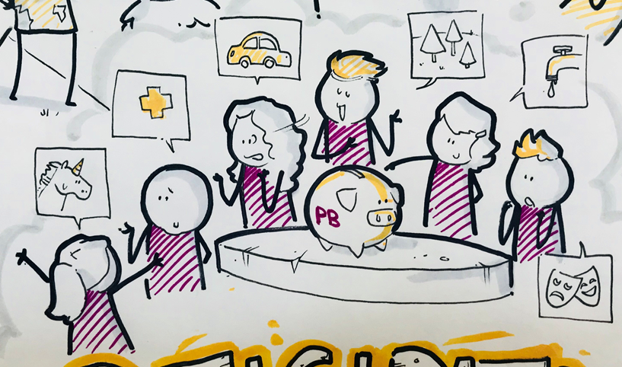

Slide 3
OUTLINE OF PILOT PROJECT ON PUBLIC PARTICIPATION
Project- To support select governments to pilot practical and meaningful mechanisms for engaging with citizens on fiscal policies.
Support pilot projects in 4-5 countries on public participation mechanisms;
Document the pilots; and
Adapt resources from the pilots and develop additional resources to help others replicate these experiences.

Slide 4
SUMMARY OF SURVEY RESPONSES
INCENTIVES FOR ENGAGING PUBLIC
Build public trust
FAMILIARITY WITH MECHANISMS
Two way exchange of information through meetings, discussions, workshops or consultations
Meetings with stakeholders only
RELATION WITH CIVIL SOCIETY
Yes, almost all governments who responded to the survey confidently named civil society organizations that they have been working with.
Accountability
Identify policy priorities
OGP commitments- organized engagement with civil society; participation in governance.
Disclosure of information

Slide 5
SUMMARY OF SURVEY RESPONSES
HIGH LEVEL SUPPORT WITHIN MINISTRY
Survey results generally conveyed ministries commitment to transparency and public engagement.
TIME & PERSONNEL COMMITMENT
Most countries mentioned the unit that will likely be in charge of the project- budget reform unit, fiscal transparency unit
GIFT, IBP RESOURCE SUPPORT
Cross country experiences and best practices
Technical assistance or access to experts
Experience with implementation of the participation process

Slide 6
?
Identify Countries for Pilots

Slide 7
PARTICIPATION PILOT ENGAGEMENT LETTER

Slide 8
Phase I: Setting the Stage
a) Establishing a national advisory group
Identify the objective of public participation
Identify the topic that the participation mechanism will cover (e.g., social spending policies, public services, etc.)
Identify the appropriate participation mechanism
Draft a research plan for assessing the impact of participation
Draft a timeline for implementing the mechanism
b) Selection of an international advisory group
experts in the field of public participation who will advise on the design, implementation and evaluation of the overall project and on country-level plans
c) Kick-off meeting
IBP, GIFT, national and international advisory groups (other stakeholders) convene

Slide 9
Implement mechanism;
Document process, evidence for impact research;
Phase III: Putting all the pieces together
Conduct a comparative analysis of public participation in the field of fiscal policy;
For each country-
Analyze, incorporate inputs;
Meeting with all groups
Evidence-based evaluations;
Strengthen our guidance to governments.
Phase II: Moving to Action

Slide 10
At the end of the project we should have:
Four to five countries with meaningful participation experience in the budgeting process;
Country case studies, with findings and recommendations;
Revision of Open Budget Survey indicators in the participation section;
Comparative review and assessment of all cases, with findings and recommendations;
An executive document to guide GIFT community on the next steps.

Slide 11
Draft tentative timeline for implementing mechanism:
The suggested timeline for each mechanism is 20 to 30 months.
Timeline | Activity
Three to four months | National advisory group meets to identify focus of public participation, the participation mechanism and draft workplan.
Three to four months | Discuss and refine workplan for implementing participation mechanism; develop evaluation framework.
Two to three months | Advertise participation opportunity; mobilize participants; distribute information needed to prepare for participation.
Four to eight months | Implement and document mechanism. Incorporate citizen inputs into draft budget; inform citizens of how inputs were used in draft budget.
Four to six months | Evaluate participation process and outcomes.
Four to six months | Comparative analysis of public participation in budgeting

Slide 12
Q&A Thank you

