Slide 1
MINISTRY OF FINANCE
OF THE REPUBLIC OF INDONESIA
GIFT MEETING
Cascais Portugal, 15-17 OCT 2018
IGA Krisna Murti
Staff of Ministry of Finance

Slide 2
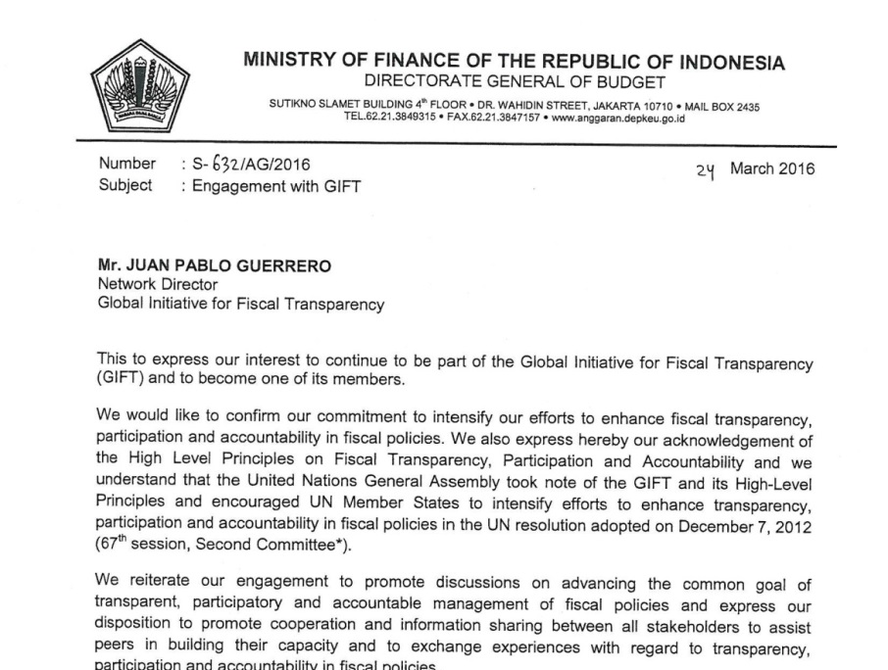
COMMITMENTS
BUDGET TRANSPARENCY IS THE ONE PART OF FISCAL REFORM
ENGAGEMENT WITH GIFT (BECAME A STEWARD)

Slide 3
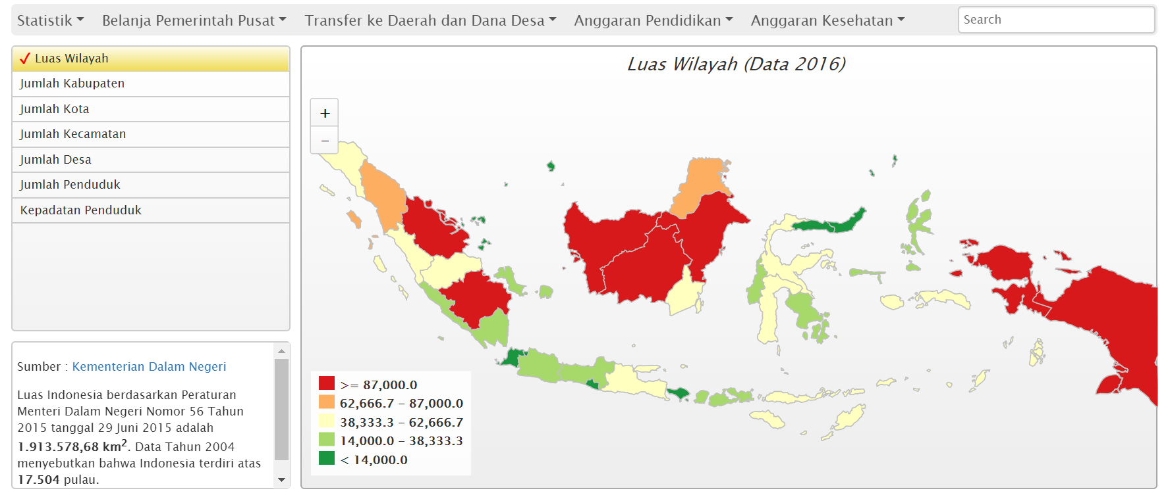
OUR PORTAL
PUBLISHING BUDGET DATA ON OFFICIAL WEBSITE
www.data-apbn.kemenkeu.go.id

Slide 4
THE MOST SALIENT ACTION
ENCOURAGING PEOPLE TO UNDERSTAND ABOUT THE BUDGETING PROCESSES :
REGIONAL ECONOMIST MEETING
BUDGET GOES TO CAMPUS (GRADUATE LEVEL)
DJA’s GREETING - DJA MENYAPA (HIGH SCHOOL LEVEL)
SCREEN DISPLAY AT COMMUTER LINE - TRAIN (PUBLIC)
APBN OLYMPIC (HIGH SCHOOL LEVEL)
NOT JUST LEARN ABOUT BUDGET :
BUDGET DISSEMINATION IN ANOTHER FORMAT
HUMANISM MISSION : HELD THE DJA’S GREETING AT THE DISASTER AFFECTED AREA – RAISING THE STUDENTS SPIRIT TO GO TO THE SCHOOL

Slide 5
CONTRIBUTIONS
HOSTING GIFT MEETING at JAKARTA 2016 – REACH THE TARGET OF PORTAL DATA LAUNCHING
SEND THE SPEECH OF MINISTRY OF FINANCE INDONESIA (recorded video) FOR 2017 OBS SURVEY LAUNCHING – INCREASING THE MINISTER AWARENES ABOUT THE OPEN DATA
ATTENDANCE OF THE GIFT MEETING
NEXT .. NEED GIFT SUPPORT TO IMPROVE THE LINE MINISTRIES OF AWARENESS ABOUT THE IMPORTANCE OF OPEN DATA AND DEVELOPMENT OF ANY DIGITAL TOOL (DATA PORTAL) SO THAT PEOPLE UNDERSTANDS THE BUDGETING PROCESS.

Slide 6
THANK YOU

