Slide 1


International Data
Standards Connectivity
Unleash the power of data by linking standards

Slide 2


Opening fiscal data using International Standards can be seen as an uphill walk…
We’ve managed to navigate that path…
Big question remains: does that make information more accesible by default?

Slide 3
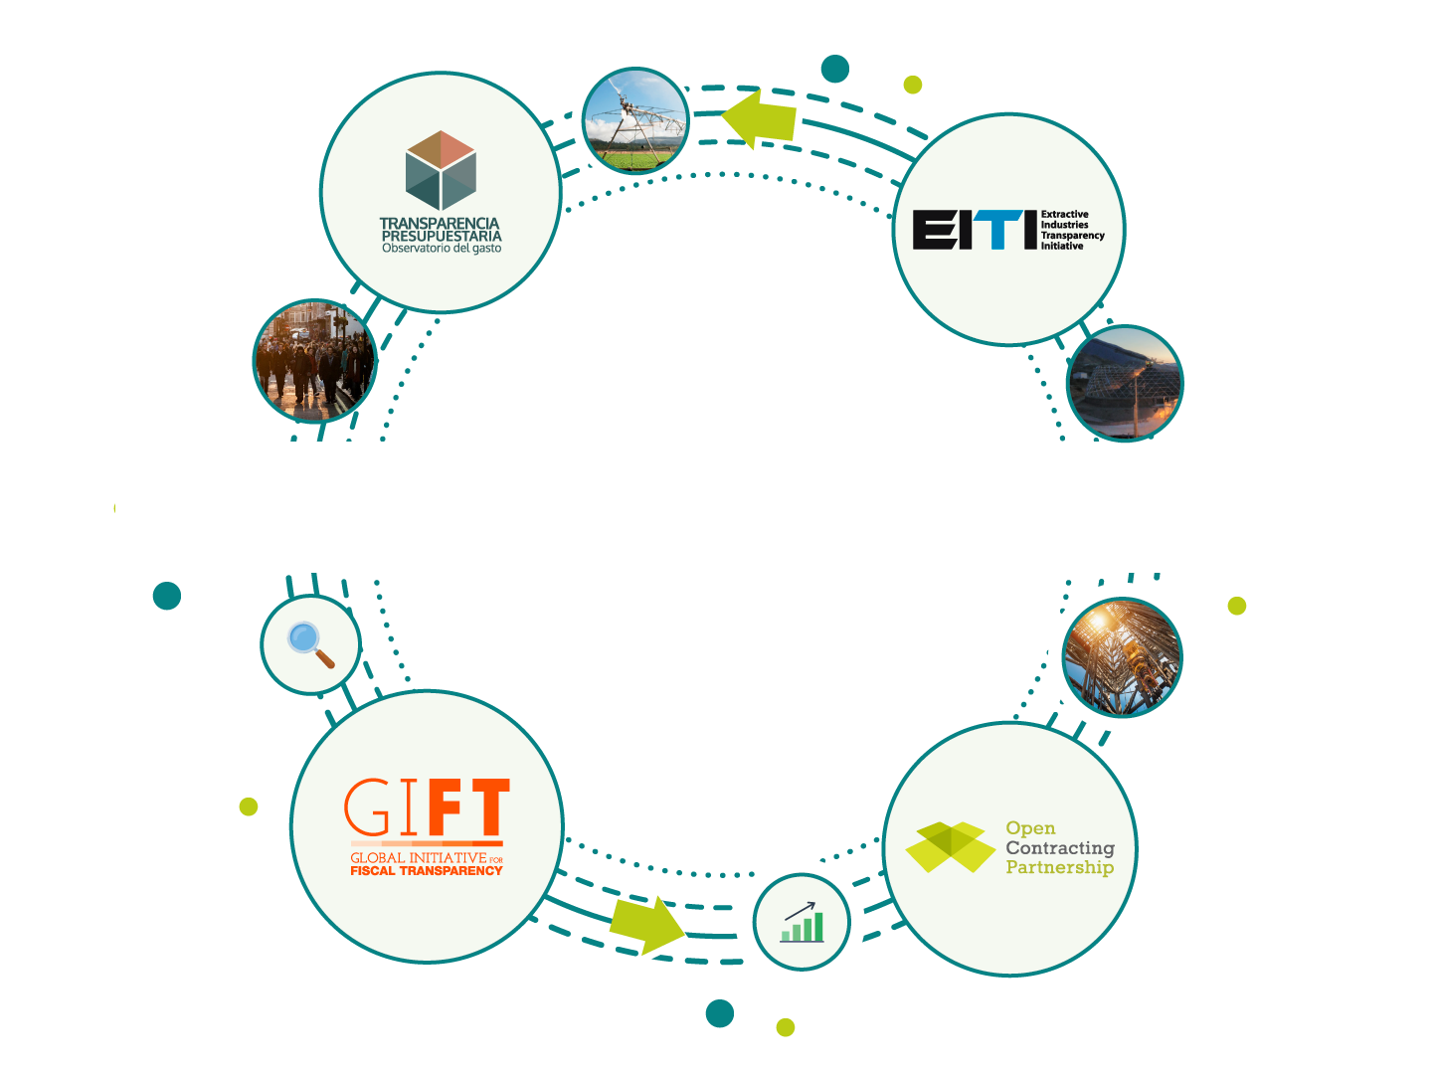
Unleash the power of data by linking standards

Slide 4

Maria walks from the subway station to work everyday.
Today she noticed a huge bridge she’s been watching from her office, for quite a bit, was moving forward fast and she asked herself…
How much of MY money must have gone into that?

Slide 5
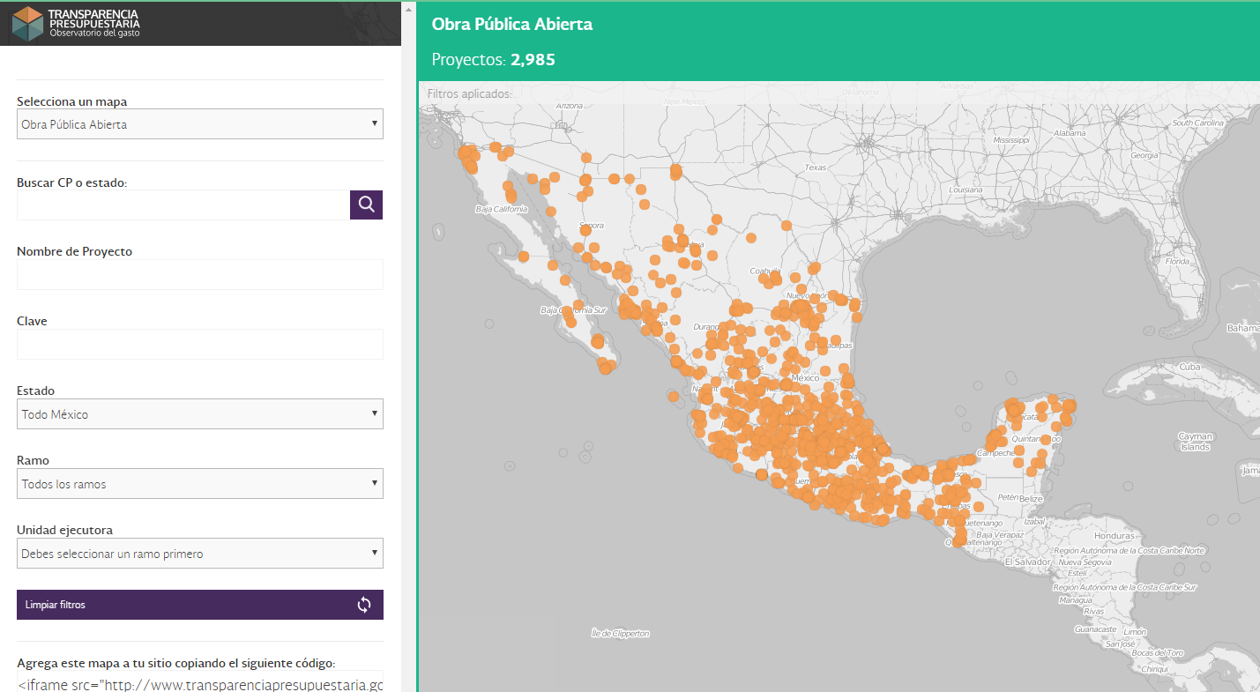
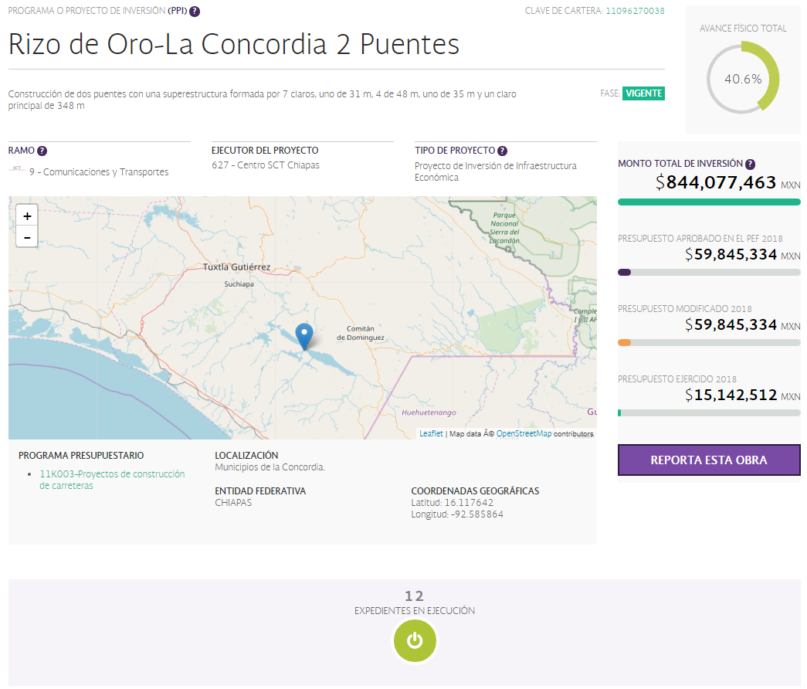

She would like to know where money came from, if there is a way to track if the project is more expensive than others,
whom benefited (socially and privately) from it…
How are they building this?

Slide 6


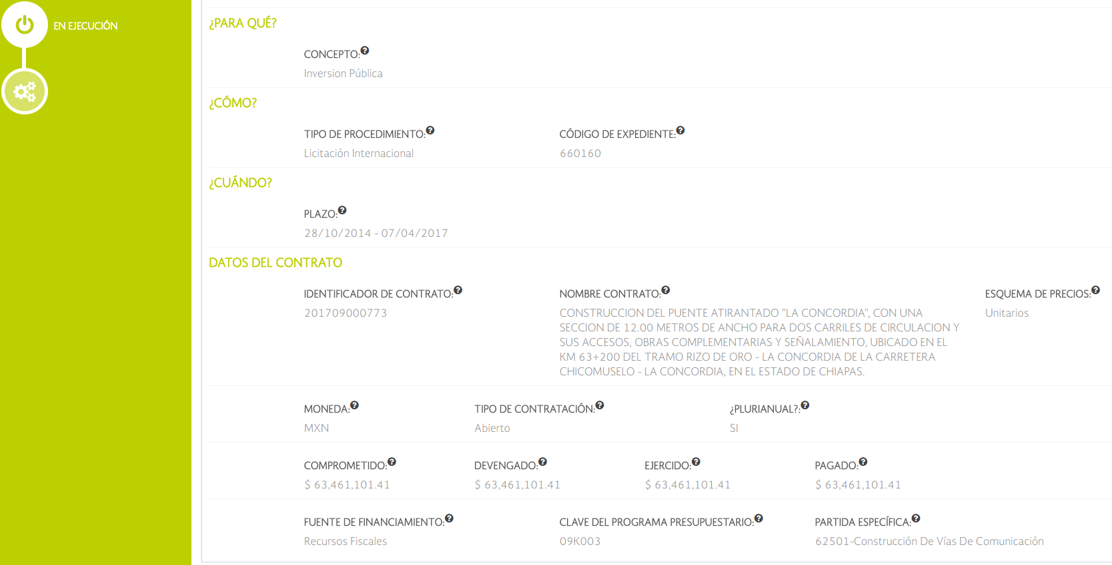

With a single clic she can find
details on how many contracts
have been awarded to build the bridge,
to whom and how much has been been payed…
She can also find the source of funding.
Any other projects financed by this?

Slide 7
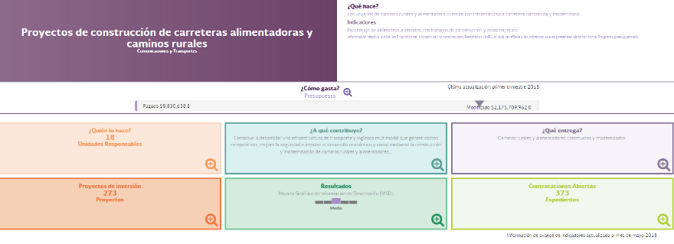
How many governmental offices participate in this kind of projects?
How many projects have the same source of funding?
Is there any performance measurement of this type of spending?
What about evaluations?
Ready to get to work!

Slide 8

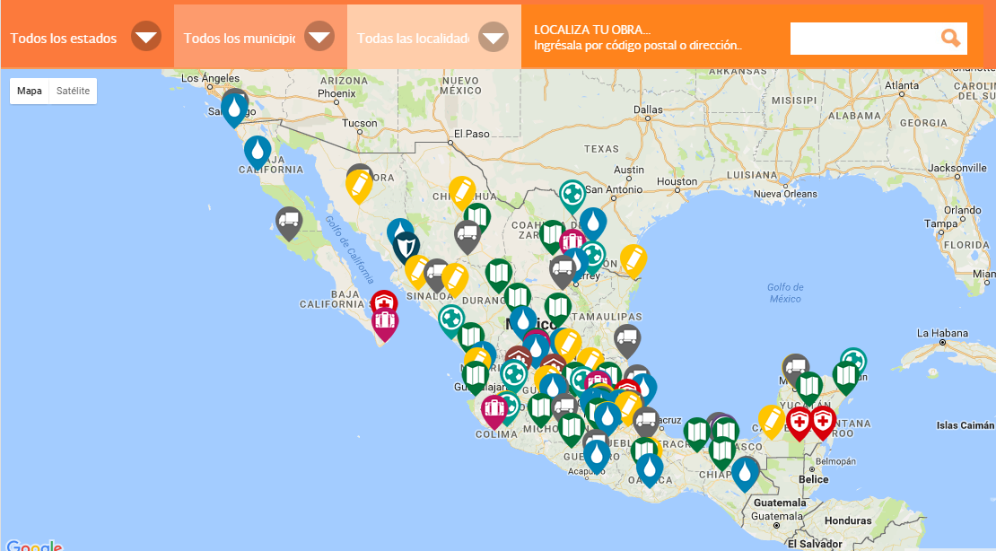
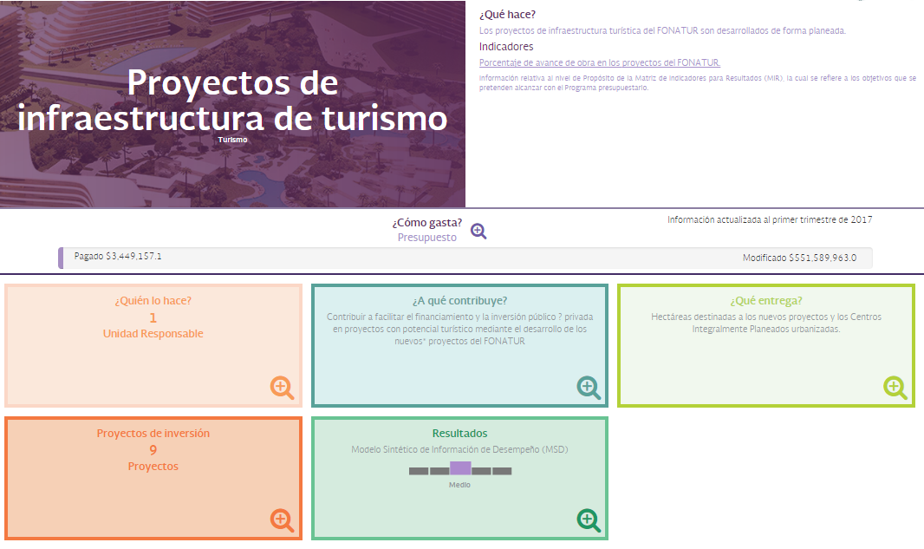
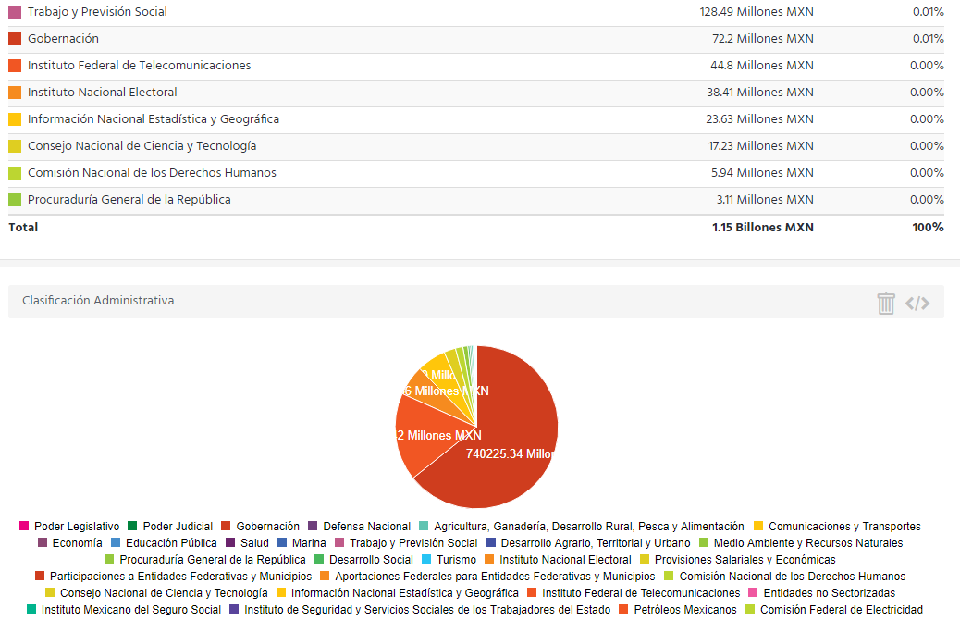
Why? Key rationale behind linking information
While linking standards entails heavily technical work…
it is a human-centered initiative.
Re-use
information
Show impact!
Provide context

Slide 9
Let’s take it to the next level…
TAKE 1
International Comparability
Providing citizens with tangible information about hot topics - such as extractive industries or contract’s procurement- by linking them to the federal budget
TAKE 2
Bringing budgetary data to everyday stories SEEMLESSLY (without the user having to mind how to figure it out).

Slide 10
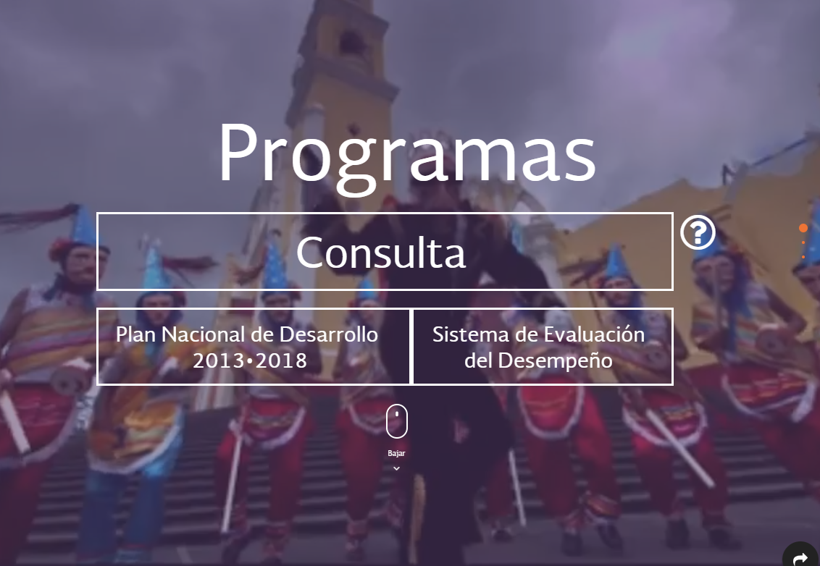
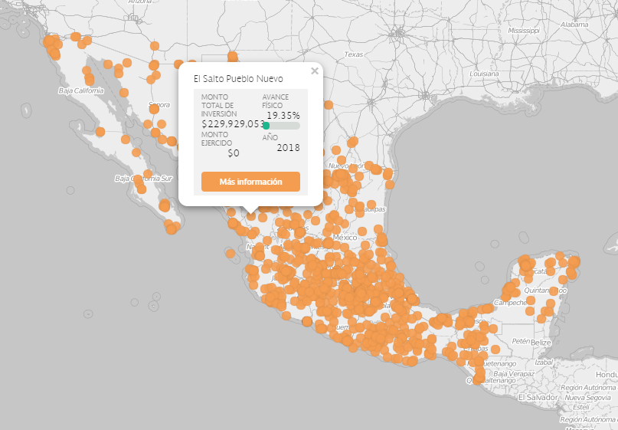
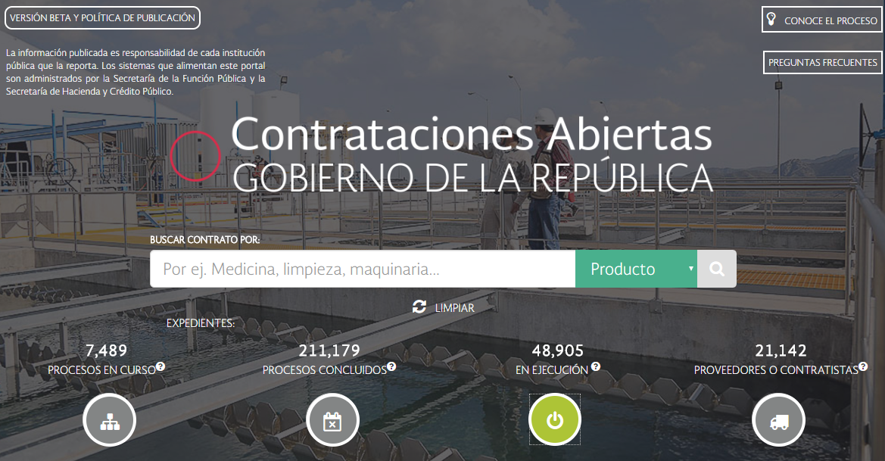
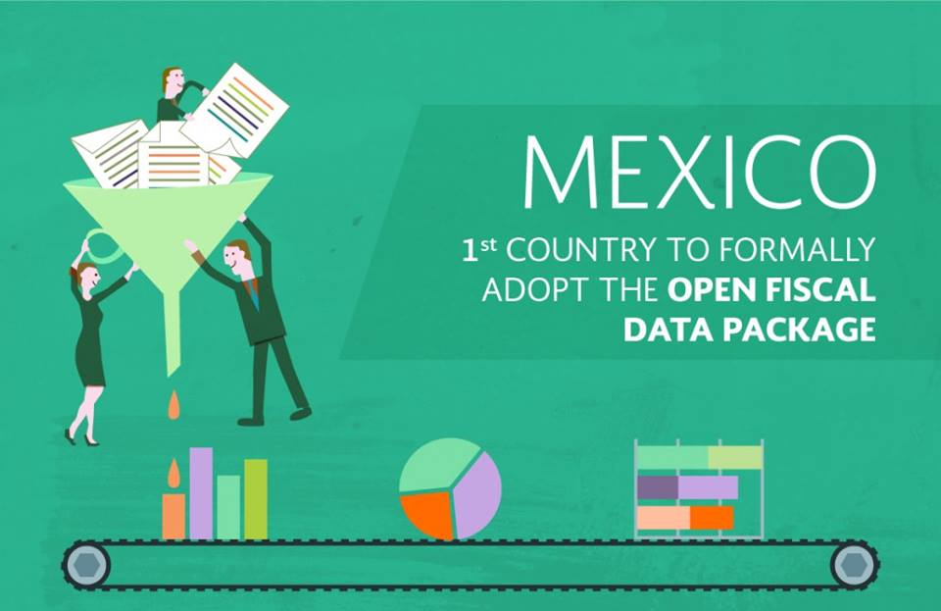
The link behind the story: many data sets, many platforms, one person.
FEDERAL BUDGET
  Programs (cash-transfers, subsidies, etc.)
PUBLIC
INFRASTRUCTURE
CONTRACT
EXECUTION
  Geo-located data
  Useful filters in search engine (including ZIP code)
  Cost-Benefit Analysis
  Source(s) of funding
  Public-private partnerships
  Tender
  Awarding mechanism
  Contract ID
  Context about the procurement process
PERFORMANCE INFORMATION
  Indicators
  Independent Evaluations and their follow-up mechanism
OPEN FISCAL
DATA PACKAGE
  Most granular level of information
  … ALL IN #OPENDATA

Slide 11

How to build the bridge?

Slide 12
Mexico’s Current situation:
  Mexico has successfully implemented the Open Fiscal Data Package (OFDP), and is currently in the process of implementing the Open Contracting Data Standard (OCDS) and the Extractive Industries Transparency Initiative (EITI).
  Each standard requires to disclose a specific set of information, which comes from different systems and it’s reported by different agencies or organizations.
100%
OFDP
100%
OCDS
80%
EITI
Notes:
Encontrar imagen para el fondo

Slide 13
Mexico´s Experience:
Step by step:
Match available information with the standard requirements.
Identify sources of information.
Localize pivot entries.
Model the information against the standard.
Publish!
Important!
Concentrate on not duplicating information, but on including only the necessary pivot entries that would allow you to move from one standard to another
Notes:
Encontrar imagen para el fondo

Slide 14
Open Fiscal Data Package

Slide 15


Match available information with the standard
The Open Fiscal Data Package offers a standardized framework to present fiscal data by its different classifications, measures and levels of disaggregation.
Mexican Example:
Administrative: by using the administrative classification, you can organize budget data to show who is spending (i.e. Ministries, Responsible Units).
Functional: the functional classification allows users to know what is the spending for (i.e. economic or social development, governmental functions, etc.)
Economic: the economic classification allows you to specify what are you buying, in other words, allows you to disaggregate information all the way down to the line item.
Important!
OFDP enables users to establish a tailored ecosystem around fiscal data, specific to the national context in which data is embedded
With this level of disaggregation, we can link the OFDP with the Open Contracting Data Standard

Slide 16
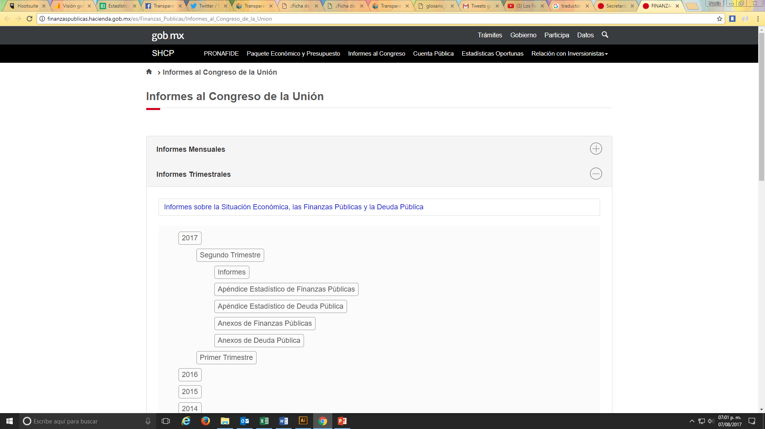
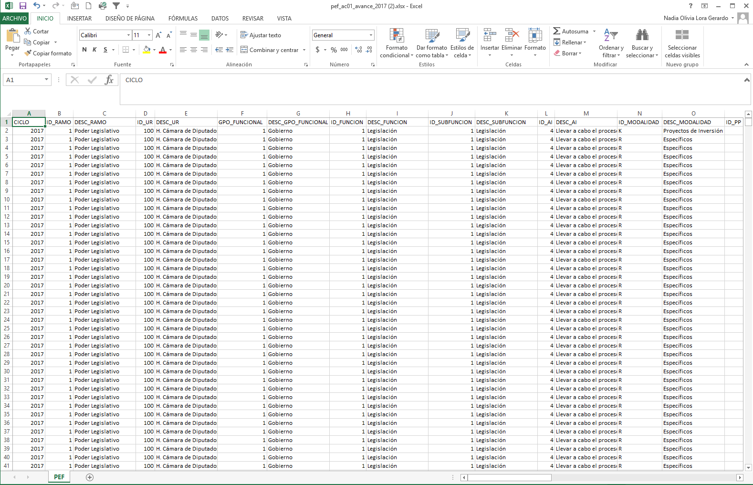
Identify sources of information

Slide 17
Pivot entries
Who is responsible of spending it?
Administrative classification
Ministry +id
Responsible unit +id
Program +id
What is it spent on?
Economic classification
Most disaggregated spending level: line item
Budgetary program
Level of specificity:

Slide 18
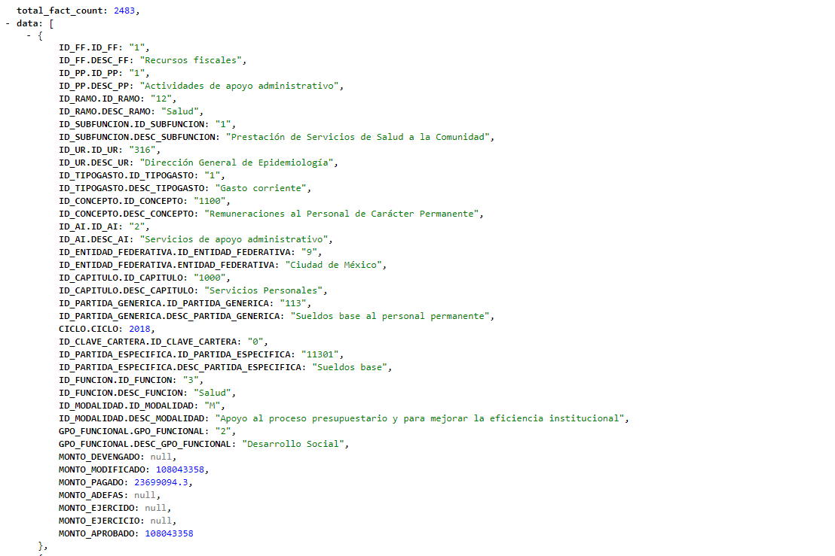
Modeling information
  … ALL IN #OPENDATA

Slide 19
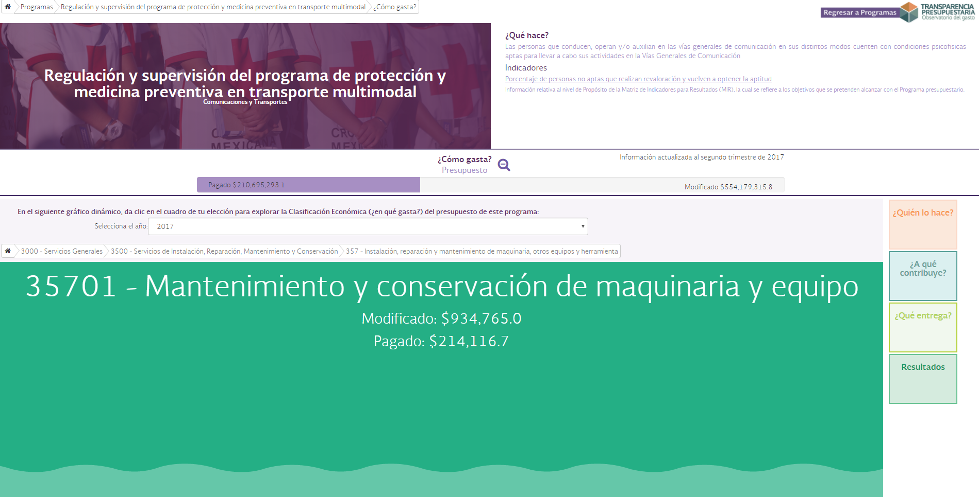
Publish!
  …IN #OPENDATA

Slide 20
Open Contracting
Data Standard

Slide 21
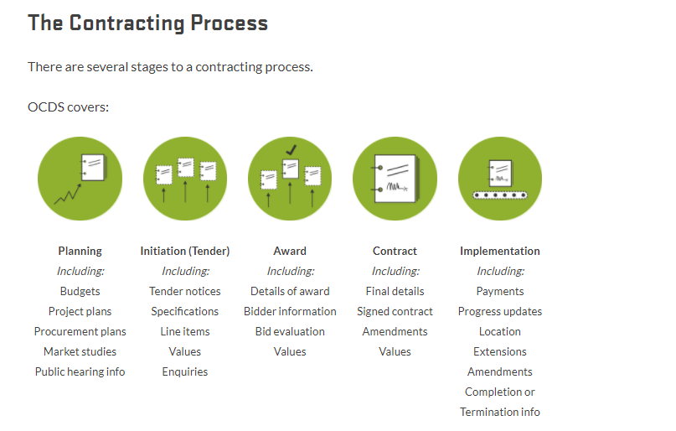
Match available information with the standard
Find information available

Slide 22



Identify sources of information
Planning
Tender
Open Fiscal Data Package
SICOP-available budget
Award
CompraNet
Implementation
CompraNet
Auditing
Open Fiscal Data Package
SICOP (Accounting)
SIAFF (Transactional)
Indicators API (Performance)
MIPPI (Infrastructure)… including …
Public-Private Partnerships
Investment projects binnacle

Slide 23
Pivot entries
By using Open Contracting Data Standard extensions we are able
to make the link:
Who spends?
Ministry +id
Responsible unit +id
Program +id
In what?
Most disaggregated spending level
(Economic classification): line item
Important!
Budget breakdown extension allows you to link several pivot entries and express their value using different spending measures: it is key to involve Ministries of Finance to achieve the link.
  +

Slide 24
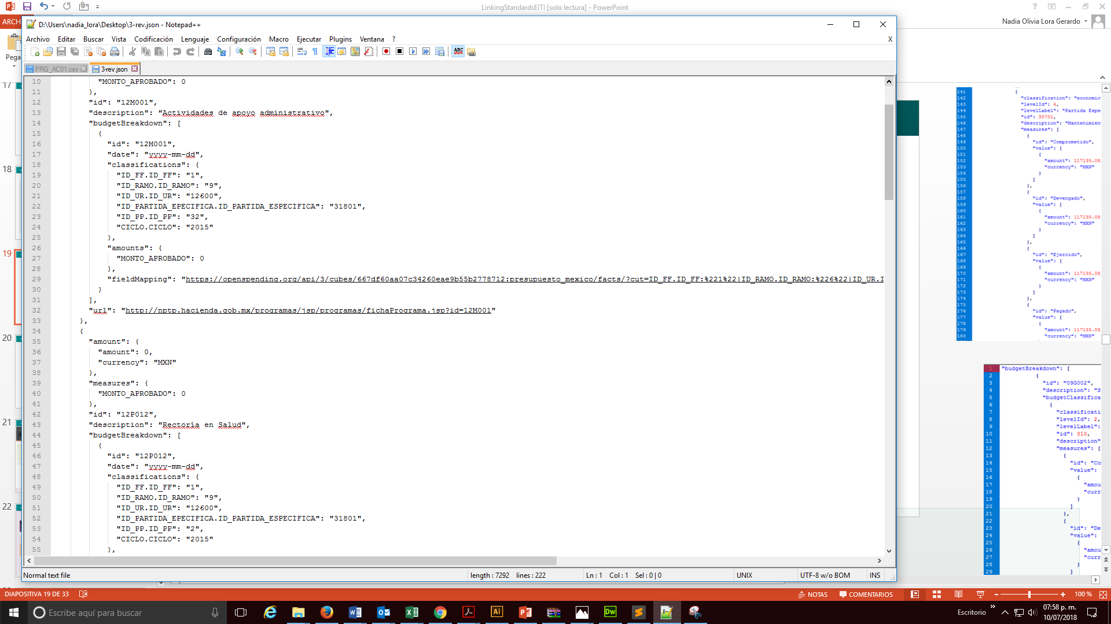
Modeling information

Slide 25
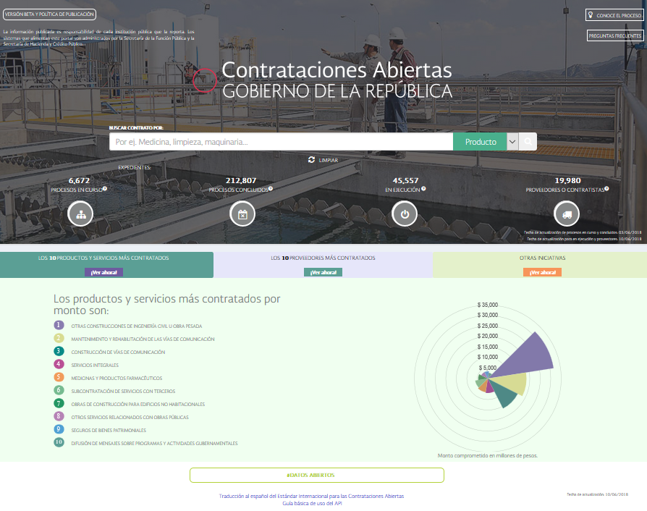
Publish!

Slide 26
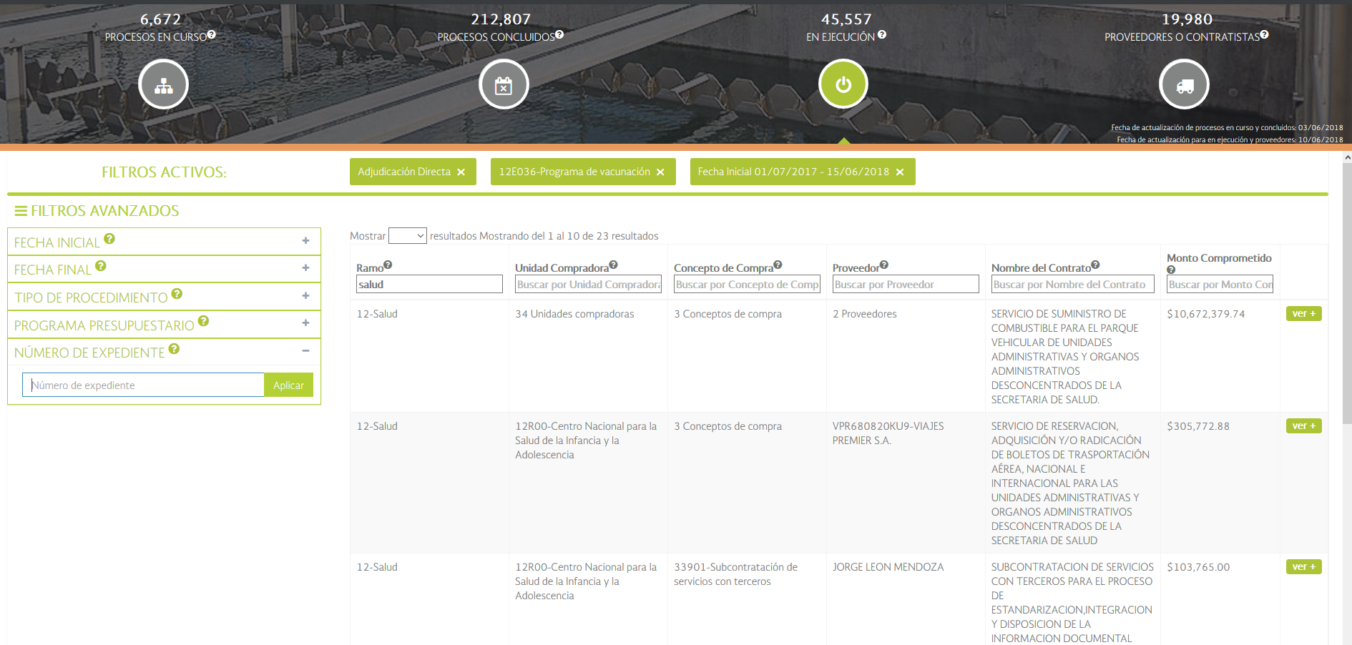
Publish!

Slide 27
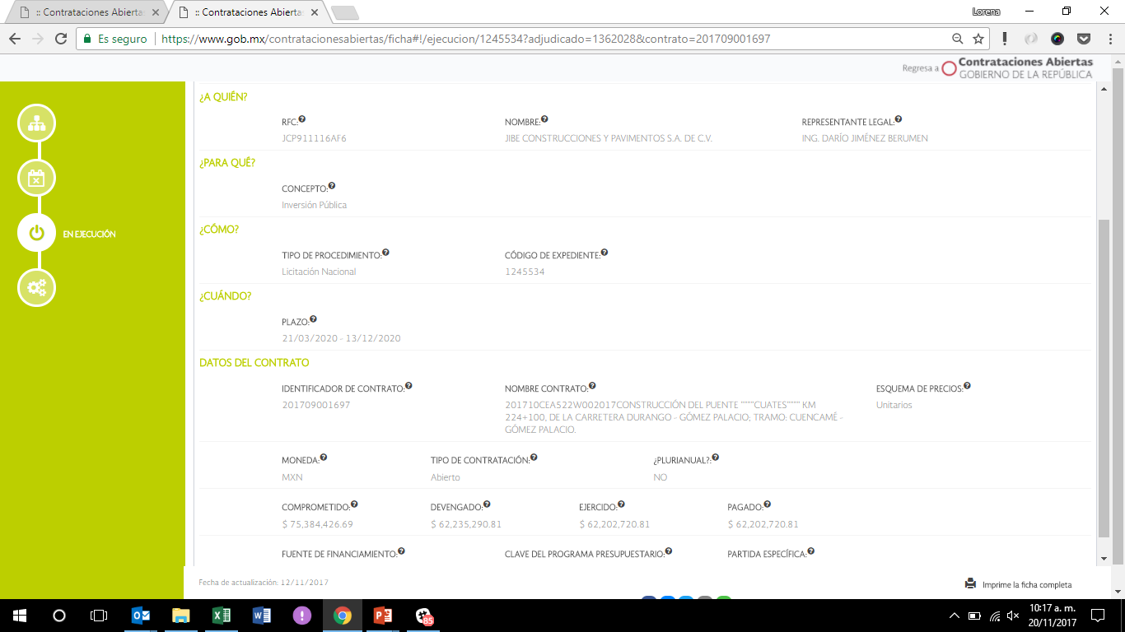

Slide 28
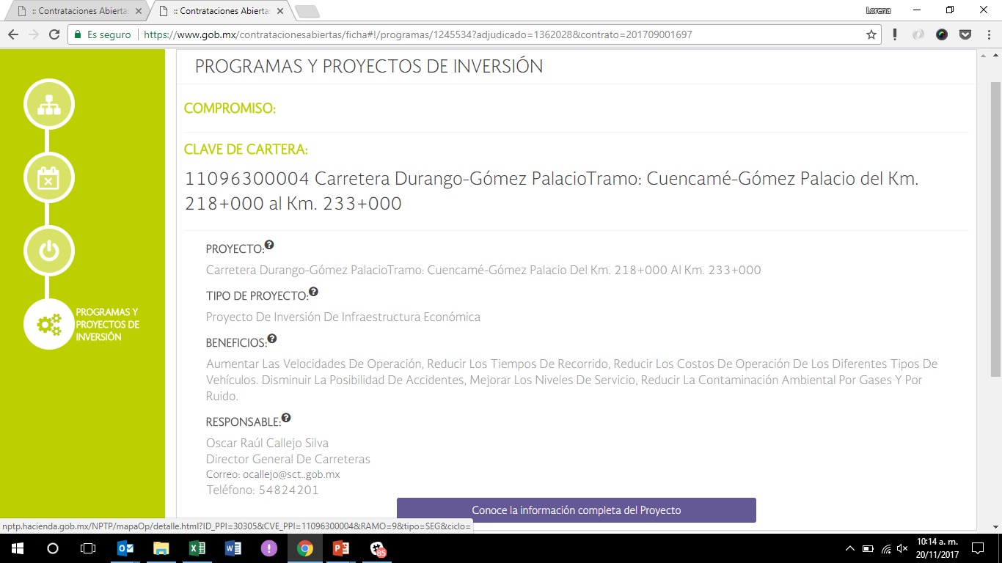

Slide 29
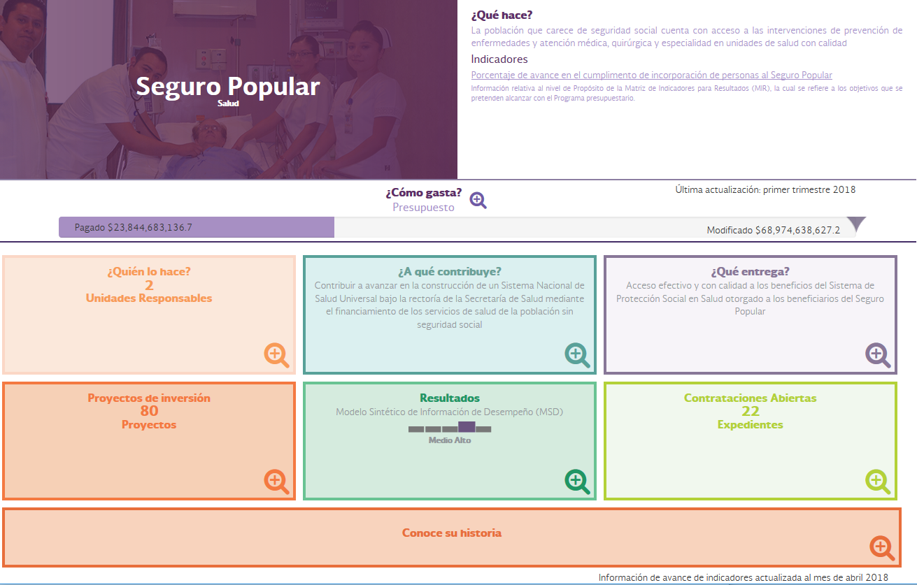
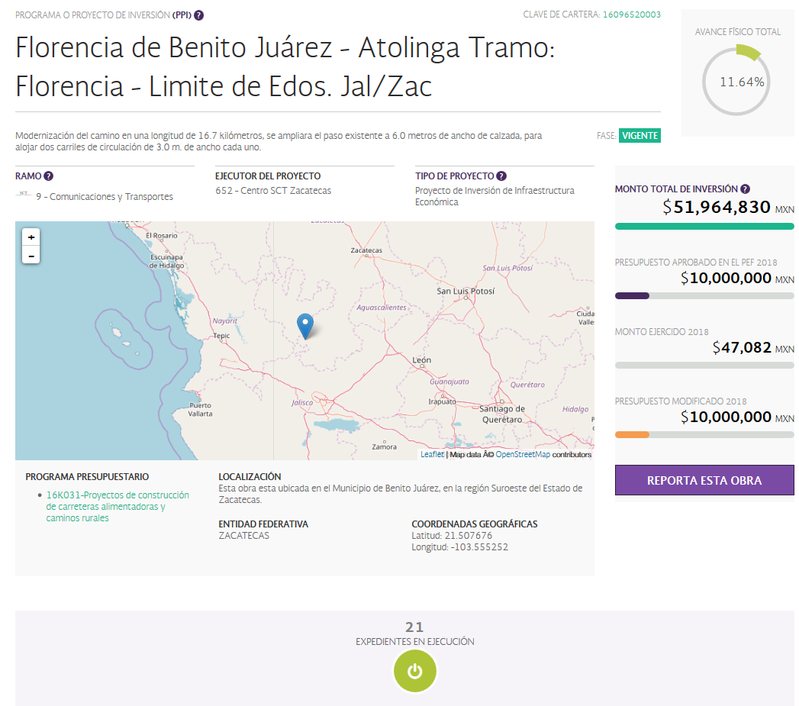

Publish!
Federal Budget
Investment projects
+
  #OPENDATA
+

Slide 30


Slide 31
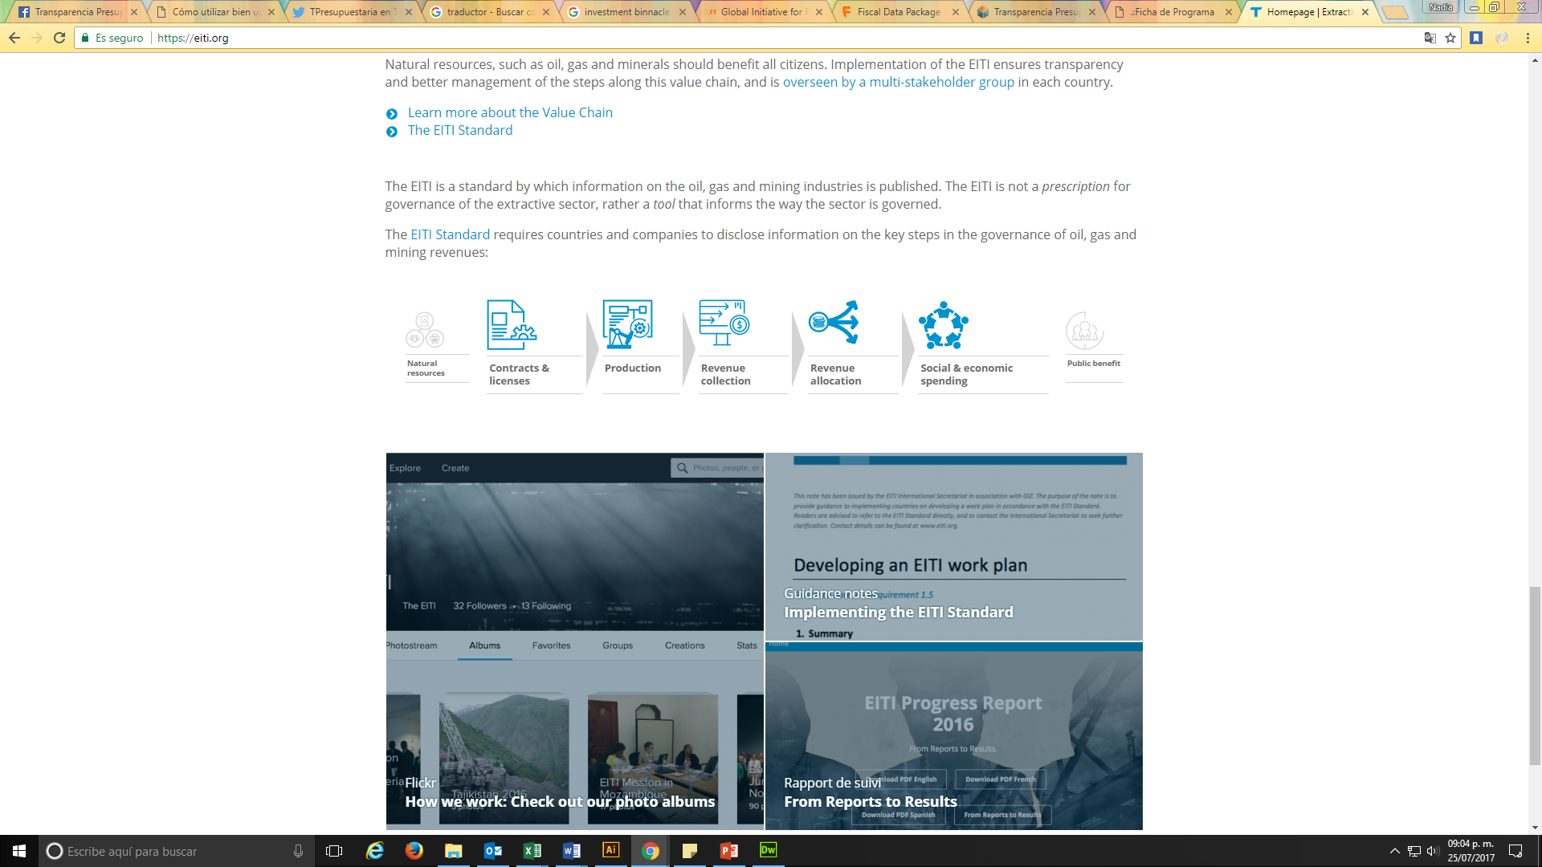
Match available information with the standard
The EITI is the international standard for the Extractive Industries’ transparency, whose main objective is to disclose information regarding the payments made by enterprises and the revenues received by the State.
The EITI Standard requires countries and companies to disclose information on the key steps in the governance of oil, gas and mining revenues:
Income
Income
Expenditure

Slide 32
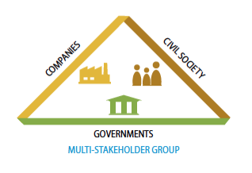





Identify information sources

Slide 33
Pivot entries
Incomes and Contracts’ information
OCID
ID_CONTRATO
The revenues in EITI will be tied to their contracts; thus, the user will be able to navigate trough standards with the “ID_CONTRATO”, plus the entry “OCID” with be added to the EITI standard to properly connect the whole procurement process.
  +

Slide 34
Pivot entries
Expenditures
Mexico will be the first country to track expenditures in EITI and this will be connected will all the information regarding Federal Expenditures through the Open Fiscal Data Package. This will be achieved by connecting these standards with 4 key entries:
Ministry +id
Responsible unit +id
Program id
Most disaggregated spending level (Economic classification): line item
id_ramo
id_modalidad
id_pp
id_partida_especifica
  +

Slide 35
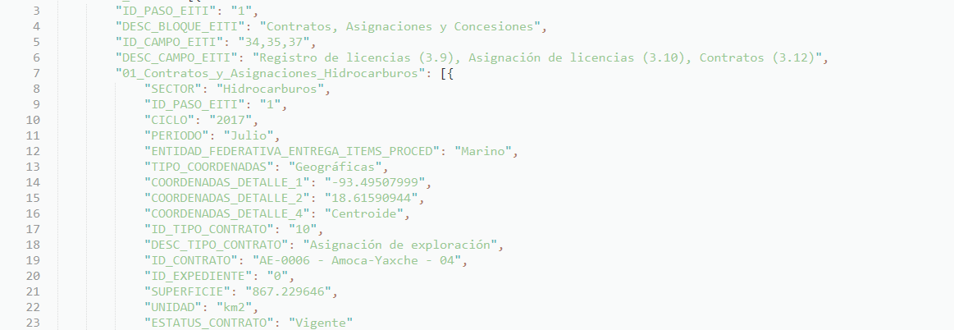
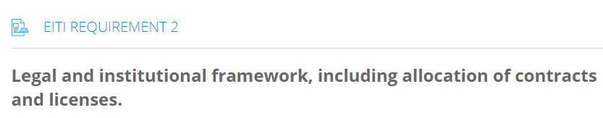
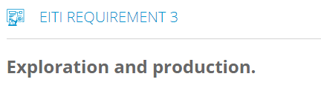
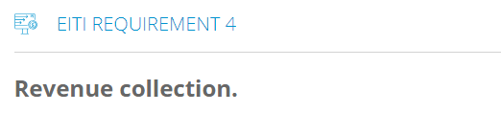
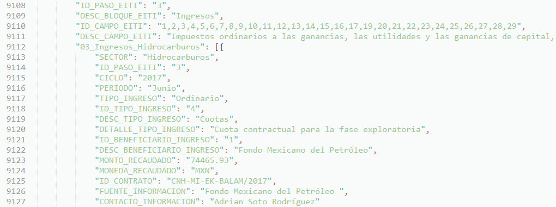
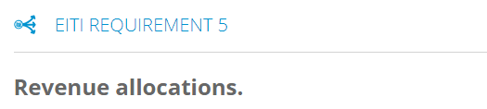
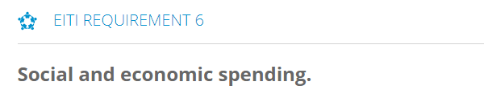
Modeling information
EITI STEP
REQUIREMENT

Slide 36
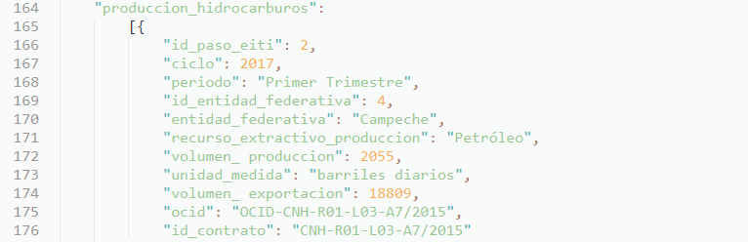

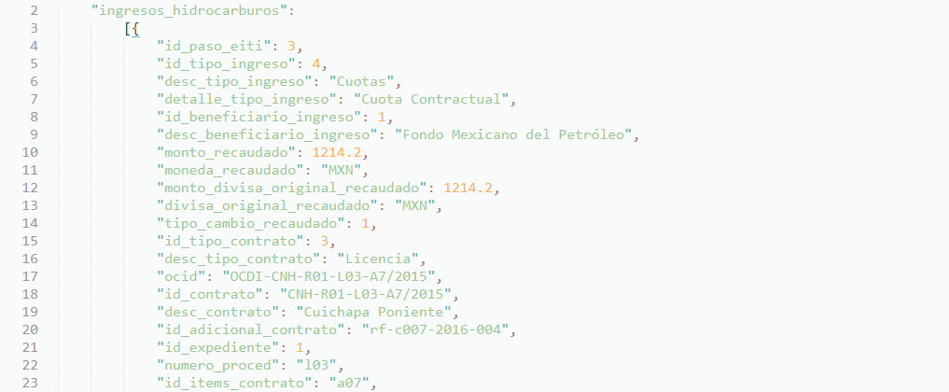
Modeling information
EITI & Open Contracting

Slide 37
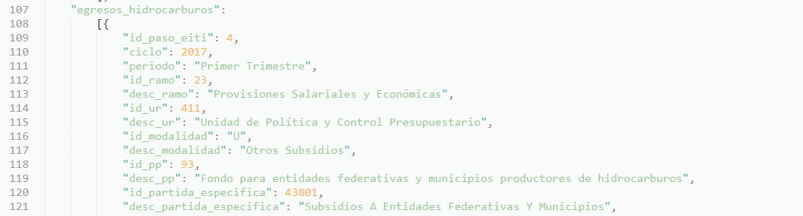
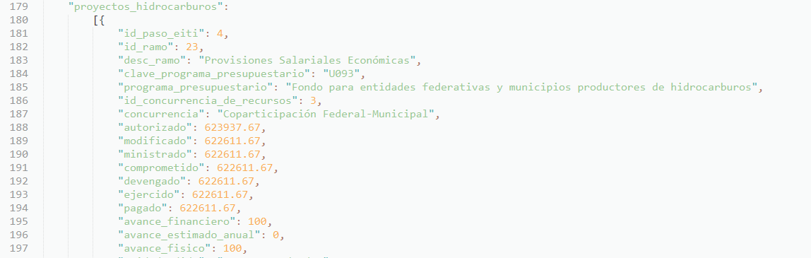
Modeling information
EITI & Open Fiscal Data Package
Expenditure
Expenditure

Slide 38
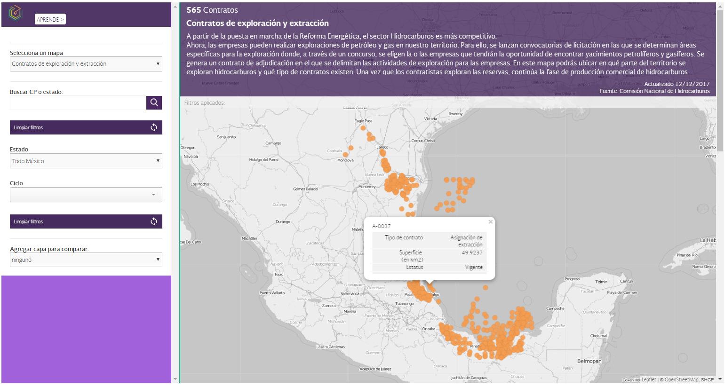
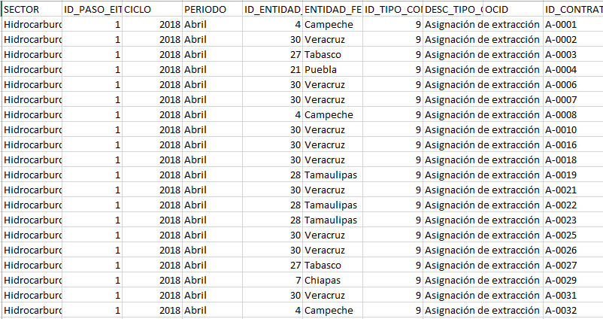
Publish!
Contracts

Slide 39
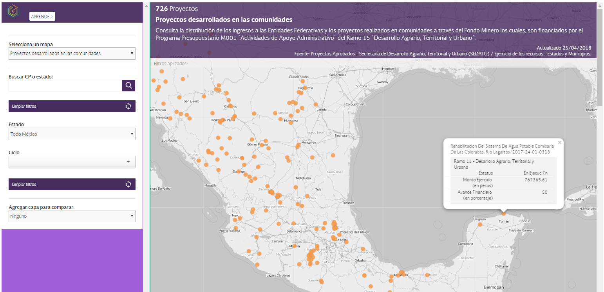
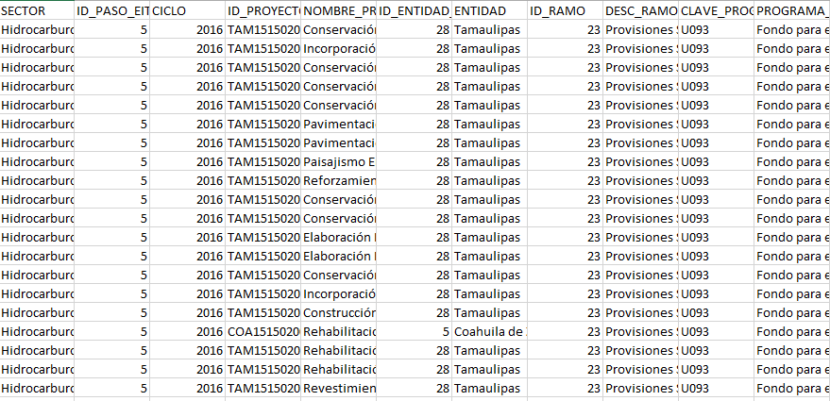
Publish!
Infrastructure projects

Slide 40
Lorena Rivero del Paso
General Director of Performance Monitoring and Information Analysis
Ministry of Finance and Public Credit
lorena_rivero@hacienda.gob.mx
@LorenaRDP

