Slide 2
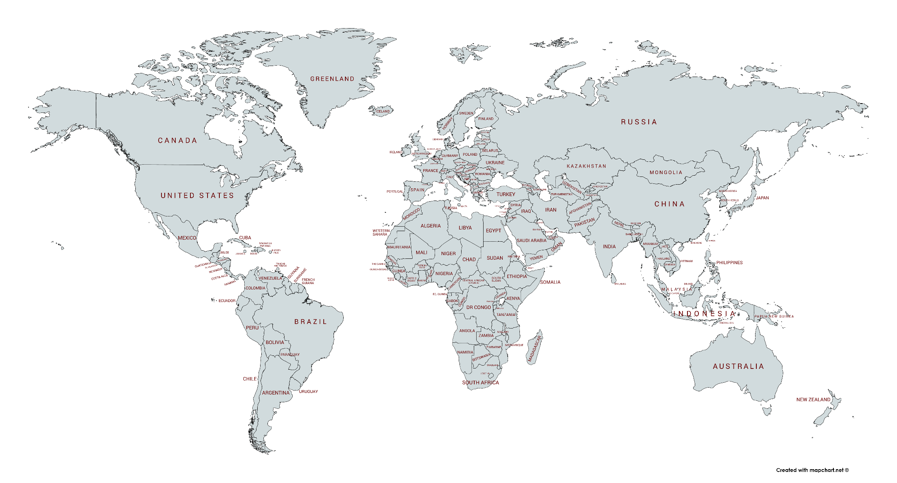
PARTICIPATORY BUDGETING WORLDWIDE, 2018
Europe
3452 - 3601
45 - 65
60 - 70
1601 - 1651
60 - 80
1100 - 1150
65 - 75
280 - 300
241 - 243
North America
75- 80
13 - 17
Asia
734 - 875
158
40 - 50
400 - 500
2000 - 2100
150 - 200
Africa
350 - 400
Oceania
10 - 15
40 - 50
Latin America and Caribe
2438 - 2700
50 - 60
PB in the World
7059 - 7671
Nelson Dias and Simone Júlio | Hope for Democracy – 30 Years of Participatory Budgeting Worldwide

Slide 3
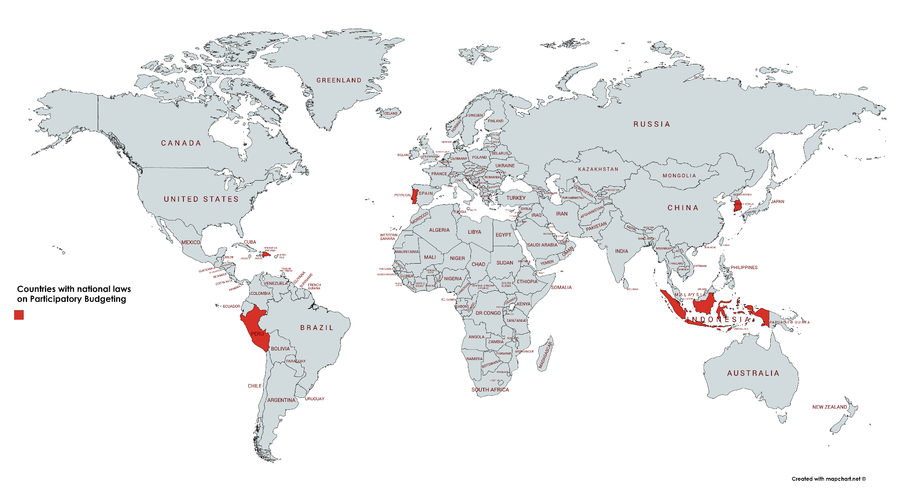
COUNTRIES WITH NATIONAL LAWS ON PARTICIPATORY BUDGETING
1100 - 1150
1100 - 1150
158
1100 - 1150
2000 - 2100
1989
2000
2004
2007
2010
2014
2017
2018
Peru
Dominican Republic
S. Korea
Portugal
Indonesia

