Slide 1
Transparency and public disclosure in the WBG’s work on tax
GIFT Steward’s meeting
October 10-11
Jim Brumby
Director
Governance Global Practice

Slide 2
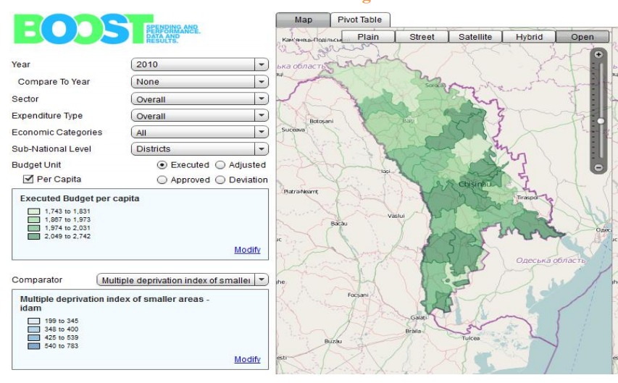
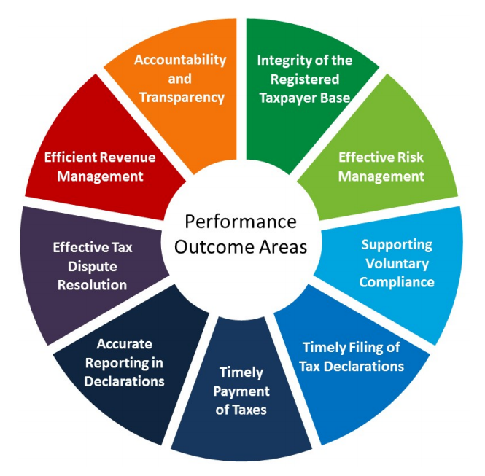
WBG is directly involved in several initiatives promoting public disclosure around revenue and tax
The BOOST initiative, produces accessible, detailed data on expenditures (40 countries) and revenues (12) taken from treasury data
User-friendly platforms that ordinary citizens and CSOs can use to examine revenue collection across a range of sectors/classifications
The Extractive Industries Transparency Agreement (EITI) - publicly disclosed information on contracts, payments and production
Tax Administration Diagnostic Assessment Tools (TADATs) reports (sometimes public) cover efficacy and performance of tax administration
GIFT; founding lead steward, encouraging move into tax and revenue
Notes:
First I want to highlight some of the direct ways we are supporting public disclosure around revenue and tax policy as well as how tax administrations operate.
Similar to the work that GIFT has been doing in Uruguay, as part of the Open Budgets Portal, we have a Bank-wide initiative called BOOST to work with our client governments to standardize and release detailed budget data. These data are then made available on online, user-friendly format. This is currently being expanded to cover revenues in twelve countries, which we collect from national treasuries and our hope is that the data can be used to increase accountability in this area. Through Bank projects directly we also actively work with tax administrations to get them to disclose more data on revenues, which can useful for both civil society as well as researchers looking to evaluate government policy.
The WBG also supports the Extractive Industries Transparency Initiative (EITI), where CSOs, extractive firms and country governments have partnered to publicly-disclose reconciled information on payments to government, production and related data. At this point, some of our key challenges are making the information useful and accessible to the public, so they can best hold governments to account, as well as reducing discrepancies with national budget data, which reduces the impact of EITI data on country policies.
The Bank is also one of several supporters of the Tax Administration Diagnostic Assessment Tool (TADAT). Completed in over 30 countries, TADATS aim to provide an assessment of strengths and weaknesses in a country’s tax administration, ranging from dispute resolution to knowledge of the potential taxpayer base. While these assessments are not always made available to the public, they can be useful tools for driving change in improving tax administrations, whether that drive comes from civil society, other international organizations, or the government itself.

Slide 3
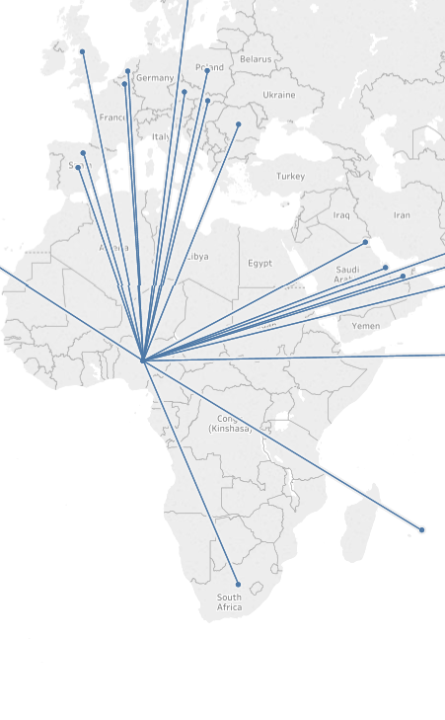
Transparency is the basis for most of our international tax work
Global Forum for Exchange of Information for Tax Purposes, helping countries exchange taxpayer information through:
Requests for exchange of information (EOIR)
Automatic exchange (AEOI) of bulk taxpayer data
Also includes the collection of beneficial owner information (not shared with the public!)
With WBG lending and TA support, developing countries are joining the Inclusive Framework on Base Erosion and Profit Shifting
Country-by-Country reporting, large multi-nationals are required to file detailed information on profits, taxes and operations across all subsidiaries
Information is then shared by competent authority in HQ country with others
However, CBC taxpayer information is not shared with the public due to confidentiality concerns
Notes:
Transparency is the basis for much of our international tax work:
One strand of this work is under the Global Forum for Exchange of Information for Tax Purposes (Global Forum) which has established a standard to ensure countries are in a positon to exchange relevant information. Such information exchange can be on request (which covers all taxpayer information, including on beneficial ownership, where the requesting country can demonstrate that it is needed for a specific tax investigation), or through automatic exchange of information (AEOI covers the automated exchange of standardized financial information from the banking system).
Exchange of information on request is in the implementation stage. AEOI is in the pilot stage, with gradual implementation starting in 2018.
A second strand is Country-by-Country reporting (CBCR) by MNEs on their activities, which is part of the OECD/G20 Base Erosion and Profit Shifting (BEPS) project. It is a minimum standard that countries who have joined the Inclusive Framework for BEPS implementation have committed to comply with.
Under CBCR, countries require of very large multinational companies headquartered in that country to file a country-by-country report and subsequently provide the confidential (non-public) report to countries with which a legal basis for exchange of information exists. The exchange happens between Ministries of Finance/tax administrations (the “competent authority”) and use of the information is restricted to risk assessment.
Most of these initiatives involve greater transparency and disclosure between competent authorities, but not to the public, as country-by-country reports and taxpayer information is considered confidential.

Slide 4
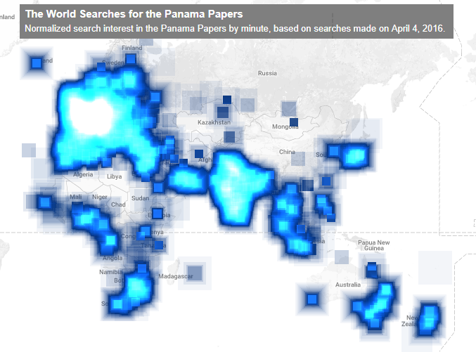
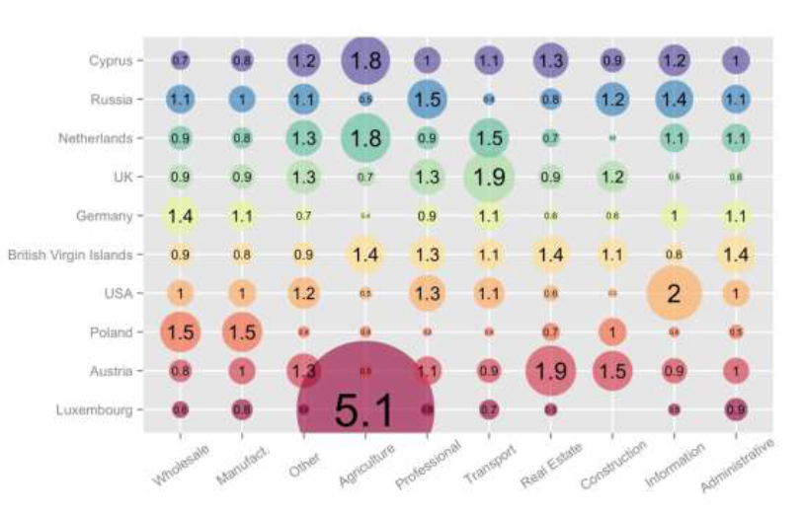
Greater disclosure and transparency can improve our own work helping countries raise revenues
Impetus for change:
Mossack Fonseca leak led to calls for reform in many countries, not only OECD
Development Policy Loan to Panama included requirements that the sign up for Global Forum standards, only possible due to new pressure
Realization that countries giving away tax bases through harmful competition
Opens up analytical work:
Better access to government data allows us to build the evidence base for Bank tax operations
Publicly available financial records can help us pinpoint areas where harmful policies are leading to revenues losses.
Example: Ukraine analysis of tax treaties
Notes:
But in general, greater levels of disclosure can make our work more effective. I’ll give two examples:
The first is that greater information about the actions of individuals or corporations overseas can create a remarkable impetus for change. The Mossack Fonseca leaks led to an outcry in many countries, not just in the OECD, and that sentiment can create the right conditions for improving international tax policy. We recently signed a Development Policy Loan with Panama, which included requirements that they sign up for the information exchange standards of the Global Forum, something that would only be possible in a post-leaks world.
Greater disclosure by governments of both tax data and financial information enables us to do more and better analytical work in this space, which in turn can improve our work with client countries and help build a consensus around certain tax policies. For example, a recent WB research used financial records made available to the public in Ukraine to quantify the revenue losses from unfavorable tax treaties. This kind of work helps us work with client countries to renegotiate treaties and redesign their audit processes to bring in more revenue.
This is another are where assistance from GIFT might be helpful. Developing countries lag significantly behind in data disclosure, which runs the risk that analysis of the above kind only reflect the tax problems that richer countries face.

Slide 5
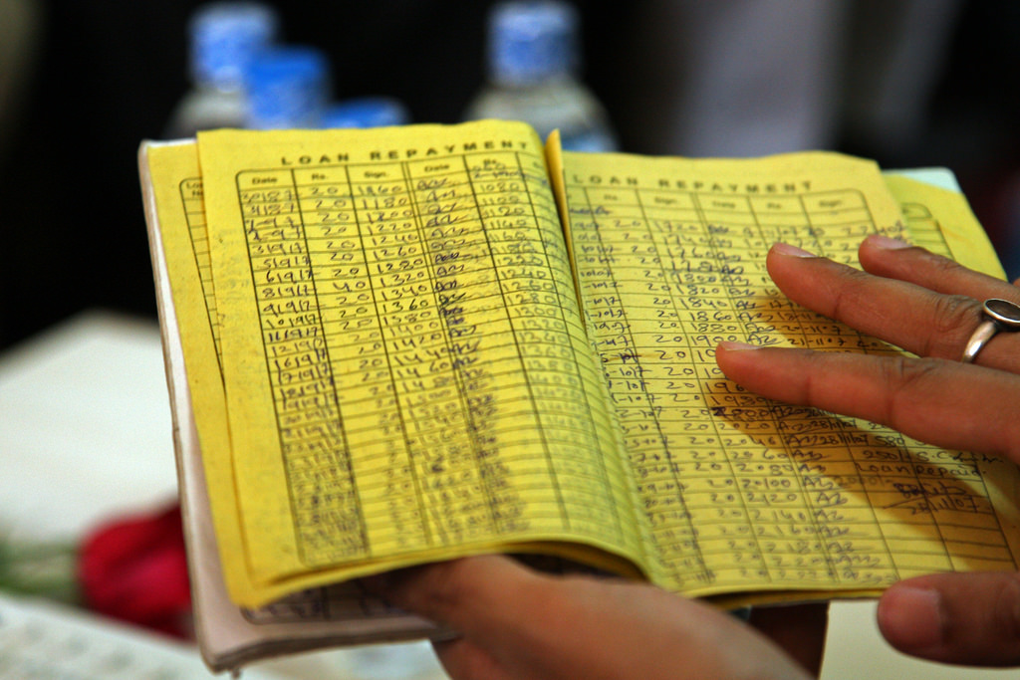
There can be tensions – data quality and open decision making
Civil society is pushing for even greater levels of disclosure around beneficial ownership and making country-by-country reports public
Quality of data is a concern, even in advanced economies; the strong need to make sure that data is up-to-date and in agreed format before being disclosed, to prevent misleading information leading to the wrong conclusions
Notes:
Understandably, CSOs and the public have been pushing for much greater transparency and disclosure in international tax matters. This includes making country-by-country reports public and for governments to collect beneficial ownership information and publish it on an open registry. Their worry is that it will take time for developing countries to adopt the standards necessary for information exchange and so will be bereft of the information they need for their risk analyses.
Beyond that, there is a general feeling from the CSO community that more eyes on the problem is better, and that when data is public, people will spot problems that tax administrations don’t catch and put more pressure on them.
But one major concern about full disclosure is around the quality of the data. Public registries may not always be up to date, even in advanced economies, and the complexities of country-by-country reports can lead to misinterpretations. Validation processes need to be in place to prevent disclosure of misleading information.
As Nobel prize winner, Herbert Simon, said: ‘a wealth of information creates a poverty of attention’.

Slide 6
From Transparency to Results on the Ground
Lack of deliberative transparency is an obstacle to reform
Discriminatory tax incentives and exemptions arise when countries engage in tax competition in the hope of attracting investment away from other countries—but additional job creation only happens in 4 out of 11 countries and the price per additional job is high
Negative investment lists are when foreign interests are kept out of certain industries, chosen by governments, to protect domestic interests but rarely consumers
Adoption of export bans: using high export taxes to distort behavior
Where transparency includes deliberations, results follow
Research in Brazil shows that treater numbers of voluntarily-adopted participatory institutions are associated with higher levels of local tax collection
Notes:
Against that, I personally advocate for ‘deliberative transparency’ to remove the cloak of information protection from the deliberation process; this is not about passive transparency of data; this is about active transparency of decision making processes.
Tax incentives: investors by playing countries against each other to secure lower taxes, they may benefit at the expense of countries’ finances. In some countries, these incentives are estimated to cost more than five percent of GDP. Lack transparency. On tax incentives benefits vs costs, based on research by Sebastian James. 11 countries studied were: Burundi, Guinea*, Jordan, Kenya* Mozambique, Rwanda, Serbia*, Tanzania*, Thailand, Tunisia, Uganda. For these countries, it was assessed whether investors attracted by tax incentives created more jobs than ‘regular’ investors (ie, not influenced by incentives). In only for countries (Guinea, Kenya, Serbia and Tanzania), investors swayed by incentives (marginal investors) created more jobs. And this does not take account of the cost of the additional jobs. And this cost is often excessive. For example, the tax given up per job created is $2.084 in El Salvador, $18,487 in Tunisia, and $5.819 in Yemen.
Negative investment lists: capture masquerading in the national interest.
Adoption of export bans on certain minerals or discriminatory high export taxes–under the guise of developing value-added downstream industrialization—tend to create massive winners and losers overnight. The economics behind such decisions is wobbly, at best.
Deliberative transparency works! In only one example of a growing literature, Michael Touchton (University of Miami), Brian Wampler (Boise State University) and Tiago Peixoto (World Bank). They looked at tax outcomes across all 5,570 municipalities going back to 2000. Voluntarily-adopted participatory institutions include municipal level inclusive policy councils and participatory budgeting (PB):
On average, municipalities with greater than mean-levels of policy councils have tax outcomes that are 27% greater than those without the councils (after matching on other important dimensions, such as local GDP and administrative capacity). This translates to approximately 2.5% of mean municipal budgets
On average, municipalities with PB have tax outcomes that are 34% greater than those without PB. This translates to approximately 3% of mean municipal budgets.
Research confirms that the causality runs from deliberative transparency and accountability to tax compliance, not the other way around. Participation in and oversight over local government increases trust, perceived legitimacy, and tax revenue. Promoting participatory institutions along with administrative capacity and economic growth is justified to generate revenue and promote development

Slide 7
What’s at stake and what are the next steps?
Revenue is a necessary condition for growth, state function and development
But between 30-40% of developing countries still have tax-to-GDP levels < 15%
Increasing tax capacity requires more collaboration and trust between governments and the public and CSO sector; not only opening tax records but also processes by which tax base is ‘given away’
Perceptions that international firms and the rich are not paying their fare share is negatively impacts on tax morale
Can GIFT play a role in this?
More work to highlight international tax work and create a dialogue between governments, international organizations, the public and CSO could increase overall support and trust in the system
Countries will soon be developing and adopting Medium Term Revenue Strategies, creating a space for the involvement of the public/CSOs
Deliberative transparency – reduce capture
Notes:
The stakes are always high with domestic revenue mobilization. Developing countries need tax revenue to fund public goods, health and education programs, and finance the SDGs.
But many countries are still lagging behind, by our estimates between 30 and 50% of countries receiving IDA funds have tax-to-GDP levels which are too low.
Increasing the ability of governments to collect tax revenue will require more transparency and collaboration between governments but also with the public and the CSO sector.
But the international tax space is both highly complex and equally poorly-understood. And evidence suggests that the sometimes legitimate perceptions by ordinary taxpayers that large multinationals and high-net worth individuals aren’t paying their fair share of tax can have a depressive effect on people’s tax morale and lead them to disengage.
One way in which GIFT could play a role is to facilitate more dialogue between these governments, international organizations that work on tax, and civil society, specifically around issues of international tax policy and revenue transparency and disclosure.
Currently, as part of an initiative with the IMF, the OECD, and the UN, known as the Platform for the Collaboration on Tax, we are helping a number of countries develop Medium Term Revenue Strategies (MTRS). These are meant to be comprehensive, committed efforts to raise revenues. The development of these strategies might offer an excellent opportunity for GIFT to bring together multiple stakeholders to discuss issues around transparency and disclosure.

