Slide 1
2023 Workplan
as of January 2023

Slide 2
2023 IMPACT WORKSTREAMS
Capacity building for more effective and inclusive use of public resources
Advancing transparency and public participation in fiscal policies
Consolidating GIFT as a cohesive action network

Slide 3
Advancing transparency and public participation in fiscal policies
Global norms harmonization
Dialogue on how IFIs can further promote fiscal openness during emergencies
Dissemination of Transparency Principles for Tax Policy and Administration
Dialogue on principles within network
State-of-the-evidence review on tax and revenue transparency for OGP’s Skeptic’s Guide to Open Government
Meeting on methods and techniques for SDG and cross-cutting priority budget tagging

Slide 4
Advancing transparency and public participation in fiscal policies
B. Public participation mechanisms
Proposal to expand GIFT/IBP Fiscal Openness Accelerator (FOA) project. New countries: Cameroon, Chad, Côte d’Ivoire, Madagascar and Zambia
Technical assistance to:
Lesotho (with UNICEF)
Guatemala (with DAI-USAID)
Côte d’Ivoire (with WB)

Slide 5
Advancing transparency and public participation in fiscal policies
C. Fiscal transparency innovative approaches for inclusive budgets and development
Contribution to UN World Public Sector Report 2023
Partnership with UNICEF Egypt on fiscal transparency and public participation (focus on children & youth)
Partnership with UNICEF Lesotho to develop training materials on PBB, SDG budgeting, etc.

Slide 6
Advancing transparency and public participation in fiscal policies
D. Budget authority/CSO partnership events
Continuation of #DataRallies for public infrastructure monitoring & #BetterBudget Dataquests for sustainable development led by GIFT stewards
Hosting of Annual Global Winners’ Showcase event

Slide 7
Capacity building for more effective and inclusive use of public resources (increasing and improving knowledge exchange)
A. Peer-collaboration and technical assistance for stewards
Technical meetings and workshops to support GIFT stewards (with focus on local govts)
Support to Europe Foundation in conducting online and in-person training on public participation
Technical support on fiscal transparency and public participation to El Salvador (in partnership with EU and GIZ)
Technical assistance to Guatemala (with DAI-USAID)

Slide 8
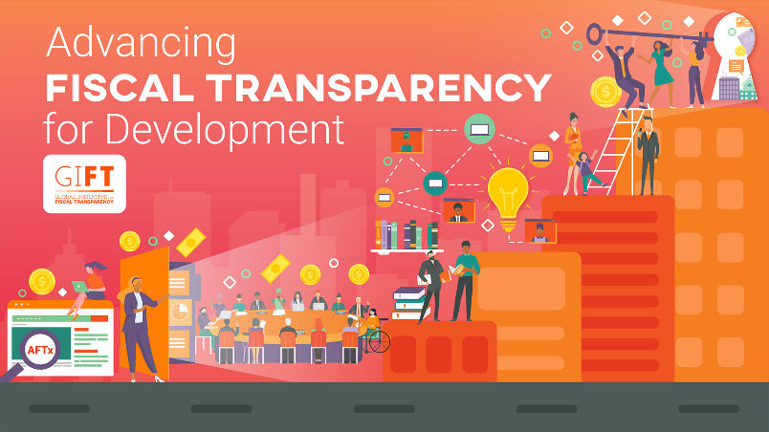
Capacity building for more effective and inclusive use of public resources (increasing and improving knowledge exchange)
B. Fiscal transparency online course
Proposal to:
Produce Advancing Fiscal Transparency for Development course in Spanish & Arabic to broaden its potential reach
Actively disseminate course in 4 languages to increase enrolment
Implement strategies to increase course completion rate

Slide 9
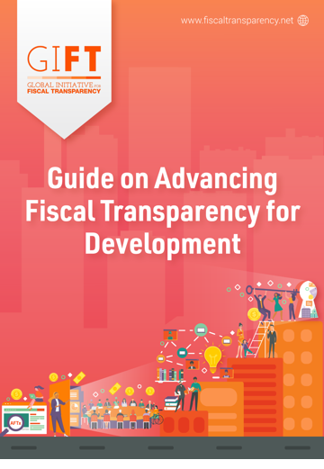
Capacity building for more effective and inclusive use of public resources (increasing and improving knowledge exchange)
B. NEW fiscal transparency guide
Contents based on online course
Comprehensive, up-to-date compilation of tools, practices, methods, tips, and resources on fiscal transparency
Lead stewards invited to launch event on 22/23 February
Lead stewards invited to actively share Guide as a new resource in the field

Slide 10
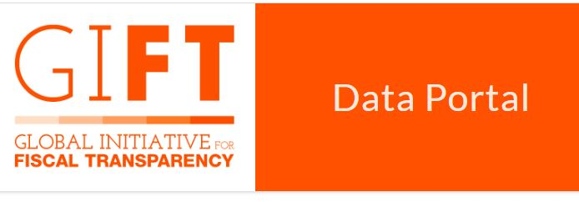
Capacity building for more effective and inclusive use of public resources (increasing and improving knowledge exchange)
C. Digital tools for
user-centered fiscal transparency
Assistance in disclosing budget information in open formats (including NEW OFDP)
Dissemination and use of the Public Finance module of the Global Data Barometer (GDB)
GIFT Step-by-step Guide
Complementarity with OBI

Slide 11
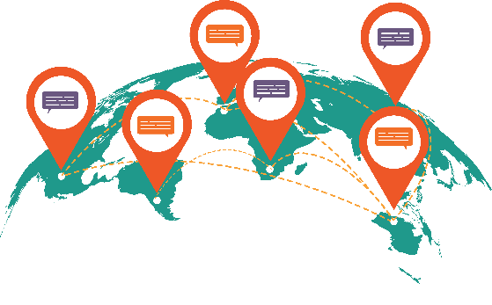
Consolidating GIFT as a cohesive action network
Greater integration, collaboration & peer learning
Consideration of potential applications for membership (e.g. Senegal and Cote d’Ivoire)
GIFT SGM 2023 in virtual format
Increased collaboration with UNICEF, EU, GIZ, and USDOS

